Slide 1
Dynamics of the Benefits of Dual-Class Voting by Kim and Michaeli
Discussion by Kate Litvak

Slide 2
Research Question
Impact of Dual-Class Shares of Firm Valuation, Performance, etc.
Theory Reasons to Think: Older Firms Different
Tests Whether Older Dual-Class Firms Different
From younger dual-class firms
From older non-dual-class firms

Slide 3
This Paper
Lots of Data Collection Work
Including by hand
Lots and Lots of Tests
Feels too much
Almost hard to tell which are the core results
I understand the problem: there is a competing concurrent paper, must do something to differentiate
If not for that, I would have recommended splitting the paper into two

Slide 4
Voting Premium and Firm Maturity (I)

Slide 5
Voting Premium and Firm Maturity (II): Issues and Concerns
Sample – only dual-class firms with tradable superior class
And prob that’s only a minority of superior class
Because controller does not trade
But real problem with dual-class shares
in firms with non-tradable superior class
Or for controller in tradable class who does not trade
(at least it’s so for takeovers, the channel of the effect that authors propose):
Problem: No market value for non-traded blocks
→ so, cannot test that
So, this is as best we can do
But patterns prob are not the same as for tradable superior class
Esp if the main concern is hostile takeovers

Slide 6
Voting Premium and Firm Maturity (III): Issues and Concerns
Panel Data, but Does Not Use Panel Techniques
No firm fixed effects
No industry fixed effects
No year fixed effects
None in main results column
Yes year FE in second column, but result barely there
Clustering standard errors on firm does not remove bias generated by not using fixed effects
Where We See Main Result on Maturity
When we treat each year in firm’s life as independent event
And compare them to each other as one giant cross-section
Ignoring year, industry, most other firm characteristic except couple of controls
Cannot Call that an “Effect” – No Identification

Slide 7
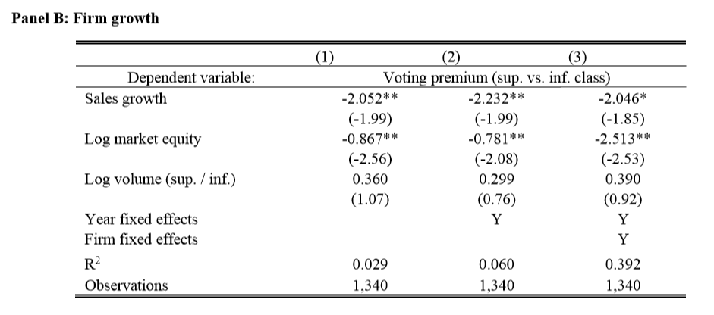
Voting Premium and Firm Maturity (IV): Issues and Concerns

Slide 8
Voting Premium and Firm Maturity (V): Issues and Concerns
Ask re Theory for Using Sales Growth as Proxy for Maturity
At least for this research question
Which has to do with behavior of founders, dependence on their unique skills, etc.
Notice: Uses Firm FE
And Panel A did not
Need to explain
Result with Very Weak for Firm FE
And for year FE or no FE – also week
Is this barely-there result – fruit of large sample, few controls?
Need more robustness checks to show it’s not so

Slide 9
Specification I Prefer Here: Diffs-in-Diffs
Treated shares – superior class
Control shares – inferior class
Event for before-and-after:
Firm switching from “not mature” to “mature”
Add panel techniques
Firm FE
Year FE
Firm clusters for standard errors
Controls for time-variant characteristics
More flexible measures of “firm maturity”
Not just above-below sample median
Still no identification!
Because no exogenous shock to treated
Firms become “mature” for same reasons that also affect their outcome variables
Esp if “mature” is defined not as years, but as sales growth and such
But at least something

Slide 10
Voting Premium and Firm Maturity (VI): Smaller Issues and Concerns
Maturity is measured very crudely
Yes-no; above sample median age (12 years) or not
But need to see more detailed breakdown
Where is most of the effect?
In the very tails?
In the middle?
More granular measures of maturity
Age in years
Quartile regressions
Very tails separately (top-bottom 10%)
Other age-based divisions of sample

Slide 11
Better Specification: Diffs-in-Diffs with Stronger Shock than “Maturity”
Treated firms – dual-class
Control firms – non-dual-class
Event for before-and-after:
Firm switching from dual-class to single-class or in reverse
And add the following panel techniques
Firm FE
Year FE
Firm clusters for standard errors
Controls for time-variant characteristics
Still not great identification!
Because firms choose to change class structure
In response to outcome variables, like share prices
Or in response to world conditions that affect share prices directly, like macro variables
Or can make existing dual class shares publicly tradable or not
Which adds or removes them from sample
But at least something

Slide 12
Results for Dual-Class Recaps and Unifications
What’s Good About These Tests
Identification is cleaner
Treated firms
Did recap or unification
Control firms
The rest of the market, via the event-study methodology
Shock
The event of recap or unification
So, we measure treated and controls before and after the shock
Shock is short → reduces worries re intervening variables
What else happened on exactly those days?
Weakness: Shock is not exogenous
But ok

Slide 13
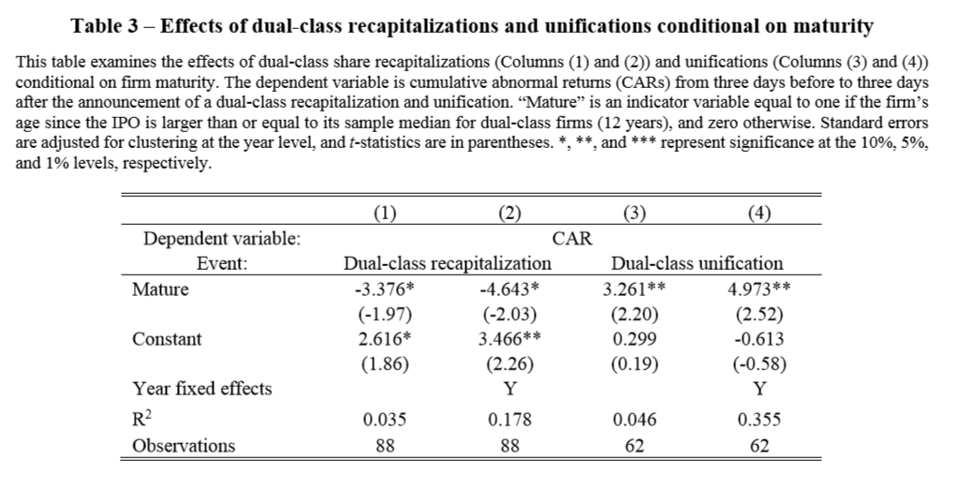
Results for Dual-Class Recaps and Unifications

Slide 14
Results for Dual-Class Recaps and Unifications
One Event Per Firm (I hope)
So, not firm-level panel, like prior table
Don’t need Firm FE
Still need Year FE and clusters
Good if can control for industry, at least roughly
Another possible test – flip the question:
Which pre-event firm characteristics predict which firm would do dual-class recap?
Or unification
Better firms?
More traded firms?
Firms in declining industries? Etc.
And ask whether that pattern differs for mature and not mature firms

Slide 15
Table 4 – Effects on Firm Value (Tobin’s Q)
My preferred question
Standard spec:
Firm FE
Year FE
Firm Clusters
Various standard controls
Matched sample, so treated and control firms are similar
So, you don’t estimate on strange small areas of common support
Table 4 does not have a single column like that
No columns with Firm FE and Year FE
But that’s standard for panel regressions
In the one column with firm FE → almost no result on coeff of interest
Mature * Dual-Class

Slide 16
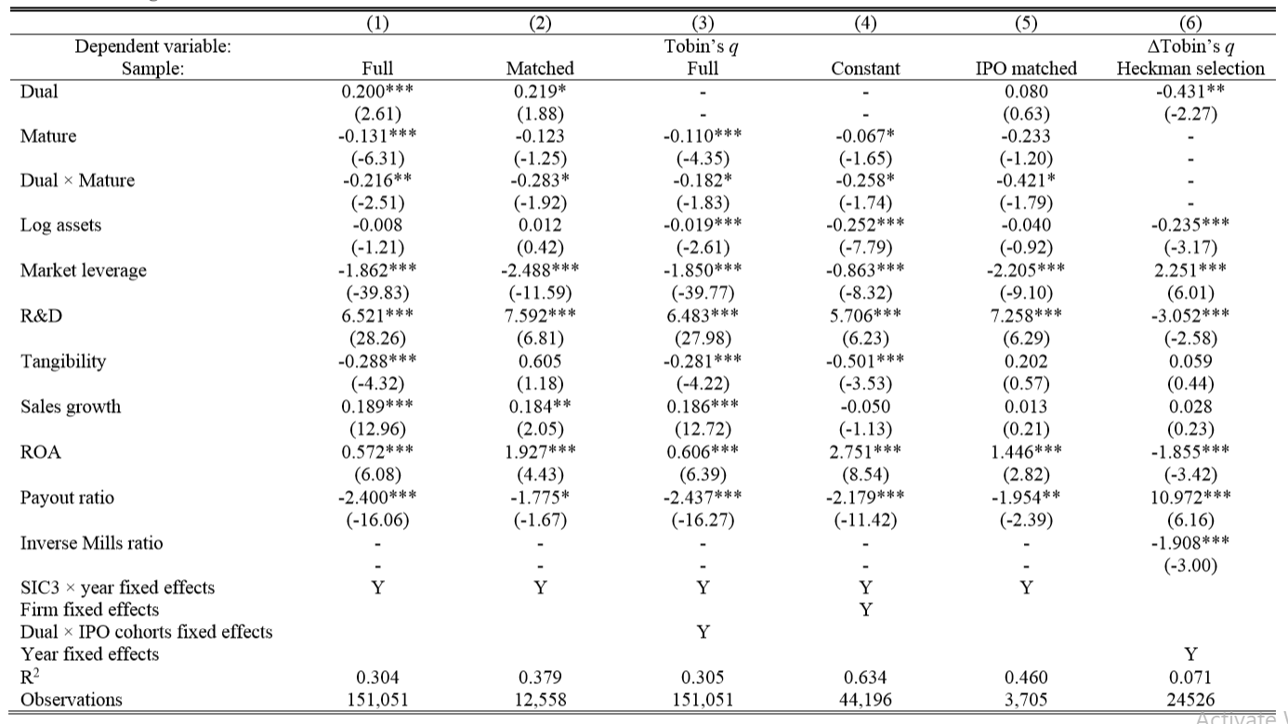

Slide 17
A Few Theoretical Issues
What Is Tobin’s Q for Firm where Controlling Class Not Publicly Traded?
Cannot measure b/c don’t know mkt value of non-traded shares
What if We Think of Q as Mostly Measure of Investment Opportunity?
High investment opportunity + low assets = high Q
Get older → can raise more capital and invest → increase assets + lower unexplored investment opportunity = lower Q
Suppose dual-class firms are better at raising capital and investing
Then, over time, their Q will go down more
But this has nothing to do with hostile takeovers
Alternative explanation for paper’s results that needs to be ruled out
Is Sales Growth in this Context Good Measure of Maturity
People usually run tests for Q and use sales grows as proxy for investment opportunity

Slide 18
Econometric Comment for All Subsequent Tables
I’d Do Firm FE and Year FE and Firm Clusters Everywhere
None of your panel regs have this spec
Not in operating performance table
Not in innovation table
Here, results especially weak, will likely disappear entirely with proper spec

Slide 19
Table 10 – Switches Due to Sunset
Very Nice Identification, Likely Best of All
For time-based sunsets
Exact Date of Sunset is Exogenous (Kind of)
Set up ahead
No good relationship to what’s going on much later
So, good sort-of exogenous shock for a Diffs-in-Diffs test
Possible problems:
Controllers might be able to control whether or when the unification actually happens by e.g., amending charter, buying shares, issuing new classes, etc.
Maybe sample is too small?
Paper says only 6.4% of dual-class firms have time-based sunset

Slide 20
Bottom Line
Very important research question
Great data collection work
Some interesting results
But I prefer different specifications and robustness checks

