Slide 1
Financial Markets and the Political Center of Gravity
Mark J. Roe and Travis Coan
Global Corporate Governance Institute
Inaugural conference---Stanford
June 5, 2015
Notes:
Travis: econometrics skills

Slide 2
Overview: I
In strongly pro-labor political environments, diffuse ownership works poorly for shareholders
Hence, in strong social democracies, with strong labor, one shouldn’t expect diffuse ownership, deep stock markets
Describes post-WWII decades in western Europe
However (say critics) major corp gov reforms for diffuse stockholders enacted by gov’ts led by Social Democrats in 1990s
Hence, counter-example falsifies political thesis
But polity of 1990s was not that of 1950s.
Entire polity became more pro-market (less anti-market)
Contrast Tony Blair’s Labour with James Callaghan’s Labour
Notes:
A few bullet points of what we’re trying to do in the paper.

Slide 3
Overview: II Literature background
Corporate governance is partly a function of politics
The post-WWII western European polities were not market-friendly.
One should not expect deep stock markets and boards loyal to distant shareholders to emerge in that environment.
Roe (2001); Perotti & von Thadden (2006); Rajan & Zingales (2003), Pagano & Volpin (2005).
Many pro-SH corporate governance reforms were made in the 1990s, when “Social Democratic” parties were in power
Schröder’s reforms. Anecdotal earlier. (Was it pro-shareholder?)
Now: Considerable political science literature on shifting party politics
Are the two points inconsistent?
Anti-market politics impedes the public firm
Social Democratic parties promote stock market reforms in 90s and 00s
Notes:
A few words on the literature background to the paper.

Slide 4
Mutual support system Labor rents (where they’re high) as one part of political environment
Labor rents,
peak-level bargains
Concentrated ownership of largest firms
Labor-management influence on competition policy
Low product competition; monopoly power
Political ideology is not pro-market
Notes:
Had Marco Pagano’s other paper been presented, we would have been primed for the second item
The sequence may begin at the lower right with the level of product market competitition in the economy and the polity.

Slide 5
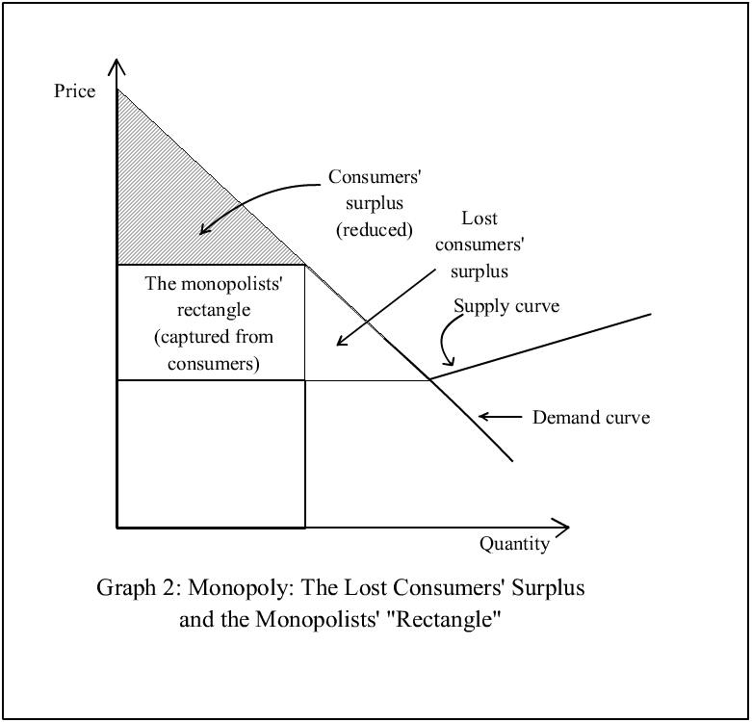
Monopoly rents
Notes:
Contest to grab the monopolist’s rectangle.
[Color the rectangle red.]

Slide 6
Comment on tone
Stripped down and raw
Some, especially social democrats, contest tone
Varieties of capitalism people (in political science academe) assert equal efficacy of viable alternate productions systems
Notes:
Ideas do have their own life, but they often arise from crude material relationships
Or value can be had by reducing situation to raw basic division of monopoly spoils
Even if some political beliefs, like some religious beliefs, helps people to better organize their lives

Slide 7
Implications
Helps to explain a package of institutions (of which corp gov and ownership structure are only a subset)
Labor power
Either via strong unions or gov’t supporting regulation (or both)
Weak financial markets
Because strong financial markets would erode some of labor benefits
Perotti & von Thadden (2006)
Concentrated ownership
To better assure that shareholders get a good percentage of the monopolist’s rectangle
To better deal with labor
Cancelled paper
Philippon, others
Managers with agency costs might not preserve that value as vigorously
In part because they do not face the discipline of competitive product markets
Polity and voters not market-friendly, because markets don’t do much for average voter.
Social democracy vs. Liberal democracy
Notes:
A system and an ideology
Anti-market
Or suspicious of fully corrosive, competitive markets, and especially their financial correlates
More fairness
[More]

Slide 8
Break-down
As one or another piece in the mutually supporting system break-down, tensions arise
Example: competitive product markets weaken the capacity to support labor benefits.
Weakens labor’s value in a cross-class coalition

Slide 9
Empirical support for the mutual supporting systems
No omnibus work links the systems empirically
But each node (except one) gets substantial support
Monopoly power of firm yields higher wages for labor
Karier (1985), Unions and Monopoly Profits; Freeman & Medoff (1984); Kwoka (1983). But see Weiss (1966)
Related: Higher free cash flow yields more firm pro-social behavior: Borghesi, Houston & Naranjo (2012)
Cf. Bertrand & Mullainathan (1999, 2000)
Exposure to int’l trade facilitates financial liberalization
Rajan & Zingales (2003)
Weakly competitive firms more likely to have concentrated ownership
Giroud & Mueller (2012); Roe (2002, 2003)
Strong labor power correlates with ownership concentration
Roe (2001, 2003).

Slide 10
BUT inconsistent with new comparative political economy scholarship
Social Democrats promote financial and corp gov reform in the 1990s and 2000s
One major node in this systemic view fails to get empirical support
Indeed, contradicts the big political picture
Financial market development and shareholder-oriented reforms occur while Social Democratic parties were in power
Hence the modern political economy of financial market development is a left-propelled development, say proponents
Cioffi & Hopner (2006), Culpepper (2011). Cf. Hall & Soskice (2001)
Social democrats (corporatists?) as financial market friendly
In the political scientists’ conceptualization this refutes political theories of corporate governance
Such as those in Roe (2001, 2003); Perotti & von Thadden (2006); Rajan & Zingales (2003); and Pagano & Volpin (2005)

Slide 11
And converse: the right promotes stakeholders
"[Political] theorists ... show in their work that, in places like Germany and Italy, the stakeholder society was also an initiative of … parties of the center-right. …“
Culpepper (2010: 15), summarizing; Cioffi (2010: 35): “Conservative parties in … Germany, Japan, France, and Italy fashioned … concentrated shareholding, … protections for employees, and relatively egalitarian distributions of income”
E.g., in France, significant job rigidity originated not during the Mitterand era but during the (conservative) Gaullist era
Roe (2003)

Slide 12
Does this trash the mutual dependency conceptualization of corporatism and related political explanations for corporate governance?
No.
The better way to see this phenomenon
Focus less on local left-right divide
The entire polity moved rightward
On a pro-market spectrum
From 1960s to 1990s
Becoming less corporatist, less social democratic
Ideologies and interests shifted over the decades.
Median voter theorem as easiest conceptualization

Slide 13
The Corporatist Polity in Comparative Political Economy Work
Social Democrats
[pro-financial market development]
Schröder
Christian Democrats
[pro-stakeholder]
De Gaulle
post-war era
Notes:
So they could find that deGaulle & Kohl have pro-labor policies, and therefore conclude that left-right makes a limited difference in predicing pro-labor policies.
But that’s because the whole spectrum is shifted left in those nations.
The concept that I’d recommend the authors use when they re-write is Downs, Economic Theory of Democracy. All parties tend toward the median voter.
The median voter differs in cont’l Europe and in the U.S. Local left and local right are second-order differences, but that seems to be their primary focus.

Slide 14
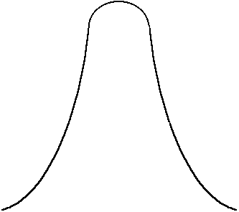
Corporatist polities move rightward, 1960-1990
Christian Democrats
[pro-stakeholder]
Social Democrats
[pro-financial market development]
1950s,
1960s,
1970s
1990s
2000s
Left
Right
1960s
Market ideology moves right
1990s

Slide 15
Corporatist polities move rightward, 1960-1990 Intuit: Labor in Britain, Tony Blair v. Callaghan
Christian Democrats
[pro-stakeholder]
Social Democrats
[pro-financial market development]
1950s,
1960s,
1970s
1990s
2000s
Left
Right
1960s
Market ideology moves right
1990s

Slide 16
Evidence
Principle is clear. Is there systematic evidence?
Party manifesto data
Extensive comparative politics scholarship uses and refines the party manifesto dataset
Measures ideology of political parties in democracies, via counts of mentions of key terms
What does it show us about the median voter’s economic views since the 1960s?

Slide 17
Western Europe (Population Weighted Average)

Slide 18
Sweden

Slide 19
Data results, verbally:
Median voter moved to be more pro-market
Move correlates with changes in financial markets, some corp reforms, and changes in policy
Yes, financial market changes occur while Social Democrats are in power in 1990s.
But the median voter (and the social democratic platform) had shifted rightward in Europe
Occurs as corporatism weakens

Slide 20
Economic orientation Outcome: Stock market capitalization/GDP
 | (1) | (2) | (3)
 | OLS | OLS | GLM
Left (higher value means left party in power) | 0.073* (0.030) | --- | ---
Economic Orientation (higher value means median voter more market-oriented) | --- | 0.001 (0.002) | 0.009* (0.004)
Log(GDP/capita) | 0.224 (0.291) | 0.089 (0.363) | 0.667 (0.596)
Log(Inflation) | 0.100* (0.046) | 0.091* (0.043) | 0.348* (0.175)
Capital Acc’t Openness | -0.003 (0.029) | 0.017 (0.022) | 0.200** (0.060)
GDP Growth | 0.018* (0.008) | 0.019* (0.008) | 0.041* (0.017)
Constant | -2.235 (2.744) | -1.096 (3.383) | -8.024 (6.265)
Country Fixed Effects | Yes | Yes | Yes
Year Fixed Effects | Yes | Yes | Yes
Observations | 590 | 626 | 538
R² | 0.438 | 0.383 | ---
* p < .05
Current political science thinking in column (1). E.g., Pinto et al. (2011). But measuring political center of gravity via median voter changes results.
Significance of “left-in-power” lost in OLS, and then displaced in GLM.

Slide 21
Economic Median Voter

Slide 22
Economic orientation
 | (1) | (2) | (3) | (4) | (5)
 | OLS | OLS | OLS | GLM | GLM
Left | 0.065* (0.026) | 0.073* (0.030) | --- | 0.000 (0.058) | ---
Economic Orientation | --- | --- | 0.001 (0.002) | --- | 0.009* (0.004)
Log(GDP/capita) | 0.100 (0.120) | 0.224 (0.291) | 0.089 (0.363) | 1.408 (0.977) | 0.667 (0.596)
Log(Inflation) | 0.045** (0.015) | 0.100* (0.046) | 0.091* (0.043) | -0.023 (0.314) | 0.348* (0.175)
Capital Acct. Openness | 0.016 (0.014) | -0.003 (0.029) | 0.017 (0.022) | 0.217** (0.074) | 0.200** (0.060)
GDP Growth | 0.011** (0.002) | 0.018* (0.008) | 0.019* (0.008) | 0.049* (0.021) | 0.041* (0.017)
Constant | -1.024 (0.975) | -2.235 (2.744) | -1.096 (3.383) | -14.875 (10.113) | -8.024 (6.265)
Country Fixed Effects | Yes | Yes | Yes | Yes | Yes
Year Fixed Effects | Yes | Yes | Yes | Yes | Yes
Observations | 1287 | 590 | 626 | 590 | 538
R² | 0.251 | 0.438 | 0.383 | --- | ---

Slide 23
Better data, robustness
Two data criticisms, not small
One: the CMP shows positions of the parties, not voters
But voting data unavailable over time and space needed for test
But we can test whether the movements in CMP correlate with variation in what voting or public opinion data there is
Partly done and consistent. Adams et al (2004, 2014); Ezrow (2007)
“strong evidence that shifts in parties’ policy positions … mirror shifts in the … median voter position”
But we’d like to do more extensively, for characteristics most relevant.
Two: CMP is only data-set over time and space
It has been criticized for validity
Koenig
There are fixes and we will re-run with the fixed up CMP versions
(Three: It’d be good to have an intermediate dependent variable
Done for labor mkt rigidity, but not for corporate law or corporate governance outcomes, e.g., securities regulator funding)

Slide 24
Speculation on why the rightward shift
Persuasion, opinions change
Cf. Hansmann & Kraakman, End of History
Fall of the Berlin Wall
Change in underlying production technologies
Less blue-collar intensive heavy industry
More knowledge industry
Greater product market competition
European integration, globalization
Cf. Rajan & Zingales (2003)
Demonstration effects
Intensified competition produces results
Benefits of European Union---first for political reasons, then market-based benefits
Notes:
Henry Hansmann & Reinier Kraakman wrote that corporate governance history was over. People read it and agreed.

Slide 25
Conclusion
Conceptualize postwar European corporate governance as hacking up the monopolist’s rectangle, during an era of slack competition and lack of confidence in financial markets
Social democracy, Varieties of capitalism, Corporatism
Social democracy vs. liberal democracy
Which yielded an interconnected system of institutions and ideas
Low product market competition
Weak market ideology/policy
Concentrated corporate ownership
Breaking down in recent decades
Because of increasing global competition?
Because of changing ideology? (Berlin Wall, we’re all capitalists now)
Comparative political economy literature and data are contra
But reformulate to median voter and their results reverse often, disappear regularly
Entire polity has shifted “rightward” to become less anti-market
Initial data consistent with this shift in opinion/interests.
Shift in politics correlates with shifts in financial markets

Slide 27
Clinton, Obama
Merkel, Kohl
Chirac, Sarkozy
Blair
Brandt, Schröder, Schmidt
Reagan
Mitterand, Jospin
Thatcher

Slide 28
Local vs. Absolute
France, Germany
U.S., U.K.
Brandt, Jospin, Schröder
de Gaulle, Kohl, Merkel,
Sarkozy
Clinton, Blair,
Obama
Reagan, Bush, Thatcher
Median French &
German voter
Median US,
modern UK voter
Left-right on economic issues
Notes:
So they could find that deGaulle & Kohl have pro-labor policies, and therefore conclude that left-right makes a limited difference in predicing pro-labor policies.
But that’s because the whole spectrum is shifted left in those nations.
The concept that I’d recommend the authors use when they re-write is Downs, Economic Theory of Democracy. All parties tend toward the median voter.
The median voter differs in cont’l Europe and in the U.S. Local left and local right are second-order differences, but that seems to be their primary focus.

Slide 29
Germany

Slide 30
France

Slide 31
Conceptualizations of corporatism
Corporatism as peak-level bargaining
Labor institutions cut deal with owner institutions, mediated by government
Maintains social peace, reduces labor unrest
Social democracy
Favoring employees with jobs over invested capital
Varieties of capitalism
Enables investment in employee skills
Different production forms than liberal market economies

Slide 32
Abstraction
Corporatism/social-democracy/varieties-of-capitalism is stable when major firms have market power
Unstable when embedded in competitive markets
Local monopoly
Weak int’l competition
Due to trade costs or tariff/quota barriers
When competition is more severe, the internal bargains within the firm become harder to sustain

Slide 33
Splitting the monopolist’s rectangle
Labor and management split the monopolists’ rectangles
The political science literature extolling cross-class coalitions (cf. Gourevitch & Shinn, 2005) can be subsumed
And reinterpreted as a coalition to grab, or keep, or fairly split the monopolist’s rectangle

Slide 34
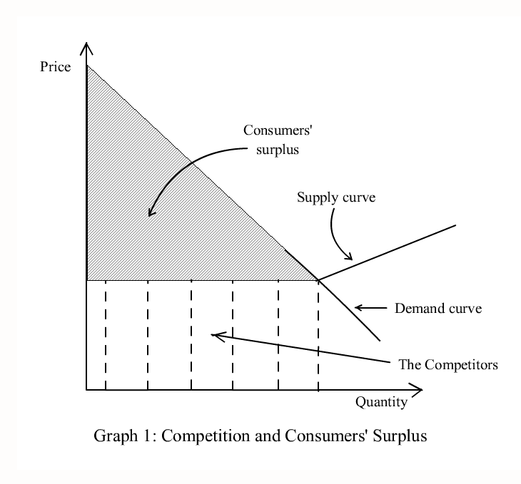
Competitive markets
Notes:
Economics 101

Slide 35
And converse
"[Political] theorists ... show in their work that, in places like Germany and Italy, the stakeholder society was also an initiative of … parties of the center-right. …“
Culpepper (2010: 15), summarizing the comparative political economy literature
This data is inconsistent with the inter-connected corporatist framework we’ve put forward here.
But re-running such findings using the median voter’s position as the independent variable yields different results

