Slide 1

The Wolf at the Door: The Impact of Hedge Fund Activism on Corporate Governance
Professor John C. Coffee, Jr.
Adolf A. Berle Professor of Law at Columbia University Law School and Director of its Center on Corporate Governance
&
Professor Darius Palia
Thomas A. Renyi Chair in Banking at Rutgers Business School and Senior Fellow, Center for Contract and Economic Organization at Columbia Law School

Slide 2
The Rising Pace of Hedge Fund Activism
The phenomena of “activist” hedge funds buying stock in targets specifically to propose changes in business policies appears to date from around 2005 (Briggs 2007).
Over a 20 month period from 2005-2006, the first study counted 52 such campaigns (Briggs)
The period from 2010 to early 2014 witnessed 1,115 “activist” campaigns.
2014 saw a record 347 “activist” campaigns (FactSet Shark Watch)—up from 209 in 2009.
At this rate, the majority of exchange-listed corporations could experience an activist campaign within another three to five years.

Slide 3
What Explains the Rise of Hedge Fund Activism?
Costs are down (deregulation)
Structural changes have also helped (decline of staggered boards, increased influence of proxy advisors, proxy access, etc.)
Profits are up (“activist” hedge funds are averaging a 13% return over the last ten years—more than double the 5.8% return for all hedge funds).
Correspondingly, the assets managed by “activist” funds have soared, growing from $23 billion in 2002 to $166 billion in $2014. The top ten “activist” funds alone attracted $30 billion in 2013.
Best yet, a short-term gain on the filing of the Schedule 13D is relatively certain, with the abnormal gain averaging 6 to 7% across all studies (and more if a “wolf pack” is involved).
Bottom line: Costs Down, Profit Up, Gain is Relatively Riskless—But a Bubble could be developing as more and more activists chase fewer and fewer obvious targets.

Slide 4
How Successful is Proxy Activism?
Several recent studies place the “success” rate in proxy fights for activists at just over 75%
The actual number of proxy contests has declined—as managements have learned that it is better to settle than to fight (as even Martin Lipton concedes).
Revealingly, at those companies where activists win even one seat on the board, the CEO leaves within 18 months in 44% of the cases (for example, Sothebys).

Slide 5
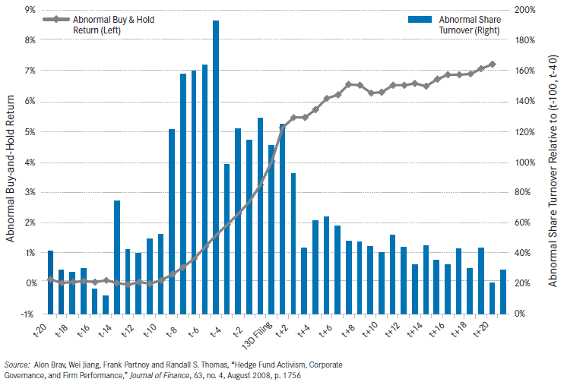
One New Tactic Probably Best Explains Activists’ Success in Proxy Contest—The Wolf Pack
The “Wolf Pack” is a loose association of hedge funds (and some other institutions) that carefully avoid forming a “group” for purposes of §13(d)(3) of the Williams Act, but share a common goal and often have advance knowledge of the impending filing of a Schedule 13D by the wolf pack’s leader.
Those forming the “wolf pack” can tip prospective allies of their plans because no fiduciary breach is involved (rather, their own institution’s interests are furthered); thus, this use of material, non-public information does not amount to insider trading. Norms of reciprocity may develop: “You tip me, and I will tip you.”
The following diagram illustrates the characteristic pattern and shows the amount of abnormal trading during the ten day window preceding the Schedule 13D filing:

Slide 6
1. The Wolf Pack Has Altered Prior Practice, and the Resulting Balance of Advantage in the Following Respects:
The Wolf Pack Acquires a Larger Stake: 13.4% as compared to 8.3% by other activists (See Becht, Franks, Grant and Wagner). And This May Understate, Because Silent Allies Need Not Disclose
The announcements of a “wolf pack” engagement produces more than twice as high an abnormal market return (14% to 6% for other activists—Becht, Franks, Grant and Wagner).
The probability of a “wolf pack” achieving at least one of its intended goals is much higher (78% versus 46% for other activists).
2. As money flows into activist hedge funds, these disparities seem likely to increase, as larger stakes can be acquired.
3. How much can a wolf pack acquire? In the Sotheby’s litigation, proxy solicitors testified that hedge funds then held an estimated 32% of Sotheby’s.

Slide 7
Outstanding Issues in Empirical Papers
What Are The Impacts of Hedge Fund Activism?
Short-term abnormal return event studies
  Distribution of Returns: Approximately 25%-40% of the sample earn negative returns (e.g., 38% in Brav, Jiang, Partnoy & Thomas 2008)
  Disconnect: Positive abnormal returns not consistently related to agency cost proxies such as high free cash flow, overinvestment in capital expenditures, bad CEO or directors, governance problems, etc.
  Negative Synergy: Positive abnormal returns in many studies for firms selling some part of firm or entire firm (e.g., Khorana, et al. 2013)
  Wealth Transfers: Transfer of wealth from bondholders to shareholders (Klein and Zur 2011)
  Employee wages stagnate and no changes in hours worked (Brav, Jiang & Kim 2013)

Slide 8
Longer Term Studies: Basically, 2 Papers:
    Bebchuk, Brav & Jiang (2015)(BBJ)
    Becht, Franks, Grant & Wagner (2015)(BFGW)
    BFGW
    BFGW find that meaningful long term gains depend upon the realization of an outcome: either a takeover or a restructuring. If those outcomes not realized, gains erode.
    Gains associated with liquidity events (special dividends or stock buybacks) are insignificant to even negative.
    Gains associated with corporate governance changes are modest and appear to relate to changes in the expected takeover premium.
    Our Interpretation: Hedge Fund Activism is paralleling bust-up takeovers of the 1980s, seeking to realize negative synergy.

Slide 9
    BBJ
    BBJ find that targets are like their industry/size/firm age counterparts after intervention but are undervalued before
      Does not show the coefficients of t-1 and t
      Interpretation?
    Firms selected by activists are not random (paper’s assumption)
      Large literature including studies by Brav & Jiang show who these targets are
      Need to control for profitability, free cash flow, institutional ownership, value, momentum, leverage, R&D, dividends, etc.
      Right methodology is matching methods (propensity score or neighborhood) to control for similarities, and then regression discontinuity to see if activism is positive/ negative/zero effect
        19% of BBJ’s Sample Falls Into a Special Category They Define as “Investment-Limiting” Interventions.
        They define “investment-limiting” to include the following:
      the increase in leverage from the base year to any of the examined years falls within the top 5% of leverage increases among all public companies in that year; or
      (ii) the increase in payout yield (including dividends and share buybacks) from the base year to any of the examined years falls within the top 5% of payout increases among all public co’s in that year; or
      iii) the increase in capital expenditure and R&D from the base year to any of the examined years falls within the bottom 5% of all firms in that year (hence decrease in investment in large magnitude). By “base year,” we refer to the year-end before targeting, that is, year (t–1)
      5. This narrow definition of “investment-limiting” suggests that if the criteria were relaxed modestly, an even higher percentage of hedge fund engagements would fall into this category.

Slide 10
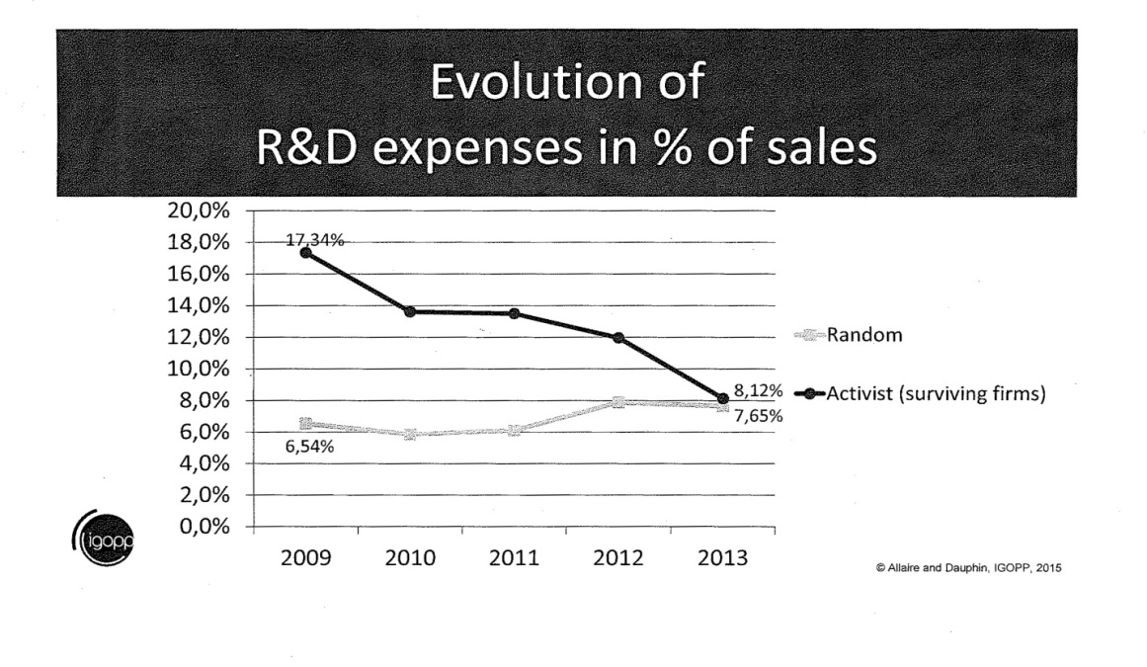
The BBJ View is that Corporate Managers Overinvest in Capital Expenditures and Research and Development. In this view, Hedge Fund Activism Corrects and Restores the Corporation to an “Optimal” Investment Policy.
But What Is the “Optimal” Policy? Overinvestment may occur, But Others Believe that Activism is Creating A Negative Externality by Excessively Curbing R&D.
For example, Allaire and Dauphin report, using the FactSet database, that in the four-year period following a hedge fund “engagement,” R&D expenses at “surviving” target firms declines by more than 50% (expressed as a percentage of sales):
Moreover, their figure may understate the R&D decline, as it does not include the likely R&D decline at firms that are taken over.
Recent High Visibility Examples Show the Urge to Cut R&D:
  Valeant/Pershing Square announced an intent to reduce the research budget at the combined Allergan/Valeant firm by over 70% if the merger was successful.
  Trian publicly sought to cut R&D at DuPont. And shut central research facility.

Slide 11
Implications and The Broader Picture:
Beyond the Hedge Funds
For better or worse, a revolution may be in progress within the public corporation, of which hedge fund activism is only the spearhead.
As a recent study by the Roosevelt Institute summarized:
  “In the 1960s, an additional dollar of earnings or borrowing was associated with about a 40-cent increase in investment. In recent years, the same dollar is associated with less than 10 cents of additional investment.” See J.W. Mason, Disgorge the Cash: The Disconnect Between Corporate Borrowing and Investment (2015).
  From the second half of 2009 through 2013, the Federal Reserve’s Flow of Funds data shows that corporate investment increased by $400 billion, while shareholder payouts increased by $770 billion and corporate borrowing by nearly $900 billion. In effect, corporate borrowing is primarily funding shareholder payouts, not investment (Id.).
  Hedge fund activism did not cause this imbalance, but it appears to be accelerating it.
  Ultimately, the question becomes whether the public corporation in the 21st Century can fund R&D or even retain its capital. BBJ’s assumption that activism is enforcing an “optimal investment policy” is undefended and needs closer examination.
  Are institutional shareholders “greedy” (or characterized by “short-term” investment horizons), while individual and “indexed” shareholders are “patient”? The former sought to break up DuPont, while the latter defended it. Why is this division so clear-cut? Clearly, one cannot assume activism produces optimality without more inquiry and clearer criteria.

