Slide 1
Financing Disruption
John Armour
Luca Enriques
Oxford University
GCGC Colloquium 2015
Stanford Law School

Slide 2
1. Introduction

Slide 3
Motivation
Innovation thought to drive growth, jobs
‘Disruption’ – innovation + impact
Policymakers want to stimulate innovation because of these good things
New policy initiatives– ‘lower costs’ of accessing outside capital (JOBS Act, EU Capital Markets Union Green Paper)
Also changes in financing practices (crowdsourcing, dual-class tech IPOs)
To think about policy, need to understand practice

Slide 4
The idea
Innovation requires more than just finance
Requires judgment about project development
Think of innovative projects as real options
Information revelation informs continuation decision
More valuable if decisions made with more information, by people who better understand implications (capabilities of technology, social impact).
Basic idea: mode of finance affects firm’s investment decisions

Slide 5
The problem
Innovating agent
Has relevant knowledge (access to revelation of information, human capital regarding interpretation)
But liquidity constrained– needs outside finance
Investor
Concerned about agent opportunism
Investor control rights
Reduce (observable) agent opportunism
But induce agent to substitute effort from unobservables into observables
Optimum level of investor control depends on ‘wisdom’ of investor
‘Wisdom’ : how much information observable to investor, or investor’s capacity to interpret it

Slide 6
Sources of finance
Public equity markets
Specialist private investors (venture capital)
Debt? (no collateral)
Also
Non-specialist private investors (crowdfunding)
Consumers (crowdfunding)
Employees (stock compensation)

Slide 7
2. Public equity markets

Slide 8
The wisdom of markets
Stock markets aggregate information about investors’ expectations through trading (Gilson & Kraakman, 1984; 2014)
Crucial for this process are ‘smart money’ investors who do analysis of fundamentals (Goshen & Parchomovsky, 2006)
Analysts focus on comparison– how does event x relate to y which is already known?
Where it works well, can be a good guide for managers (Dow & Gorton, 1997 JF; Gordon, 2007 Stanf L Rev)
Tying managers to stock price not only reduces agency costs but can aid corporate investment policy
The bigger the innovative leap then the less useful such comparative analysis is
‘Market control’-- tying managerial payoffs to stock price – can distort corporate investment in favour of things analysts understand (Stein, 1988 JPE)

Slide 9
The wisdom of markets (2)
Empirical findings: exposure to mechanisms of market efficiency associated with less exploratory innovation
Analyst coverage (He & Tian, 2013 JFE)
Stock market liquidity (Fang, Tian & Tice, 2014 JF)
Undergoing an IPO (Bernstein, 2015 JF forthcoming)
Effects mitigated if have ‘dedicated’ institutional investor(s) (Aghion, van Reenen & Zingales, 2013 AER)
Buy & hold significant stake
Interpretation: invest more in understanding firm’s innovations rather than comparing with rest of industry
Rationale for controller entrenchment? (Goshen & Hamdani, 2014; Cremers and Sepe, 2014)
But how to mitigate agency costs?

Slide 10
3. Venture capitalists

Slide 11
The wisdom of specialist investors
VC as the archetypal ‘wise’ investor for innovative projects
Bring knowledge, take control rights (staging, vetos, board seats) (Black & Gilson, 1998; Gompers & Lerner, 1999)
But VC human capital varies (Gompers & Lerner, 1999; Ewens & Rhodes-Kropf, 2013 NBER WP)
More control, in hands of less experienced VCs, associated with less innovation (Mao, Tian & Yu, 2014)
And VCs’ ability to add value decreases with distance (Lerner, 1995)
Finite supply of VCs with appropriate knowledge for a particular innovation
Costly to identify them ex ante

Slide 12
4. Crowdfunding

Slide 13
The wisdom of crowds?
Crowdfunding (CF)
Going direct to the public for funding via internet
Investors do not take control rights
Sole control over firm’s investment policy is through decision to fund
Types of CF contract
Equity CF: funders get shares in firm
Reward CF: funders get unit(s) of the product

Slide 14
The wisdom of crowds? (2)
Equity CF
Retail CF investors don’t bring specialist knowledge (unlike VCs)
No secondary market to aggregate information (unlike public equity markets)
Likely to result in herding (Agrawal et al, 2013; Armour and Enriques, 2015)
Funding decision may have little to do with merits of project

Slide 15
The wisdom of crowds? (3)
Reward CF
Funders do have specialist knowledge: about their preferences regarding product
Reward CF financing is conditional on meeting target: aggregates information: allows firm to test product market
Herding less likely than equity CF (unless similar products are on offer)
Tapping consumers for finance yields new knowledge for firm about product impact

Slide 16
4. Employees

Slide 17
The wisdom of techies
R&D employees have knowledge about capabilities of innovations and firm’s culture for making use of them
“Raising capital” from employees by paying them in stock is expensive because of risk premia
Poorly-explained as incentive alignment– employees don’t usually have ability to influence stock price
(Options, on the other hand, create incentives to innovate: Chang, Fu, Low & Zhang, 2015 JFE)
But paying employees in stock creates a commitment to outside investors
If controllers abuse discretion, employees will leave
Paying them in stock can help outside investors accept a lower level of control rights
Mitigate adverse impact of managing to stock price on innovation

Slide 18
How it works: Facebook’s EIP
Facebook Inc
Class A shares
Mark Zuckerberg
Class B shares
61% votes
15% cashflows
Employee Incentive Plan
“align[s] the objectives of our
stockholders and our employees”
RSUs
Outside
investors
Executives & Employees
5% cashflows
Executives
0.2% cashflows
R&D employees
3.6% cashflows
Other employees
1.4% cashflows

Slide 19
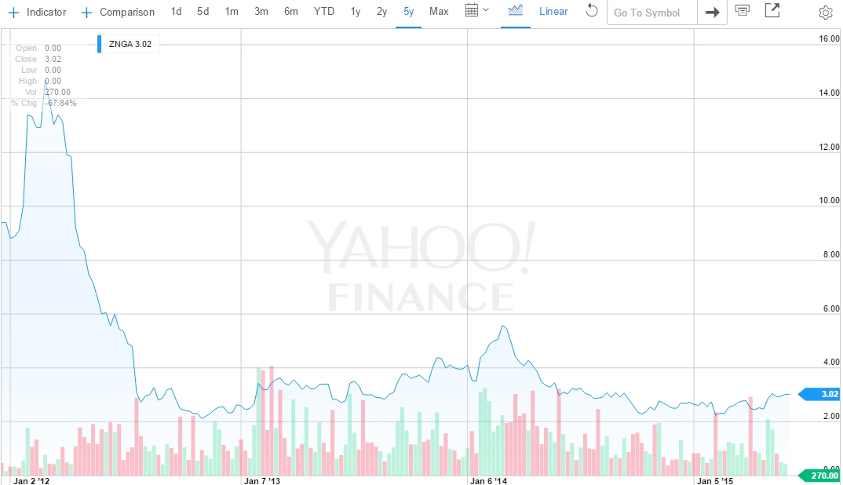
Case study: Zynga
Mar 21, 2012: Acquires OMGPOP
for $183m, which is shut down within a year.
Mar 3, 2014: launch
of 3 new games
July 25, 2012:
earnings 1/6 of
expectations
Jul 1, 2013: Pincus,
Rated one of “America’s worst 5 CEOs” for 2012,
appoints Don Mattrick (from Xbox) as CEO
Apr 9, 2015: Pincus
returns as CEO, Mattrick fired
Dec 16, 2011: IPO
Marc Pincus
(founder, CEO) has
16% cashflows +
voting control
Fall 2012: reported
defections of key programmers
May 5, 2015: Fires
25% of workforce

Slide 20
Zynga’s employees (1)
“Will more Zynga employees be on their way out the door, as the company continues to struggle after going public only eight months ago? Yes, indeed, if morale at the San Francisco-based social games company continues to sink as quickly as its stock has been dropping. … Several sources at other companies say they’ve started seeing a “flood of resumes” in recent weeks from Zynga developers looking for jobs …” (AllThingsD, Aug 10, 2012)
“‘Mark's challenge is how to make great games when his assets—his developers—are literally walking out the door,’ said Richard Greenfield, a BTIG analyst.” (WSJ, Nov 15, 2012)
“One thing has stood out to Wall Street. Few of Groupon’s executives have left. Some of Facebook’s have. A torrent of Zynga’s have.” (Pandodaily, Nov 19, 2012)

Slide 21
Zynga’s employees (2)
“[O]ur ability to execute our strategy depends on our continued ability to identify, hire, develop motivate and retain highly skilled employees, particularly game designers, product managers and engineers. These employees are in high demand, and we devote significant resources to identifying, recruiting, hiring, training, successfully integrating and retaining them. We have experienced significant turnover in our headcount over the last year, which has placed and will continue to place significant demands on our management and our operational, financial and technological infrastructure. As of March 31, 2015, approximately 33% of our employees had been with us for less than one year and approximately 51% for less than two years.
… In addition, our recent operating results, the decline in our revenue and the current trading price of our Class A common stock may cause our employee base to be more vulnerable to be targeted for recruitment by competitors. Some of our employees may have been motivated to work for us by an expectation that our Class A common stock would be trading at a higher value and may be less motivated by the equity compensation they receive as a result. Competitors may leverage any resulting disappointment as a tool to recruit talented employees. Competition for highly skilled employees is intense, particularly in the San Francisco Bay Area, where our headquarters is located.”
(Zynga 10-Q, May 7, 2015)

Slide 22
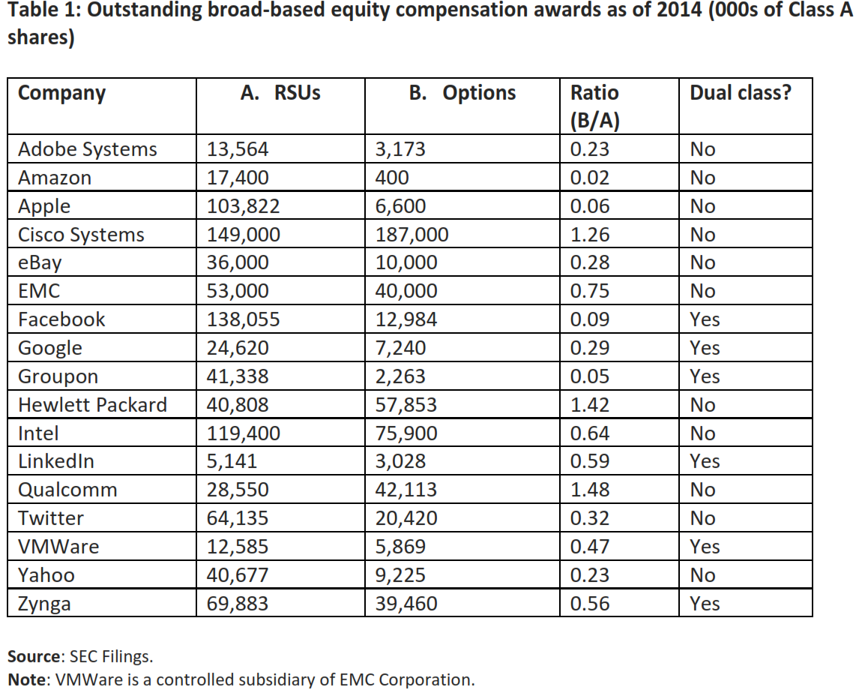
Dual class mean: 0.34
Single class mean: 0.61

Slide 23
Outstanding Broad-Based Equity Compensation Awards as of 2014 (thousands)
Firm | RSUs | Options | RSU % | Dual class
Adobe Systems | 13,564 | 3,173 | 81% | 0
Amazon | 17,400 | 400 | 98% | 0
Apple | 103,822 | 6,600 | 94% | 0
Cisco Systems | 149,000 | 187,000 | 44% | 0
eBay | 36,000 | 10,000 | 78% | 0
EMC | 53,000 | 40,000 | 57% | 0
Facebook | 138,055 | 12,984 | 91% | 1
Google | 24,620 | 7,240 | 77% | 1
Groupon | 41,338 | 2,263 | 95% | 1
Hewlett Packard | 40,808 | 57,853 | 41% | 0
Intel | 119,400 | 75,900 | 61% | 0
LinkedIn | 5,141 | 3,028 | 63% | 1
Qualcomm | 28,550 | 42,113 | 40% | 0
Twitter | 64,135 | 20,420 | 76% | 0
VMWare | 12,585 | 5,869 | 68% | 1
Yahoo | 40,677 | 9,225 | 82% | 0
Zynga | 69,883 | 39,460 | 64% | 1
RSUs / (RSUs + options)
Dual class mean: 76%
Single class mean: 68%
Source: SEC Filings

Slide 24
Policy?
Public equity markets
Pro- ‘growth firm’ measures focus on reducing disclosure obligations : ‘facilitate IPOs’ (JOBS Act Title I, Title IV; EU Prospectus Directive Review):
May lower costs of doing IPOs, but reducing disclosure likely to increase knowledge gap
Permitting dual-class tech IPOs
May be beneficial way of avoiding substitution from hard-to-understand to easier-to-understand projects
Employee stock compensation as commitment mechanism against opportunism
Private investors
Subsidise VC investment? (EU CMU Green Paper, 2015)
Doesn’t increase knowledge of VCs
Subsidised entrants crowd out established players (Gilson, 2003; Armour and Cumming, 2006; Lerner, 2009)
Reward crowdfunding
Using product market to raise capital generates relevant new information
Facilitate equity crowdfunding? (JOBS Act Title III; EU CMU Green Paper, 2015)
Most useful if can match firm to investors with relevant specific knowledge

