Slide 1




The Great Pyramids of America:
A Revised History of US Business Groups, Corporate Ownership and Regulation,
1930-1950
Eugene Kandel (Hebrew University, CEPR and ECGI)
Konstantin Kosenko (Bank of Israel)
Randall Morck (University of Alberta)
Yishay Yafeh (Hebrew University, CEPR and ECGI)

Slide 2
A Typical Large US Corporation Today
Widely held
  No controlling shareholder
Freestanding
  Listed firms typically do not hold control blocks in other listed firms
Minnesota Mining and Manufacturing
Almost 100% ownership
Domestic subsidiaries
Almost 100% ownership
Public Shareholders

Slide 3
Edper Group
Bronfman Group (Canada)

Slide 4
Anglo American Group (South Africa)
De Beers
Centenary
81 Main
St Nom
Oppenheimer
Family
Foreign
shareholders
29.4%
50.0%
Debswana
Diamond
8.0%
6.3%
SA Mutual
52.0%
23.4%
5.2%
8.8%
13.1%
Anamint
5.3%
West DP
44.5%
ANGLOS
10.2%
8.5%
23.7%
10.0%
Amplats
35.8%
49.7%
8.3%
38.4%
6.9%
De Beers
50.0%
Amic
Std Bank
Nom Tvl
11.1%
6.5%
8.2%
Vaal RFS
32.0%
Sanlam
14.5%
5.7%
Amcoal
51.7%
Afex
24.8%
5.5%
43.6%
Tongaat
First National
Kloof
8.8%
50.0%
51.0%
20.4%
AECI
Highveld
Gencor
28.6%
39.4%
24.5%
GFSA
26.0%
27.6%
40.2%
Southern Life
35.2%
50.0%
Premsab
Liberty
Dries
9.5%
36.3%
50.0%
JCI
26.8%
20.6%
28.3%
5.1%
39.6%
Bevcon
Premier
Johnnic
35.0%
NEC
Amgold
50.5%
22.6%
27.5%
30.0%
Freegold
Samancor
SA Brews
Source: Financial Mail

Slide 5
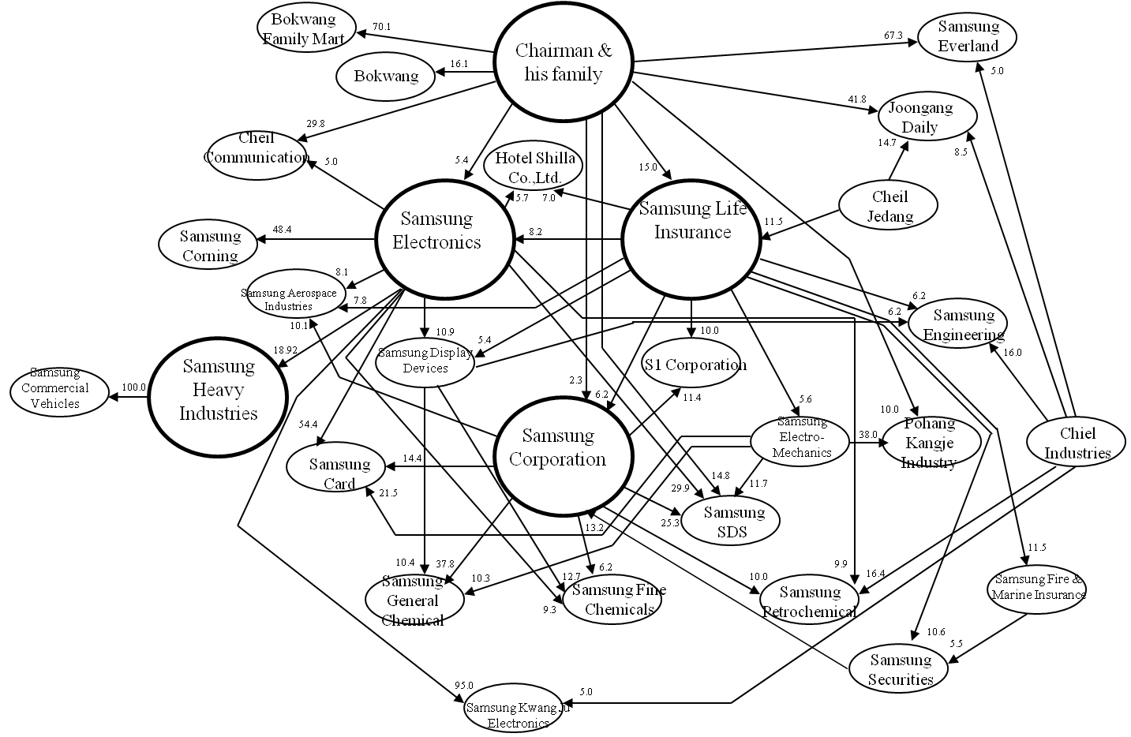
The Samsung Group
Dark circle for company of more than 3 trillion in assets. Dark arrow represent circular equity investment.
Source: Korea Investor’s Service, reproduced from Chang (2003)

Slide 6
Corporate Ownership Around the World (LLS, 1999)

Slide 7
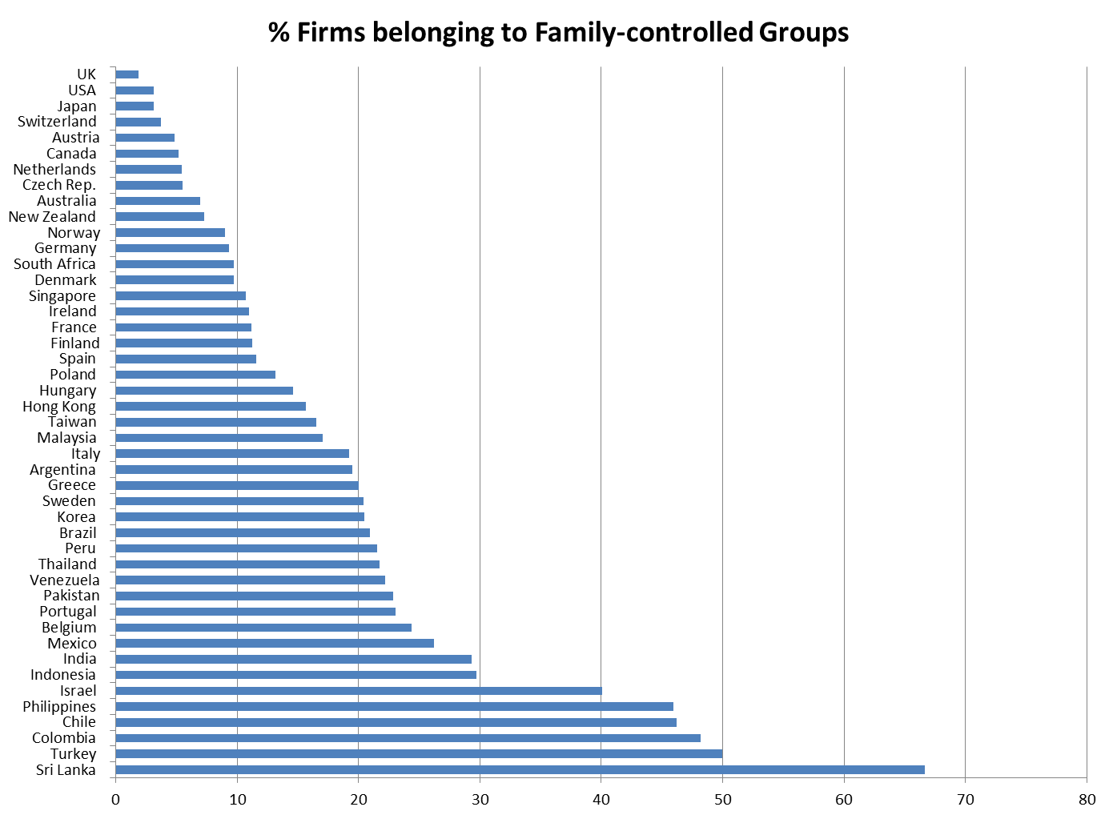
US Corporate Ownership Today Is Different
Source: Masulis et al. (2011)

Slide 8
When and How did US Corporate Ownership become “Exceptional”?
Has it always been like this? Is common law inconsistent with pyramidal ownership structures?
If it is not common law,
Is regulatory measures?
Is it economic reasons?
Is it politics?
How does the history of corporate ownership in the US compare with the evolution of corporate ownership in the UK, Germany and Japan?

Slide 9
This Paper:
The US wasn’t always like that
As in many countries today, until the middle of the 20th century, business groups dominated the US economy, controlling (at the peak of their activity) about 50% of all non-financial corporate assets as well as many powerful financial institutions
As in many countries today, some groups were family-controlled, pyramidal and diversified across a range of industries
But some US groups were focused (undiversified) in one sector: public utilities and transportation
Unlike most groups today, the holding (apex) company of many focused US groups was diffusely held, not family controlled

Slide 10
What Led to the Absence of Groups in the US? None of the “Suspects” Did It Alone…
Groups existed (since the end of the 19th century) - not inconsistent with US common law
Groups continued to exist in the 1940s; 18 survived until 1950, some survived even later – their disappearance was gradual
Group demise was not an immediate response to the introduction of any major regulatory measure of the 1930s
Diversified family-controlled groups disappeared first
Claim: the demise of groups in the US was due to a combination of regulatory forces applied against the backdrop of a special political climate

Slide 11
Regulatory Forces at Play?
Establishment of the SEC and improved investor protection (1933-1934)
PUHCA (starting 1935)
Taxation of inter-corporate dividend (starting 1935)
The Investment Company Act (1940)
Antitrust enforcement (starting late 19th century)
Estate Taxes (starting 1916)
Claim: A combination of factors, no single reason

Slide 12
Additional Observations
Did dual-class shares replace pyramids? Co-existed in early years; became unpopular/ prohibited in the late 1920s; no study of the link b/w the use of dual class shares in recent decades and “our” groups
Great Depression and WWII: impact is ambiguous
The academic and public discourse of groups in the 1930s: effects of groups on competition and politics in contrast with the modern focus on investor protection
No clear link between business groups and the rise of conglomerates/multidivisional firms in the 1960s (group “alumni” firms were not involved in the conglomerate merger wave (Dirlam, 1970))

Slide 13
Introduction to Pyramidal Business Groups
Ubiquitous
Not conglomerates
Often very large in size (e.g. the Wallenberg group in Sweden controls about 1/3 of market cap; Samsung revenues account for about 1/7 of Korea’s GDP)
Upside: Groups can make up for missing institutions in various ways (e.g., Khanna and Yafeh, 2007)
Downside: Monopoly power; rent seeking; minority shareholder expropriation (e.g., Morck et al., 2005)
Policy makers in many countries (e.g. Korea, Israel, Italy) seek mechanisms to limit the downsides of groups/restrict their influence on the economy and politics
Lessons from history/President Roosevelt: Relevance of the present study

Slide 14
Pyramidal BGs in the US - History
Use of holding companies becomes common towards the end of the 19th century (legal reform in NJ; replaces previous collusive arrangements, especially “trusts”(Moody, 1904)) [Not inconsistent with common law]
Antitrust legislation starting in the late 19th century (Sherman Act (1890), Clayton Act (1914) and more)
Proliferation of business groups, 1915-1928: Outside the scope of antitrust regulation; Competition for firm incorporation across States; Limited regulation; Preferential tax treatment; Also – “missing institutions” arguments for the formation of business groups
Different types of groups emerge: widely held groups focused in utilities (and railroads); and diversified family-controlled groups in other sectors
Concerns emerge in the late 1920s: groups hamper competition; groups are risky to investors (collapse of the Insull Group); groups over-expand…

Slide 15
Related Literature
Extensive writings on holding companies in the 1930s; Bonbright and Means, 1932, as the ultimate source; mostly antitrust language, limited reference to investor protection issues
Literature on business groups (Morck et al., 2005; Khanna & Yafeh, 2007)
History of corporate ownership around the world: Franks, Mayer and co-authors on the UK and Japan; Morck’s NBER volume
History of corporate ownership in the US, especially Becht and DeLong (2005)
Also related: studies on managerial ownership in the US, e.g., Holderness et al. (2002)

Slide 16
Specifically on Groups in the US
Legal scholars such as Bank and Cheffins (2010) Under-estimate the importance of groups (especially outside public utilities), “like” PUHCA
Mahoney (2012) – finds negative effect of PUHCA on valuation (uses an event study methodology)
Morck & Yeung (2005) – Taxation of inter-corporate dividends as a crucial policy tool
Perez Gonzales (Stanford WP, 2014): PUHCA affected the structure of utility groups and improved the performance of affiliates which became standalone entities

Slide 17
Data: Sources and Construction
Berle and Means’(1932) original list of the 200 largest non-financial corporations
Track the evolution and structure of ownership using periodic reports from Moody’s manuals (Industrial, Public Utilities, Railroads) at six points in time: 1926, 1929, 1932, 1937, 1940 and 1950
Unbalanced panel ~ 2500 firms, 15,000 firm-years
Financial reports/statements (incomplete)
SEC annual reports (ICA and PUHCA Administration)
Various other historical sources, newspaper archives and more…

Slide 18
Data (contd.)
Tests for sample selection do not reveal any serious bias: various contemporary sources with alternative lists of large companies vs. the list in Berle and Means
Definition of a group: same ultimate owner, at least three publicly listed companies (stake < 95%) Robustness tests – groups of 4 or more
Ignore non-voting shares but there seems to be no serious bias: ultimate owner’s holdings in preferred stocks ≈ holdings in common stocks (TNEC, 1940; Becht and DeLong, 2005); verify that widely-held groups are not indirectly family controlled

Slide 19
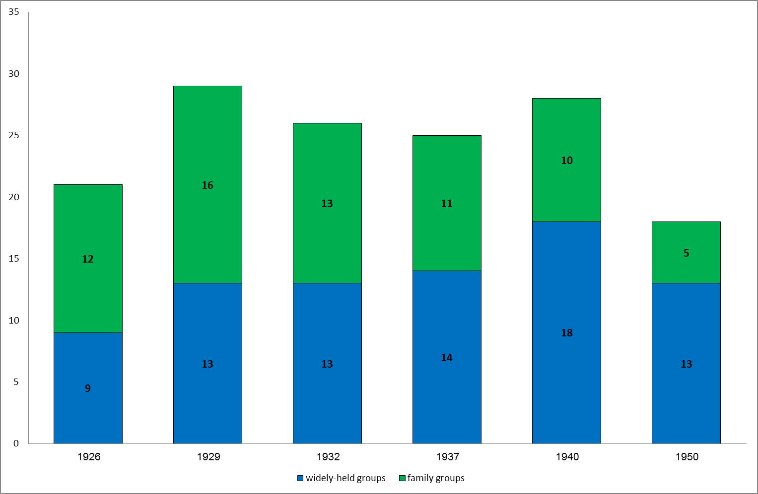
US Business Groups
No. of Family-controlled Groups (green) vs. Widely-held Groups (blue)

Slide 20
Number of Group-affiliated Firms

Slide 21
Group Size - % of Total Corporate Assets
Sources: Statistics of Income, Authors’ calculations

Slide 22
Distribution of Business Groups by Industry, 1932

Slide 23
Group Diversification (mean HHI) and Vertical Integration 1926-1950
Sources: Statistics of Income, Moody’s manuals and Authors’ calculations

Slide 24
How the VI Measure is Calculated
(Fan and Lang, 2000)
Group Vertical integration Index (VI) - a proxy for the opportunity for vertical integration (based on IO matrix coefficients) between group member firms
“In 1992, the total plastics output was $31,502 million. The total output of bags was worth $8,389 million. The bags industry consumed $1,259 million worth of plastics (aij), whereas the plastics industry employed $10 million worth of bags (aji) as an input. On a per-dollar basis, the bag industry consumed $0.15 (= 1,259/8,389) worth of plastics for each dollar of bags produced (vij), whereas the plastics industry consumed $0.0003 (=10/31,502) worth of bags for each dollar of plastics produced (vji). The vertical relatedness between the two industries is 0.0751 (Vij=1/2(vij+vji)), the average input transfer between the two industries on a per dollar basis”.

Slide 25
The Share of US Business Groups in Selected Industries, 1932

Slide 26
Group Revenues in comparison with the
Largest US Firms Today
The largest group - the Morgan Group - had revenues of $46 billion in 1932 (2005 prices), about 6.5% of US GDP
Larger (relative to GDP) than today’s largest American corporations such as Wall-Mart or Exxon-Mobil
Comparable in size to LG or Hyundai in Korea (6-7% of GDP); Samsung, the world’s largest group is twice as large

Slide 27
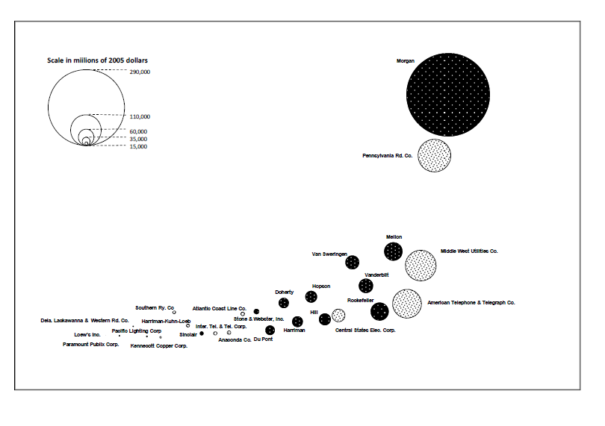
The Relative Size (total assets) of Business Groups, 1932

Slide 28
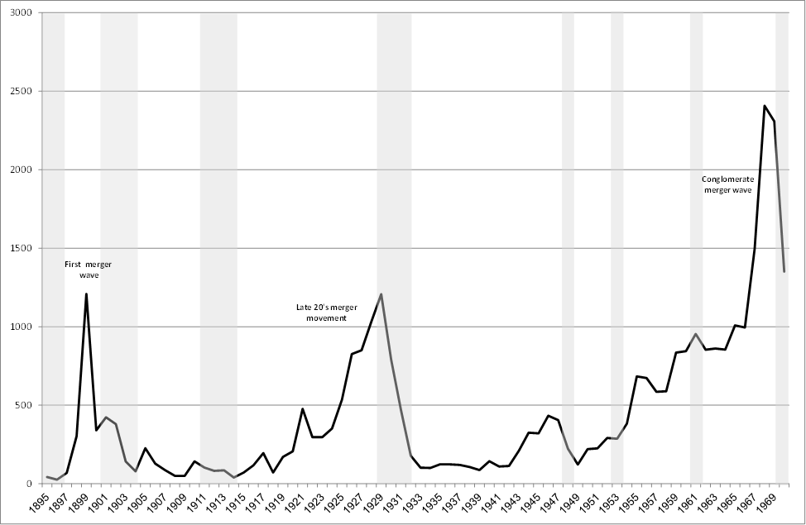
M&A Activity (Group and Conglomerate Formation), 1895 -1970
Sources: Nelson (1959), Historical Statistics of the United States (1970), NBER

Slide 29
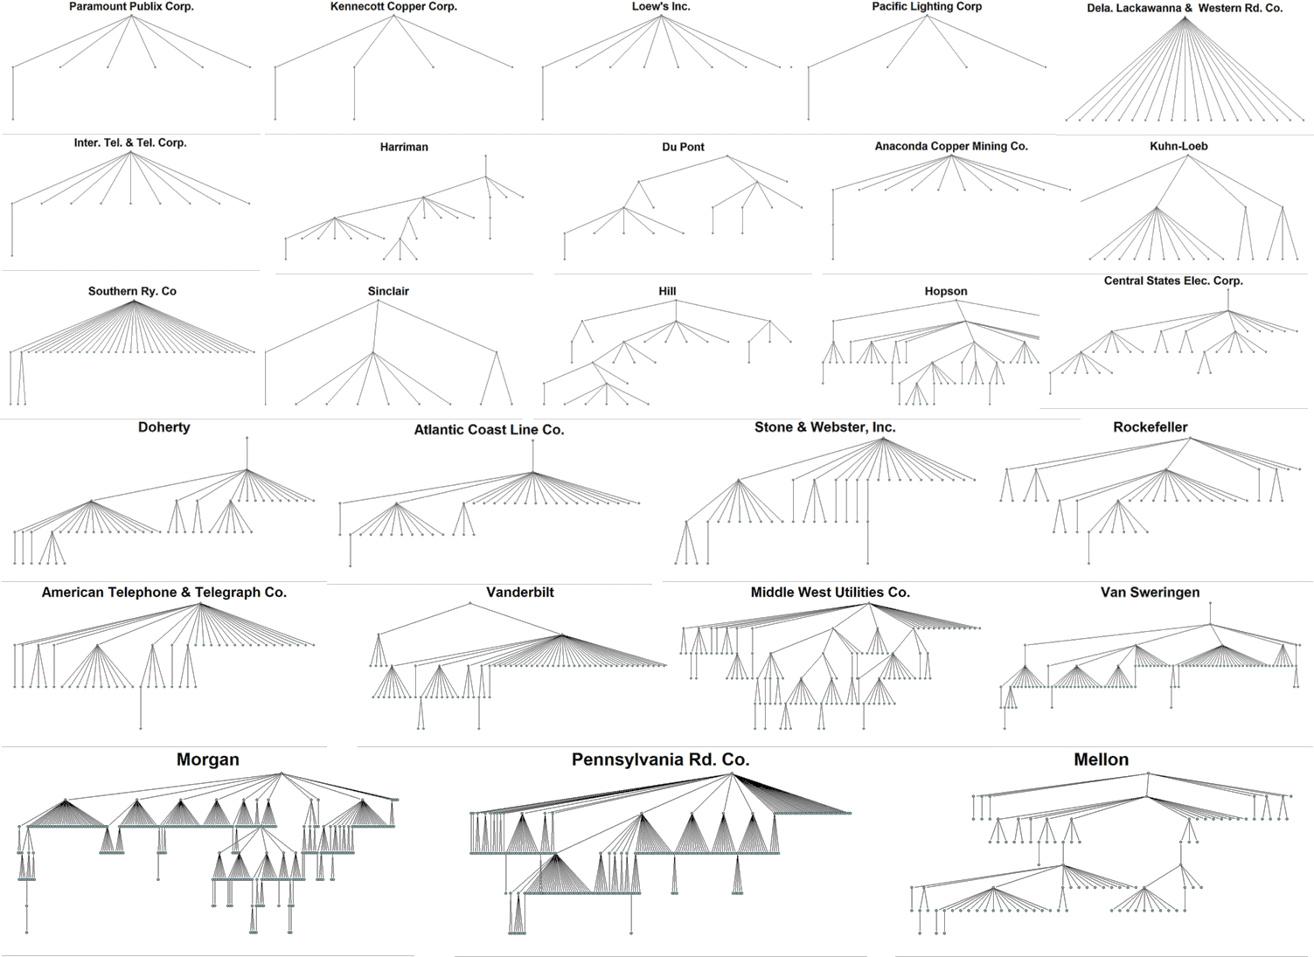
US Pyramids, 1932

Slide 30
Average Ownership Stake Held by Controlling Shareholders
T-value (diff.) | Mean | Number of companies | Population
 | 76% | 923 | Publicly-traded
7.47*** | 72% | 614 | Group-affiliates
 | 85% | 309 | Stand-alone (non-affiliated)
-1.32 | 73.1% | 285 | Family-controlled groups
 | 70.3% | 329 | Widely-held groups

Slide 31
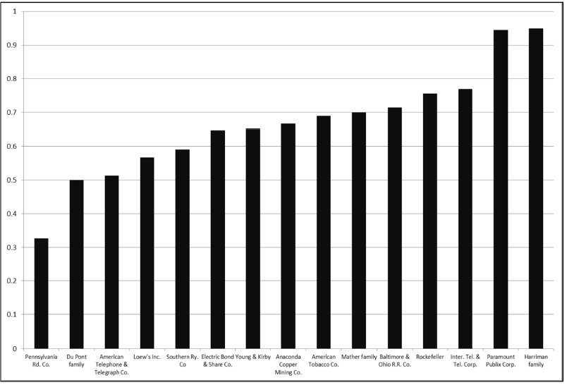
Controlling Blocks in Group Affiliates, 1940

Slide 32
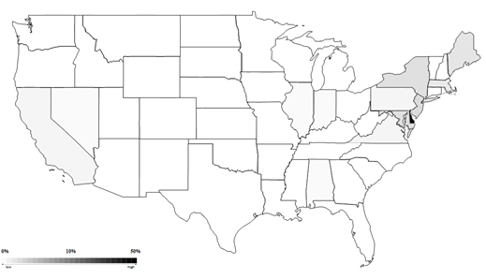
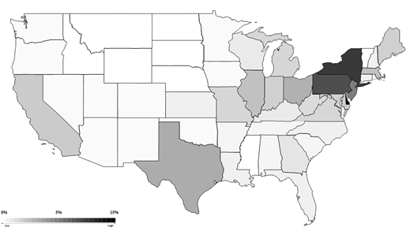
Geographic Distribution of US Business Groups, 1932
Holding Companies (N=143)
Operating Companies (N=1681)

Slide 33
US Exceptionalism - 1
Business groups in the 1930s USA | Business groups in most countries in the 2000s | America exceptional?
Commonplace | Commonplace | No
Pyramidal structure | Pyramidal structure | No
Large firms | Large firms | No
Small control wedge | Large control wedge | Yes
Industrially concentrated Geographically diversified? | Industrially diversified Geographically concentrated | Yes
Many with widely held apex firm | Apex firm is generally a family firm | Yes

Slide 34
The Disappearance of US Groups

Slide 35
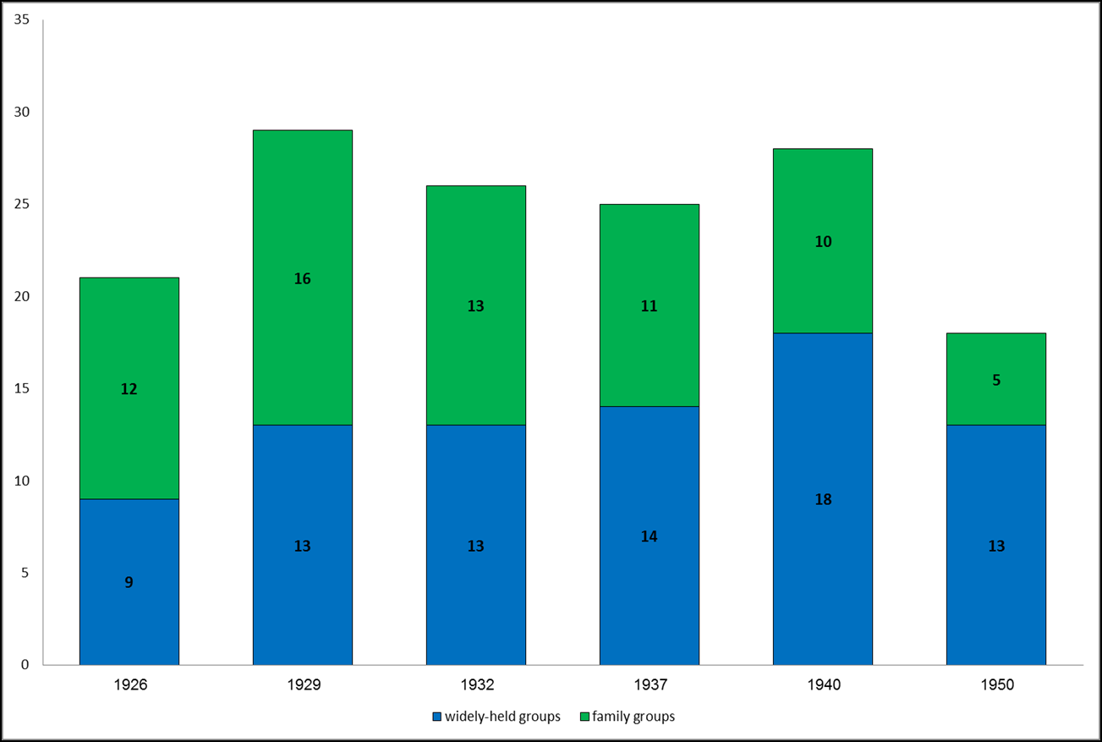
US Business Groups
No. of Family-controlled Groups (green) vs. Widely-held Groups (blue)

Slide 36
Number of Group-affiliated Firms

Slide 37
Group Size - % of Total Corporate Assets
Sources: Statistics of Income, Authors’ calculations

Slide 38
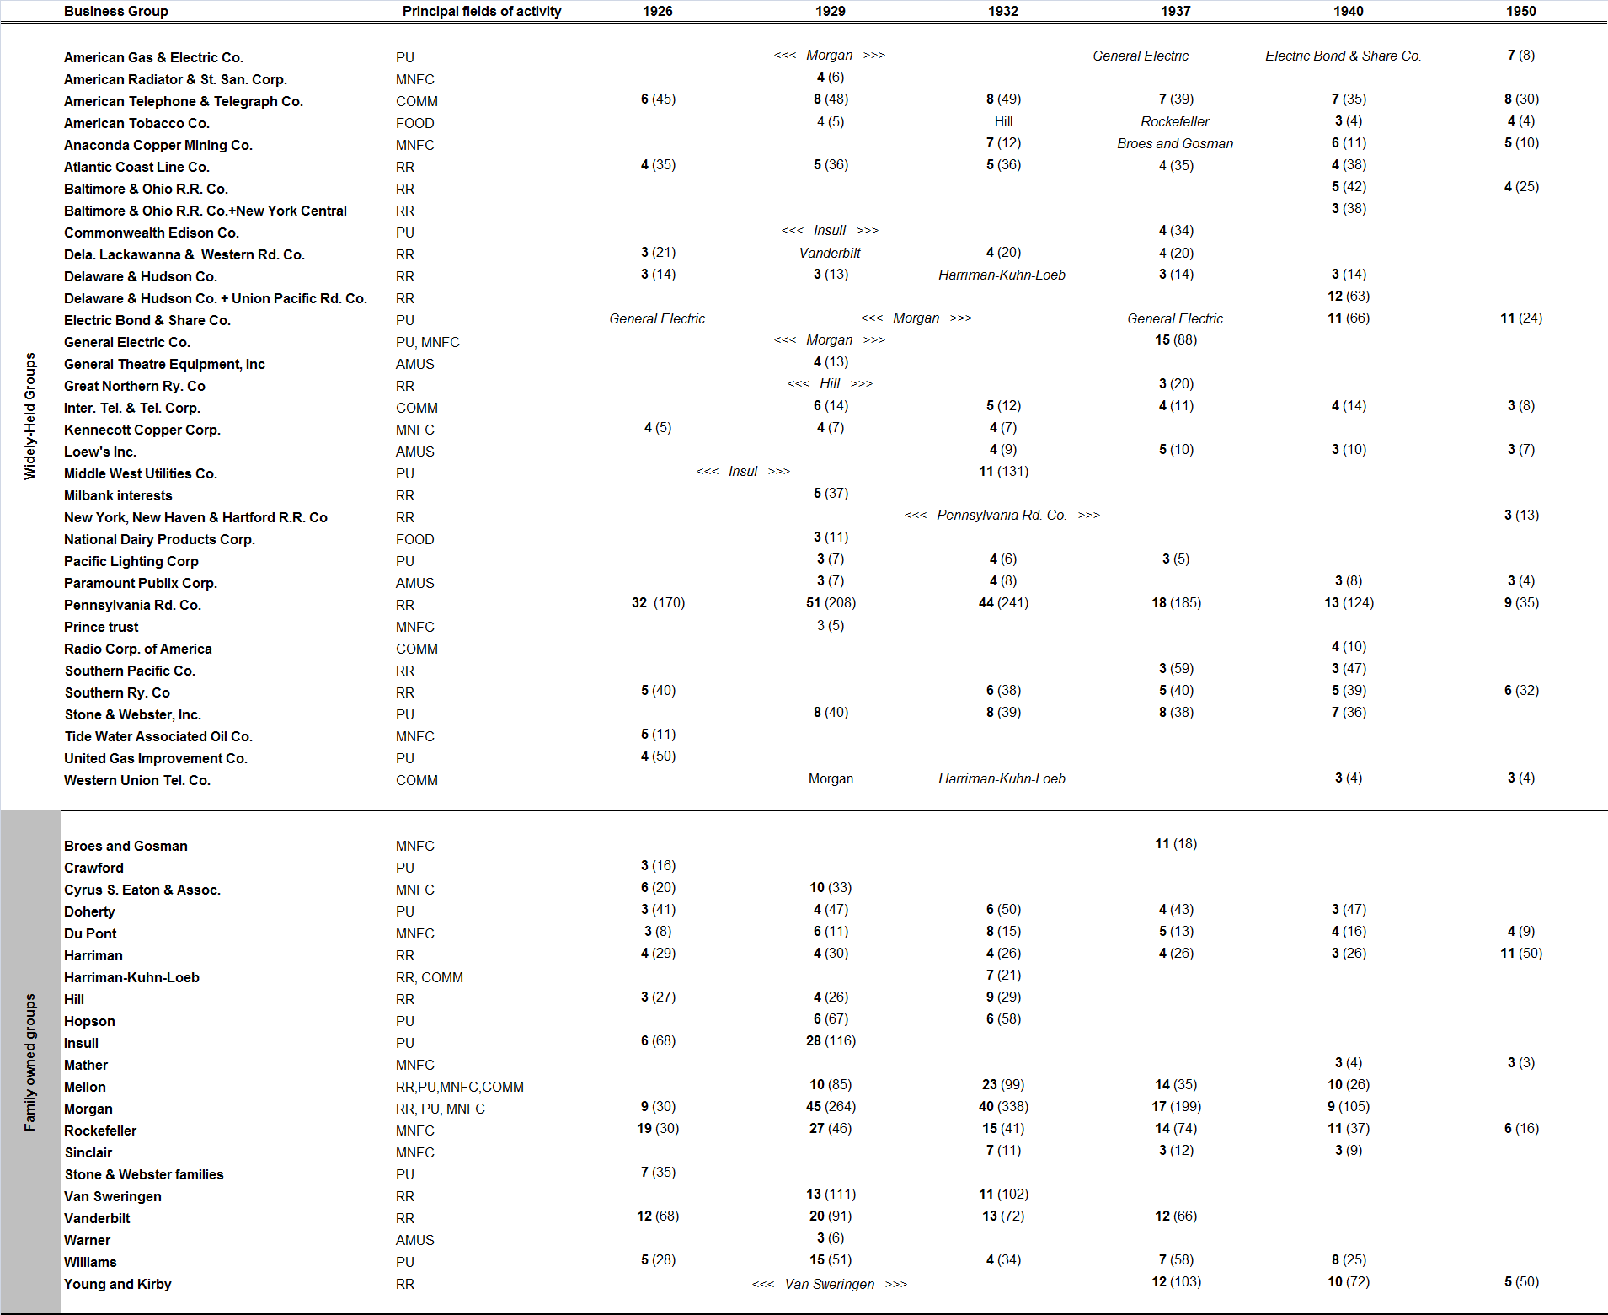
The Evolution of US Business Groups 1926 – 1950

Slide 39
US Exceptionalism - 2
Business groups in the 1930s USA | Business groups in most countries in the 2000s | America exceptional?
Commonplace | Commonplace | No
Pyramidal structure | Pyramidal structure | No
Large firms | Large firms | No
Small control wedge | Large control wedge | Yes
Industrially concentrated Geographically diversified? | Industrially diversified Geographically concentrated | Yes
Many with widely held apex firm | Apex firm is generally a family firm | Yes
Gone | Still there | Yes

Slide 40
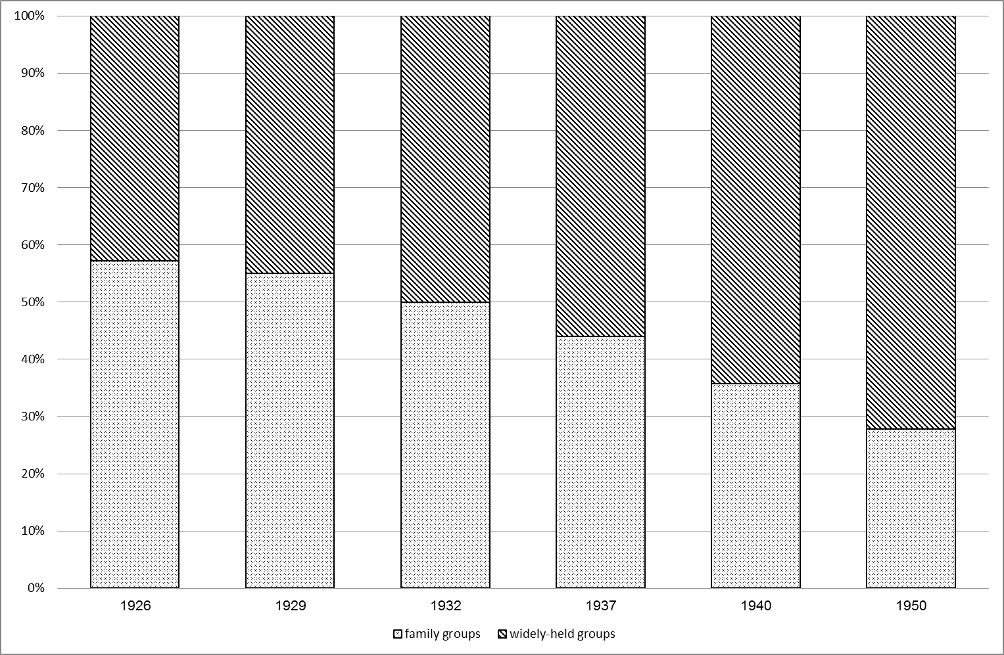
Proportion of Family-controlled vs. Widely-held Groups

Slide 41
Surviving vs. Disappearing Groups

Slide 42
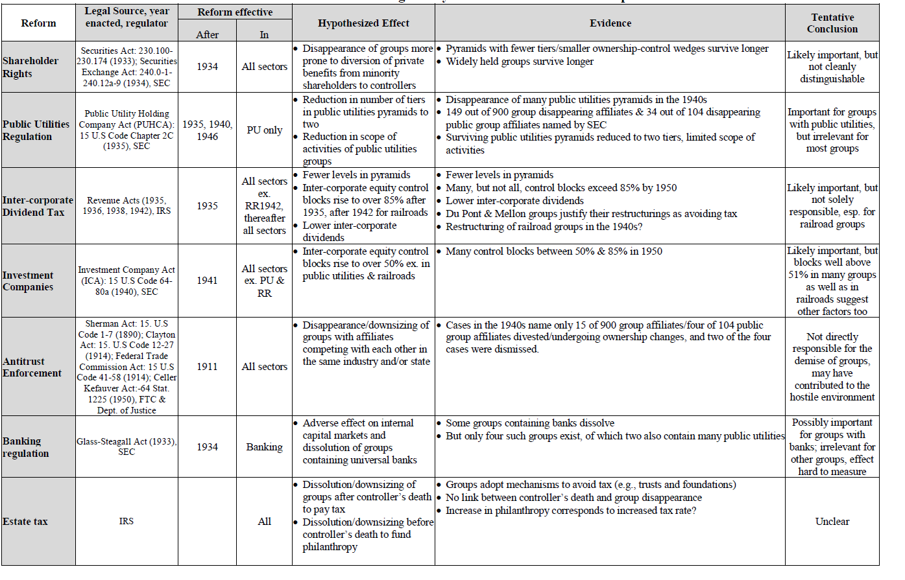
The Effect of Regulatory Measures

Slide 43
The Securities & Exchange Act (1933) and the Establishment of the SEC (1934)
Improved investor protection, disclosure rules etc.
May have reduced “tunneling”?
The disappearance of family firms (more tunneling prone?)
Disappearing groups had somewhat higher control-CF wedges than surviving groups (but difference is small)
Decline in the average number of pyramidal levels per group from 2.8 in 1940 to 2.2 in 1950 (significant)
But investor protection was not the major concern of contemporary observers
Link between improved investor protection and ownership structure not clear in other countries (Franks et al. on the UK, Japan, Germany

Slide 44
The Public Utility Holding Company Act (PUHCA), 1935
Explicitly anti-group
President Roosevelt in 1935: “among the subjects that lie immediately before us is… the restoration of sound conditions in the public utilities field through abolition of the evil features of holding corporations”
Initially, restrictions on intra-group transactions and on lobbying
In 1940, the “Death Sentence Clause” (reaffirmed by the Supreme Court in 1946):
Connected infrastructure (not operations in NY and CA)
One industry (not gas and electricity together)
No more than two pyramidal levels

Slide 45
PUHCA – Empirical Tests
Use the SEC Report from 1951 to identify all companies affected by PUHCA
Identify all companies the sample undergoing an ownership change (divestment, merger, bankruptcy etc. between 1937 and 1950) – there are about 900 such firms
Out of these 900, 149 included in the PUHCA lists
Out of 104 public companies undergoing an ownership change, 34 included in the PUHCA lists
Out of 12 groups which disappear between 1940 and 1950, PUHCA strongly affected 5 (where at least a third of all public companies appeared on the PUHCA lists)
Strong PUHCA effect on two additional groups which disappeared between 1937 and 1940

Slide 46
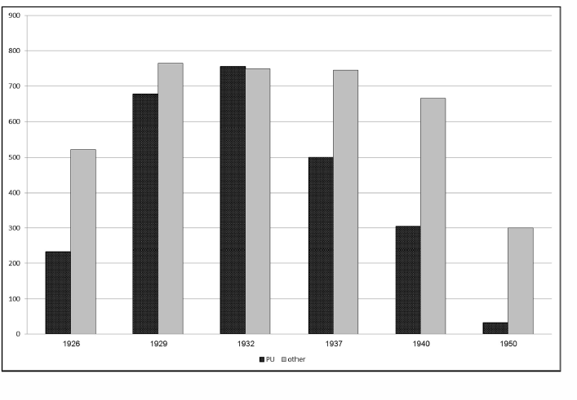
Groups whose “principal line of business” is Public Utilities vs. Other Groups (# of affiliates)

Slide 47
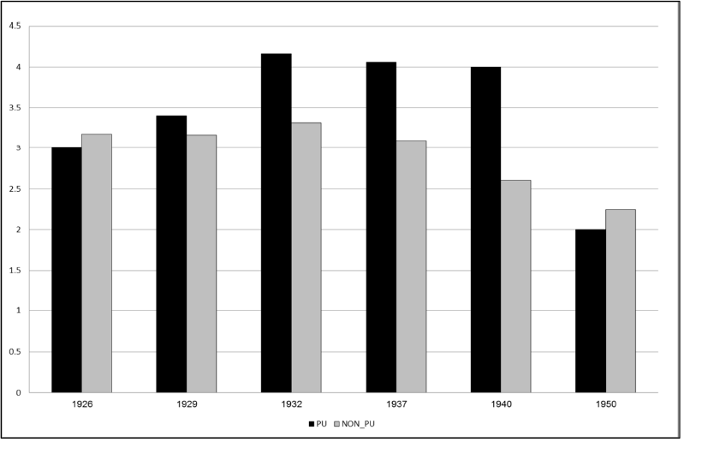
Number of Pyramidal Levels in Public Utilities vs. Other Groups

Slide 48
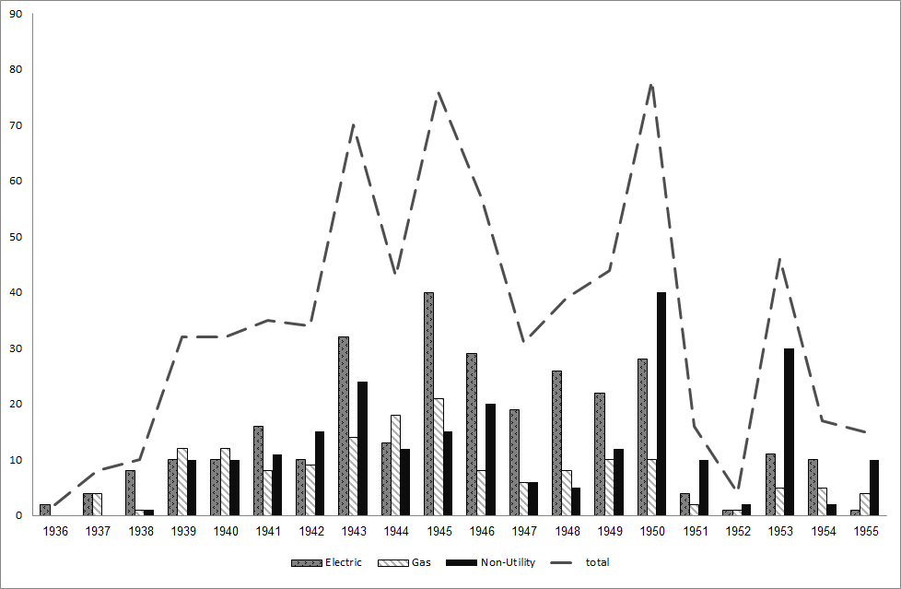
Properties Sold/Divested by Public Utilities Holding Companies, 1936-1955
Source: SEC Annual Reports

Slide 49
PUHCA - Evaluation
Clearly had an effect on groups with operations in public utilities
But groups not in PU were not affected
Mixed evaluation by contemporaries:
Anderson (1947) views the prospect for PU groups as “quite good”
SEC Chairman McDonald (1951) emphasizes considerable divestments and decline in geographic spread by many PU holding companies

Slide 50
Inter-Corporate Dividend Taxation (1935)
Explicitly anti-group
Part of President Roosevelt’s anti-group strategy: fiat restrictions on holding companies in public utilities and taxation of inter-corporate dividends
Effect is proportional to the number of pyramidal levels
Effective rates increased over time
Preferential tax treatment for downsizing pyramids
Regarded as important in previous work by Morck and Morck and Yeung

Slide 51
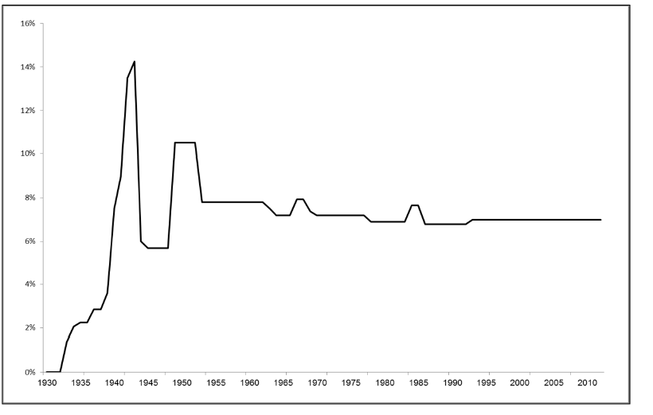
Statutory Inter-corporate Dividend Tax Rate Applied at Each Pyramidal Tier

Slide 52
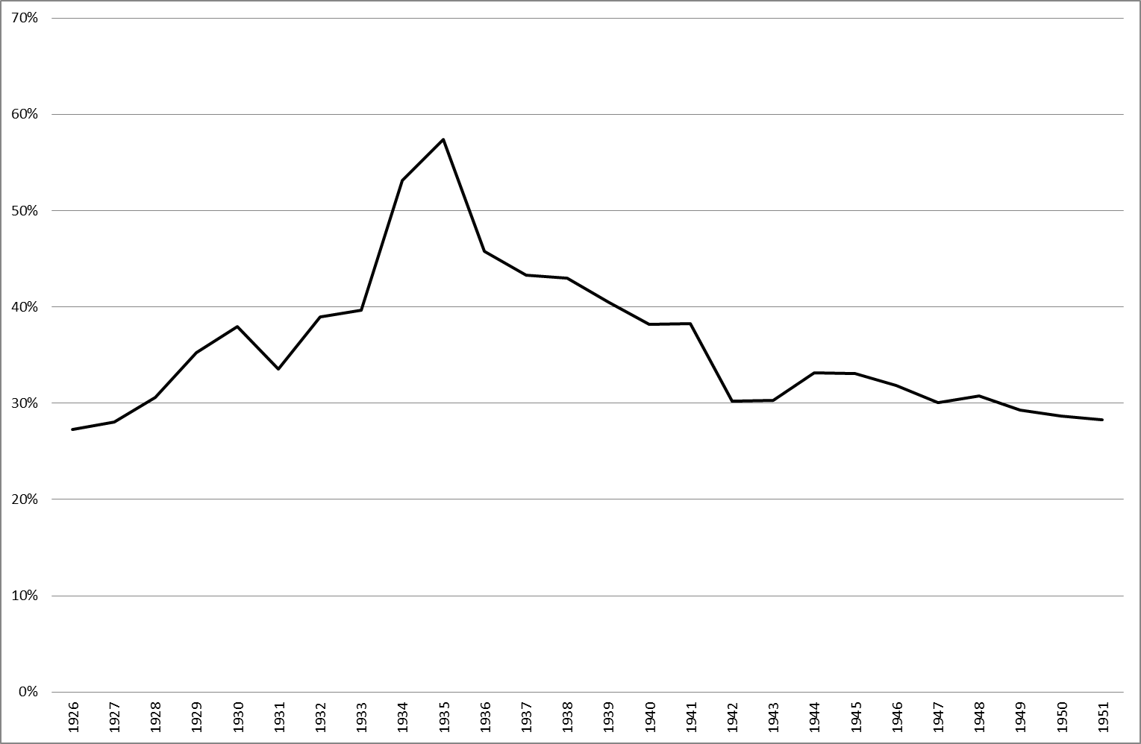
Inter-corporate Dividends to Total Dividend Payments, 1926-1950

Slide 53
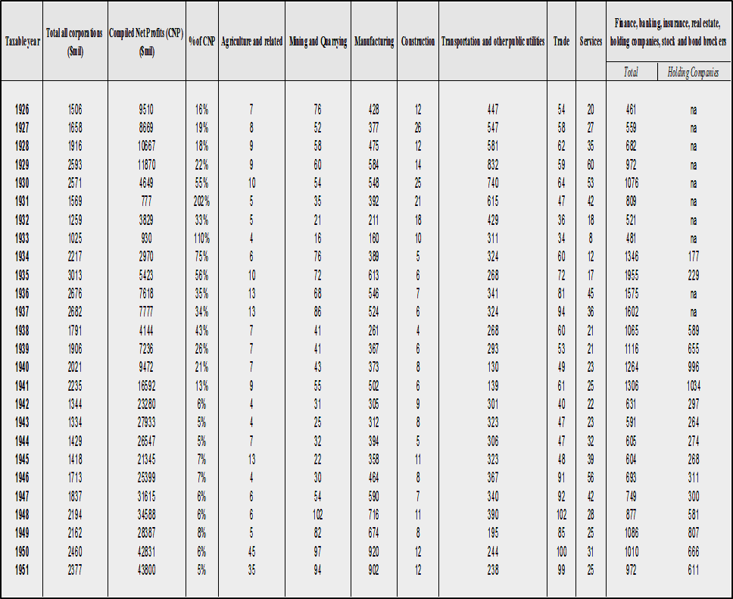
The Prevalence of Inter-corporate Dividends

Slide 54
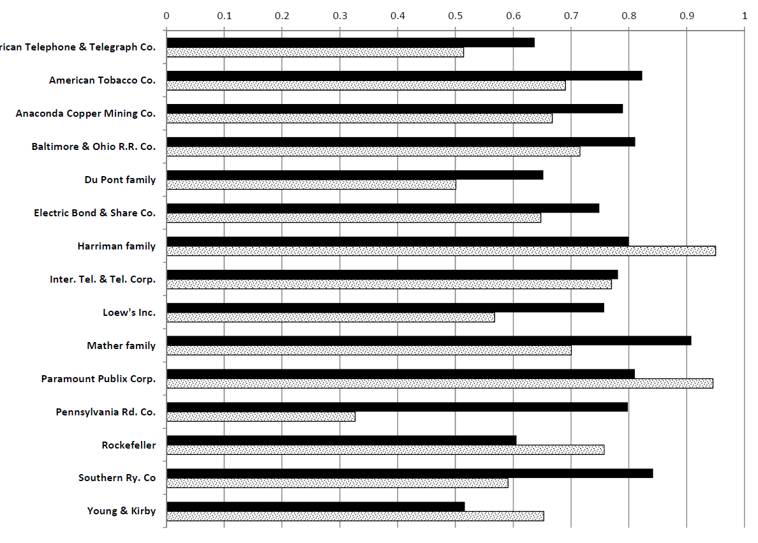
Change in Controlling Blocks in Group Affiliates, 1940-1950

Slide 55
Inter-corporate Dividend Income
(as % of corporate earnings of the recipient company)
Sources: Statistics of Income

Slide 56
Dividend Taxation (Contd.)
Decline in the number of pyramidal levels may also be due to dividend taxation
Disappearing family-controlled groups more dependent on dividends?
Companies self-professing to initiating structural changes due to dividend taxation (early, in 1937) include two group affiliates
Bottom line: Looks like dividend taxation had an effect (more difficult to measure directly than the PUHCA effect)

Slide 57
The Investment Company Act (1940)
Directed at investment funds and trusts
But potentially affecting holding companies?
President Roosevelt viewed investment companies as a means to concentrate economic power
ICA: disclosure requirements and limitations on related party transactions
Excludes companies involved in the railroads industry (supervised by the ICC) as well as holding companies included in the PUHCA
Excludes holding companies whose equity stakes exceed 50%

Slide 58
The Investment Company Act (Contd.)
No evidence that group affiliates were included in lists of affected companies (investment funds)
No evidence of legal battles in courts related to ICA
Could the increase in controlling blocks between 1940 and 1950 to levels exceeding 50% (and lower than 85%) be related to ICA?

Slide 59
Change in Controlling Blocks in Group Affiliates, 1940-1950

Slide 60
Rejuvenated Antitrust Enforcement (1940s)
Antitrust was weak between the 1920s and the 1940s (President Roosevelt said so; enforcement expenditures data reported in Fligstein, 1990)
As in the case of PUHCA we compare lists of companies involved in antitrust cases with lists of companies undergoing ownership changes after 1940 (only 66 antitrust cases in the 1930s):
640 antitrust cases during the 1940s/900 firms undergoing ownership changes (104 public companies)
Of which only 15 involved group affiliates
Of which only four were public companies
Of which two cases were dismissed
➔ Antitrust enforcement did not directly affect groups

Slide 61
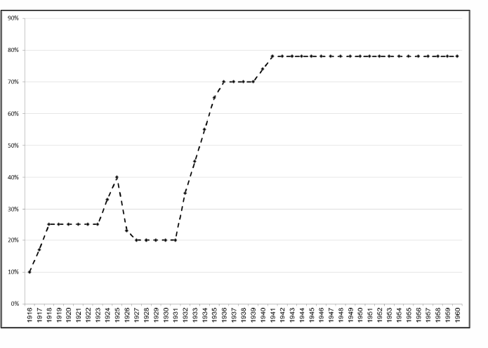
Marginal Federal Estate Tax Rate at the Highest Wealth Level, 1916- 1960
Source: Gale and Slemrod (2001)

Slide 62
Existing Mechanisms for Dealing with Estate Taxes

Slide 63
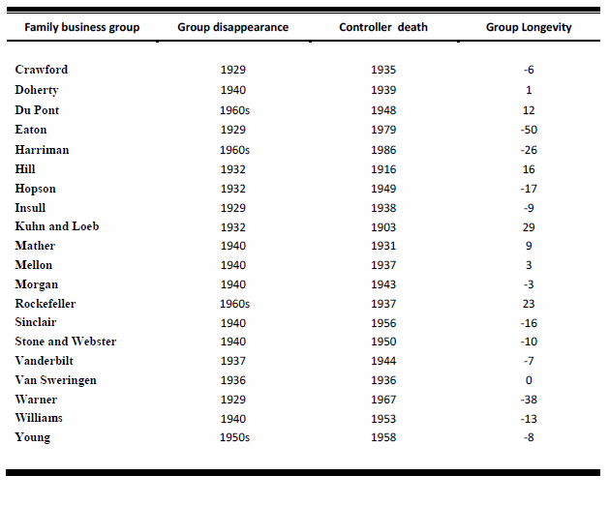
No Clear Link b/w Succession and Group Demise

Slide 64
Complete Avoidance Unlikely?
Many court cases in the 1920s on the exaggerated use of these devices? (Leaphart, Cornell Law Rev, 1930)
New Deal reduced tax loopholes? (Brownlee et al., 2002)
Donations/charity correlated with tax rates? (Fack & Landais, 2011; Clotfelter, 2012)

Slide 65
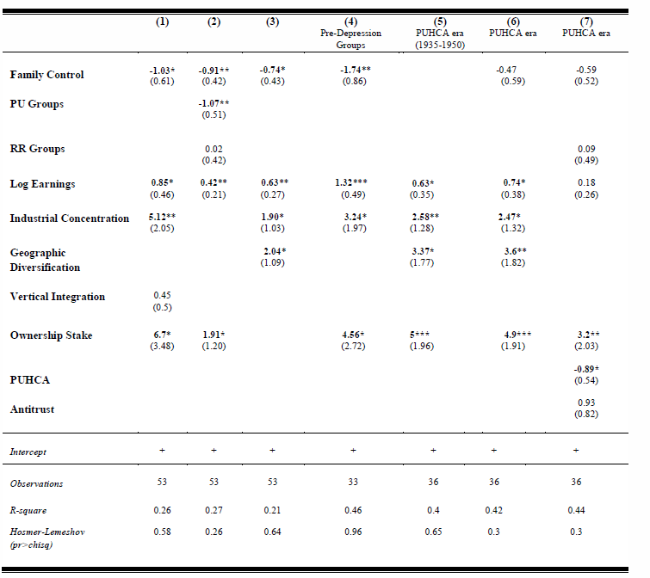
Group Survival until 1950 (probit regressions)

Slide 66
Other Factors
Glass-Steagall adversely affected ICMs?
ICC/railroad regulation: Did not attempt to reform the industry which was in decline
World War II: Increased concentration and government contracts?
Politics and the anti-group atmosphere were clearly important (in the spirit of work by Roe and others)

Slide 67
Robustness: Groups of 4+ Listed Companies
Family-controlled (green) and Widely-held Groups (Blue)

Slide 68
Conclusions/Lessons
BGs (of certain types) are not incompatible with common law and investor protection
The public discourse about them need not focus on minority shareholder expropriation
In an institutionally developed democracy, anti-group regulation is unlikely to yield immediate results due to legal (and political) challenges
A combination of forces and the right political climate are needed to achieve a dramatic ownership change? (Japan as another example)
Even measures which did not affect groups directly contributed to generating the right “climate”?

Slide 69
Evolution of Ownership in Major Economies
UK: Always dispersed, even before the introduction of formal investor protection measures (Franks et al., 2009)
Japan: The dissolution of groups and improved investor protection led to bank dominance and cross-shareholding based on block holders (Yafeh, 1995 and Franks et al., 2014)
US: Institutional similarity to the UK but nevertheless concentrated ownership and business groups until the middle of the twentieth century
US: Anti-group policy shocks as in Japan but a very different ownership structure as a result

Slide 70
Outline of a Future Research Agenda
The endogenous formation of groups: which firms were acquired and which firms were divested? (reasons for group existence)
Did the elimination of groups foster competition in the US (or in specific industries)?
Did the demise of groups affect financial development at the industry level (external financial dependence in industries without groups)?

