Slide 1
Public Audit Oversight and Reporting Credibility: Evidence from the PCAOB Inspection Regime
Brandon Gipper
Christian Leuz
Mark Maffett

Slide 2
Motivation
Accounting scandals in the early 2000s were a major shock to reporting credibility
Weak auditing was viewed as part of the problem (AA’s role in Enron)
Congress passed SOX in an effort to restore investor confidence & trust
Created the PCAOB
Required to inspect all auditors of SEC-registered companies
Major shift in audit oversight
From self-regulation and peer review to inspections by a public regulator
Significant (academic, professional, political) debate about SOX
Call for more economic analysis of SOX and PCAOB’s activities
Little evidence on overall capital-market effects of new audit regime
Did intro of the PCAOB and its inspection regime increase credibility?

Slide 3
Broader economic questions
Does audit oversight by a public-sector regulator improve trust and confidence in financial reporting?
Recent work in financial economics suggests trust is important
What are the capital-market effects of public audit oversight?
Does reporting credibility manifest in market pricing?
It is not a priori obvious audit oversight by a public-sector regulator is an improvement over prior regime
Extensive academic debate on relative merits of public vs. private enforcement (La Porta et al., 2006; Jackson/Roe, 2009)
There are various pros and cons
Notes:
We do have this at the firm-level with Big4 vs. non-Big4 (but major selection concerns and not a mandate)
Signing of financial statements (there is some debate how important this was among legal scholars). Bigger question is can you separate from SOX

Slide 4
Broader economic questions (cont.)
Pros:
Conflicts of interest between managers and auditors can reduce audit quality and credibility (e.g., impair auditor independence)
Stricter audit oversight could mitigate conflicts and hence improve reporting credibility
“In twenty-five years of operation, the profession’s self-regulated system never issued an adverse of qualified opinion on a major accounting firm.” (James Doty, PCAOB Chairman)
Cons:
Standard concerns about public regulators: Resource constraints, inefficient bureaucracies, regulatory capture, and political pressures
“Public outrage over financial scandals spurred government intervention, resulting in meaningless reforms.” (Grumet, CPA Journal, 2002)
Paper could also be view as examining a key element of SOX
Of course, SOX changed more than audit oversight
One challenge is to separate the intro of the PCAOB and its inspection regime from other SOX provisions
Notes:
Economist article essentially makes the argument that audit oversight is not enough and does not fundamentally change the problems
An accounting professional journal published in December 2002 said the recent legislative effort repeated the pattern in the late 1980s and late 1990s: “Public outrage over financial scandals spurred government intervention, resulting in meaningless reforms.” (Grumet, 2002)
After the 2008 financial crisis and the lawsuit against the PCAOB regarding its constitutional legitimacy, people changed their view on the board. An article of the Washington Post on July 11, 2010 said the PCAOB was “slow to act, veiled in secrecy and weak” and need to be replaced. Lynn E. Turner, a former chief accountant at the SEC, said he would give the board a B for its routine inspections of accounting firms, a C-minus or D-plus for its standard-setting, and an F for enforcement. Another adviser to the board, Joseph V. Carcello, said the enforcement process was “unbelievably slow.”
Palmrose (2006) suggests that PCAOB auditors lack state-of-the-art expertise because inspectors are prohibited to be active auditing professionals.

Slide 5
Introduction of the PCAOB
PCAOB inspections regime primarily affects the audit process, which is largely unobservable
Audit oversight likely operates through credibility of financial reporting
Try to identify key dates related to the introduction of the PCAOB regime
Inspection regime introduced in three phases:
One-time limited inspections (2003)
Voluntary, limited in scope, Big 4 only
Annual full inspections (2004)
Applicable to Big 4 and non-Big 4 large firms (with >100 SEC clients)
Triennial inspections (2004)
Small firms (< 100 SEC clients), 1/3 of firms phased in the first year
Exploit staggered introduction of the PCAOB
Notes:
Had extensive talks at the PCAOB
Even limited inspections were viewed as a game changer. Auditors were pretty intimidated.
Now there are monetary and career consequences for partners that have Part I findings or deficiencies.

Slide 6
Inspection process and anecdotal evidence
Inspections are designed to identify and address weaknesses and deficiencies in how audits are conducted
Audit deficiency means for instance that auditor failed to gather sufficient evidence to support an audit opinion
PCAOB first sends comment forms
Auditor can respond and provide further evidence
Inspection report:
Part I Finding - reveals deficiencies (failed to meet audit standards) without naming the audit engagement
Part II Finding – systematic quality control failures
Firm has one year to address: if adequately addressed, Part II is not disclosed
Auditors respond to both types of findings to the PCAOB and describe changes (non-public)
Notes:
One success of the inspection was the identification of an accounting violation that all four firms had failed to catch (classification of certain debt as long-term rather than current liabilities). The board asked all four firms to check other clients for the same problem. As a result, at least 20 companies had to restate their balance sheets

Slide 7
Inspection process and anecdotal evidence
Comments on new PCAOB inspections illustrates “public debate” about inspections regime:
PWC head of regulatory affairs publicly comments on process (WSJ, July 2003): “impressed by work”
CEO of KPMG published article in July 2004, saying that “reports will indicate some issues to be addressed by the accounting profession” and “we shall take those reports to heart and respond robustly.”
WSJ: PCAOB identified violation for one client and then asked all Big 4 to check their clients – lead to 20 restatements
Mulford: “Clear signal from the accounting board that it is not business as usual.”
Nicolaisen: “PCAOB’s process will lead to a sea change for the profession.”
Auditors also respond publicly saying they are committed to improve quality and address findings
Our tests are based on perceived changes in reporting credibility due to changes in audit quality and audit oversight
Notes:
One success of the inspection was the identification of an accounting violation that all four firms had failed to catch (classification of certain debt as long-term rather than current liabilities). The board asked all four firms to check other clients for the same problem. As a result, at least 20 companies had to restate their balance sheets

Slide 8
Research design
Use ERCs as a measure of reporting credibility & trust
Based on Holthausen and Verrecchia (1988)
Market response per unit of earnings surprise
If reported earnings are more credible there should be a stronger earnings response (ceteris paribus)
Maps into the cost of capital (or capitalization of earnings)
ERCs are not anticipatory, which allows us to exploit the staggered introduction
PCAOB needs to conduct inspections for credibility to change
Short-window reactions at different points in time
Timing depends on phase-in of inspection regime and FYE
Mitigates concerns about unrelated concurrent events

Slide 9
Identification strategy
But there is still a concern that concurrent market and regulatory events affect ERCs through other reporting changes
Market responses to the accounting scandals
Other SOX provisions overlap some of our tests (notably 404[b])
Key challenge is to separate the effects of the PCAOB and its inspection regime from other events that affect reporting
Conduct three separate analyses
Limited and full inspections of Big 4 and non-Big 4 large auditors
Need a control group: foreign issuers cross-listed on U.S. exchanges
Drop foreign issuers as PCAOB signs inspection agreements with respective home countries
Triennial-firm inspections
Abnormal volume analysis

Slide 10
Identification strategy
Conduct difference-in-differences analyses of the ERC using earnings announcements 2 years before and after the respective event
When does the market adjust assessments of earnings credibility?
Audits and inspections are largely unobservable
It is not obvious when investors adjust their assessments whether the PCAOB regime has increased audit quality
Use two alternative cutoff dates for “post” treatment variable
Shortly after the “treatment” of auditors (i.e., after field work)
When inspections report is released
Inspection report could also provide information about the regime
Results are not additive

Slide 11
Table 3: Limited and full inspections
Table 3: Panel A
Dependent Variable: Cumulative Abnormal Returns | (2) | (3) | (4) | (5)
 | OLS | WLS | OLS of Deciles | WLS
Post x Treated x UE | 0.264 | 0.358** | 0.078** | 0.368**
 | (1.181) | (2.469) | (2.050) | (2.392)
Observations | 41,830 | 41,620 | 41,830 | 41,620
R-squared | 0.024 | 0.044 | 0.063 | 0.050
Firm Characteristics Main Effects | Yes | Yes | Yes | Yes
Fixed Effects | Auditor & Country | Auditor & Country | Auditor & Country | Auditor & Country & Year-Quarter
Treatment Indicators (Post, Treated, Post x Treated) | Yes | Yes | Yes | Yes
UE x Fixed Effects | Yes | Yes | Yes | Yes
UE x Firm Characterstics | Yes | Yes | Yes | Yes
UE x Treatment Indicators | Yes | Yes | Yes | Yes
Robust t-statistics in parentheses
*** p<0.01, ** p<0.05, * p<0.1

Slide 12
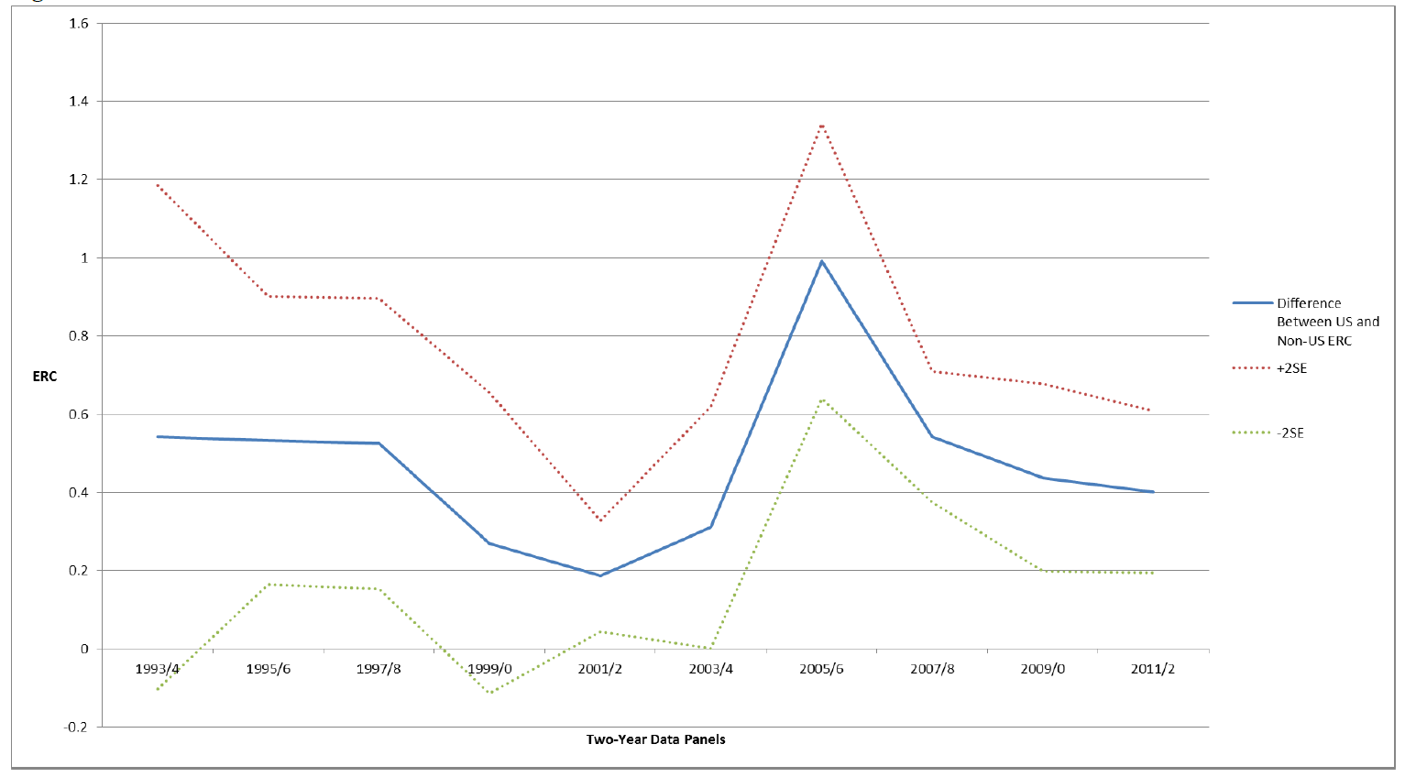
Difference in ERCs over time

Slide 13
Summary of Key Results
ERC effects start to appear with the release of limited inspection reports and are strongest for full inspections
Makes sense
Falsification exercise shows that counterfactually shifting the treatment date makes results go away
There is a window between the end of the fieldwork and the release of the reports during which the results occur
Use alternative credibility proxy
Abnormal trading volume around the release of the 10-K filing:
Captures response by investors; more credible reports should have stronger response
Find significant increase in abnormal trading volume with same design

Slide 14
Concerns about other moving parts
Potential concern is that stricter audit oversight affects other aspects of information environment
Disclosures over the course of the year
Change in managerial bias in earnings
Transitory and permanent components of earnings
Analyst forecasts
We explore changes in these factors using the same DiD design
There is little evidence that other components of the ERC are systematically changing or that this affects our results

Slide 15
Other threats to identification
Market responses to the accounting scandals
Other SOX provisions overlap some of our tests (notably 404[b])
We provide tests that results are not only concentrated in firms that have strongest incentives to respond to scandals
Firms that are former AA clients
Results are not concentrated in firms that have to comply with Section 404[b]

Slide 16
Triennial-firm inspections
Phased in over three years
Rollout separates PCAOB regime from SOX
Do not need to use foreign firms as control group
Can use other triennial auditors and their clients as a control
Fewer concerns about parallel trend assumption
Demanding FE design that looks for an effect around the change in inspections regime for their auditor
Results are similar though somewhat weaker in magnitude and significance
One possible explanation is that we didn’t quite separate concurrent SOX effects in earlier analyses as successfully
Less power and stringent within-design

Slide 17
Conclusions
Findings are consistent with an increase in reporting credibility due to public audit oversight
ERCs increase significantly following the introduction of the PCAOB regime
Abnormal volume responses around 10-K filing increase
Results provide evidence on capital-market effects (or benefits) from public audit oversight
Further evidence that reporting credibility is priced in markets and ERCs in predicted way

Slide 19
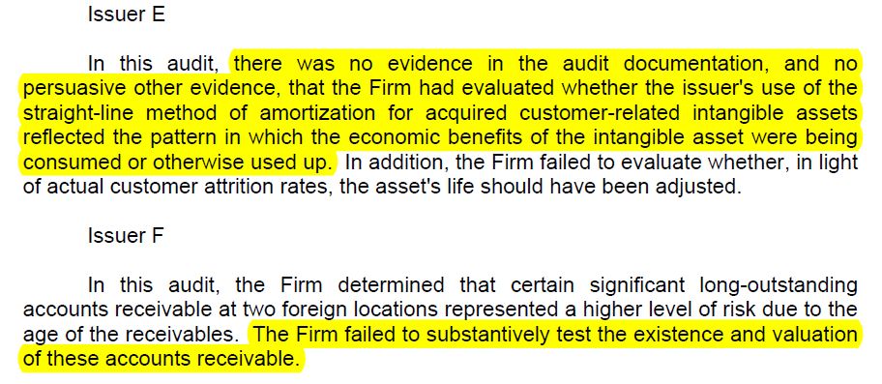
Inspection Report Part I Example
Notes:
The barrier that we look at is arguably different from the barriers in the prior literature (more explicit). Ours is more like language but language does not change (so no diff-in-diff)

Slide 20
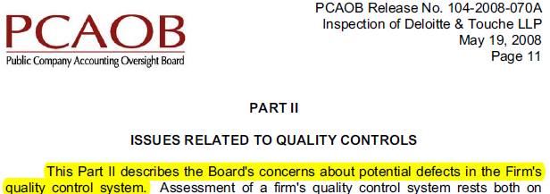
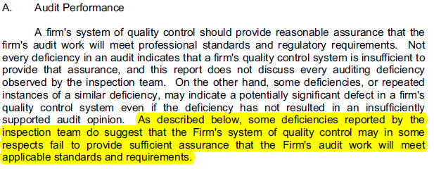
Inspection Report Part II Example
Notes:
The barrier that we look at is arguably different from the barriers in the prior literature (more explicit). Ours is more like language but language does not change (so no diff-in-diff)

Slide 21
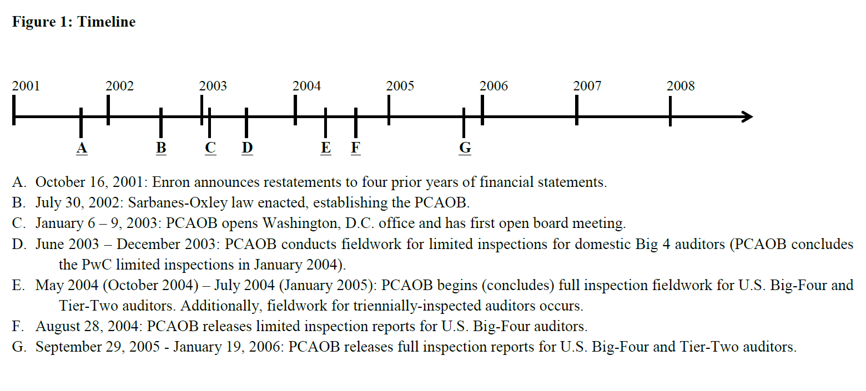
Time Line
Note that the events and analyses overlap
Results are not additive

Slide 22
Fixing ideas (continued)
Market’s Credibility Assessment
ERC
ERC Response
Firm announces E
Shock
SOX
PCAOB
Field Work
Inspection Report
Time
Timing of ERC response assumes that market adjusts to the PCAOB inspection regime after the inspection reports come out
Notes:
Market expects PCAOB regime to enhance the credibility of reporting and reacts when the regime is established.
However, credibility is not actually enhanced until the PCAOB interacts with the audit firms, can’t respond until first public earnings release after the inspection. At the first inspection report subsequent to treatment market responds to earnings based on the expected credibility
Treatment occurs at the time when the market expects the audit firm to change its practices based on its interaction with the PCAOB
This could be either after the commencement of fieldwork (we look 30 days after)
Or when the PCAOB publicly releases its inspection report
However, the release of the inspection report may also reveal information that causes the market to revise their expectations of credibility, this could lead to an additional upward or downward move in credibility

Slide 23
Data
We obtain:
(a) accounting, auditor, and market data from Compustat,
(b) additional auditor data from Audit Analytics,
(c) analyst forecasts and accounting data from I/B/E/S
(d) market data from CRSP, and
(e) fieldwork and inspection dates from PCAOB’s website
Merge these datasets into an issuer-year panel
In principle, quarter ERCs are available but not audited
Notes:
Applied for access to LFS.
Point out advantage of LFS over prior sources used in labor econ.

Slide 24
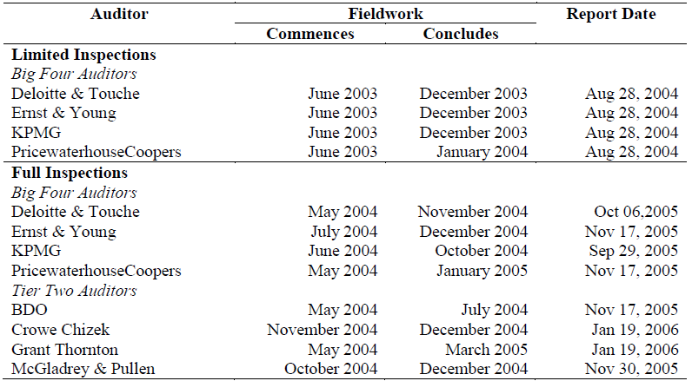
Big4 & Tier Two Fieldwork and Report Dates
Notes:
The barrier that we look at is arguably different from the barriers in the prior literature (more explicit). Ours is more like language but language does not change (so no diff-in-diff)

Slide 25
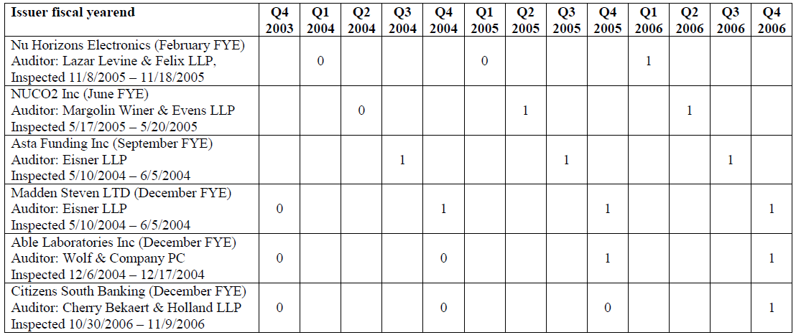
Coding the Post variable
Notes:
The barrier that we look at is arguably different from the barriers in the prior literature (more explicit). Ours is more like language but language does not change (so no diff-in-diff)

Slide 26
Fixing ideas
Market’s Credibility Assessment
ERC
ERC
Inspection Report leads to upward revision
Inspection Report does not change assessment
ERC Response
Inspection Report leads to downward revision
Firm announces E
Firm announces E
Shock
SOX
PCAOB
Field Work
Inspection Report
Time
Timing of ERC response assumes that investors expect the “treatment” to take place around the time the field work is completed
Notes:
Market expects PCAOB regime to enhance the credibility of reporting and reacts when the regime is established.
However, credibility is not actually enhanced until the PCAOB interacts with the audit firms, can’t respond until first public earnings release after the inspection. At the first inspection report subsequent to treatment market responds to earnings based on the expected credibility
Treatment occurs at the time when the market expects the audit firm to change its practices based on its interaction with the PCAOB
This could be either after the commencement of fieldwork (we look 30 days after)
Or when the PCAOB publicly releases its inspection report
However, the release of the inspection report may also reveal information that causes the market to revise their expectations of credibility, this could lead to an additional upward or downward move in credibility

Slide 27
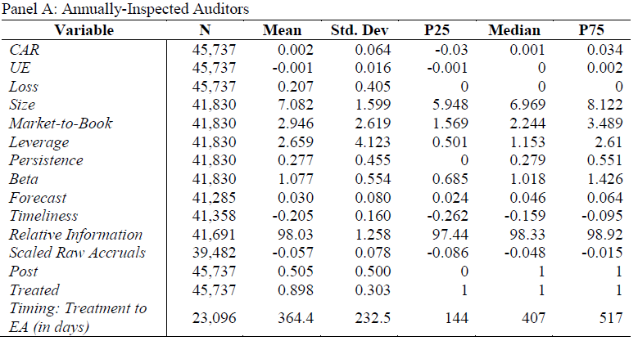
Table 2: Descriptive Statistics

Slide 28
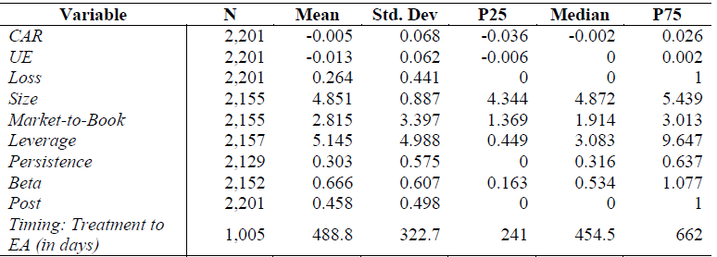
Table 2: Descriptive Statistics

Slide 29
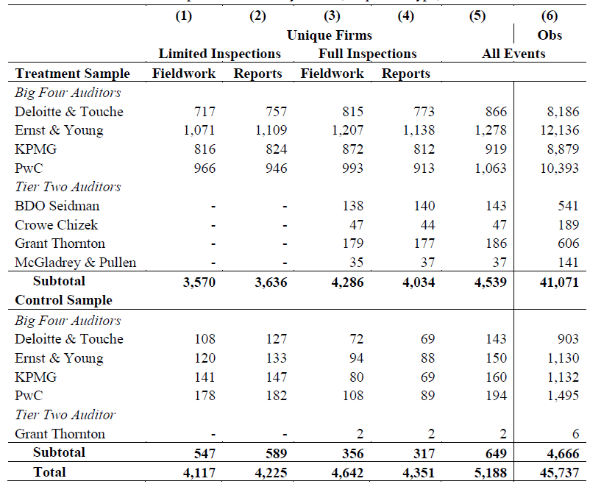
Countries

Slide 30
Table 3: Limited and full inspections
Table 3: Panel A
Dependent Variable: Cumulative Abnormal Returns | (1)
Independent Variables | OLS
UE | 0.481**
 | (2.086)
UE x Loss | -0.491***
 | (-3.658)
UE x Size | -0.006
 | (-0.264)
UE x M2B | 0.031
 | (1.261)
UE x Leverage | -0.002
 | (-0.162)
UE x Persistence | 0.073
 | (1.087)
UE x Beta | 0.298***
 | (4.436)
Constant | 0.003
 | (0.933)
Observations | 41,830
R-squared | 0.018

Slide 31
Table 3 Panel B: Limited and full inspections
Table 3: Panel B
Dependent Variable: Cumulative Abnormal Returns | (1) | (2) | (3) | (4)
 | Limited Inspections |  | Full Inspections
 | Fieldwork | Inspection Reports | Fieldwork | Inspection Reports
Post x Treated x UE | -0.023 | 0.323 | 0.903*** | 0.935**
 | (-0.113) | (1.609) | (3.254) | (2.446)
Observations | 9,499 | 10,012 | 12,076 | 10,020
R-squared | 0.057 | 0.054 | 0.050 | 0.057
Firm Characteristics Main Effects | Yes | Yes | Yes | Yes
Fixed Effects | Auditor & Country & Year-Quarter | Auditor & Country & Year-Quarter | Auditor & Country & Year-Quarter | Auditor & Country & Year-Quarter
Treatment Indicators | Yes | Yes | Yes | Yes
UE*Firm Characteristics | Yes | Yes | Yes | Yes
UE*Fixed Effects | Yes | Yes | Yes | Yes
UE*Treatment Indicators | Yes | Yes | Yes | Yes
Robust t-statistics in parentheses
*** p<0.01, ** p<0.05, * p<0.1

Slide 32
Concerns about other moving parts
There is little evidence that other components of the ERC are systematically changing
Table 4: Information Changes
 | (1) | (2) | (3) | (4) | (5)
Dependent Variables: | UE | Analyst Forecasts | Timeliness | Predicted Relative Info | Scaled Raw Accruals
Post x Treated | -0.003** | 0.000 | 0.005 | 0.027*** | -0.002
 | (-2.574) | (0.152) | (0.646) | (4.222) | (-0.550)
Observations | 41,830 | 41,285 | 41,358 | 41,239 | 39,482
R-squared | 0.047 | 0.395 | 0.244 | 0.344 | 0.151
Firm Characteristics Main Effects | Yes | Yes | Yes | Yes | Yes
Fixed Effects | Auditor & Country & Year-Quarter | Auditor & Country & Year-Quarter | Auditor & Country & Year-Quarter | Auditor & Country & Year-Quarter | Auditor & Country & Year-Quarter
Treatment Indicators | Yes | Yes | Yes | Yes | Yes

Slide 33
Table 5: Market responses to accounting scandals
Table 5: Robustness to Alternative Explanations
Dependent Variable: Cumulative Abnormal Returns | (1) | (2)
 | No Arthur Andersen: WLS | Only Arthur Andersen: WLS
Post x Treated x UE | 0.410** | 0.248
 | (2.537) | (1.271)
Observations | 35,462 | 10,093
R-squared | 0.054 | 0.085
Firm Characteristics Main Effects | Yes | Yes
Fixed Effects | Auditor & Country & Year-Quarter | Auditor & Country & Year-Quarter
Treatment Indicators | Yes | Yes
UE x Firm Characteristics | Yes | Yes
UE x Fixed Effects | Yes | Yes
UE x Treatment Indicators | Yes | Yes
Test Equality to Column: |  | (1)
Chi^2 Statistic |  | 0.82
P> Chi^2 Statistic |  | 0.366

Slide 34
Table 5: Other SOX provisions and Section 404
Table 5: Robustness to Alternative Explanations
Dependent Variable: Cumulative Abnormal Returns | (3) | (4) | (5) | (6)
 | Non Acc Filers: WLS | Treated Acc Filers: WLS | No AUOPIC: WLS | Treated AUOPIC: WLS
Post x Treated x UE | 0.584*** | 0.380** | 0.366** | 0.013
 | (2.789) | (2.381) | (2.068) | (0.068)
Observations | 10,106 | 35,449 | 25,550 | 20,005
R-squared | 0.107 | 0.048 | 0.060 | 0.063
Firm Characteristics Main Effects | Yes | Yes | Yes | Yes
Fixed Effects | Auditor & Country & Year-Quarter | Auditor & Country & Year-Quarter | Auditor & Country & Year-Quarter | Auditor & Country & Year-Quarter
Treatment Indicators | Yes | Yes | Yes | Yes
UE x Firm Characteristics | Yes | Yes | Yes | Yes
UE x Fixed Effects | Yes | Yes | Yes | Yes
UE x Treatment Indicators | Yes | Yes | Yes | Yes
Test Equality to Column: |  | (3) |  | (5)
Chi^2 Statistic |  | 1.23 |  | 1.93
P> Chi^2 Statistic |  | 0.268 |  | 0.165

Slide 35
Falsification exercise: Full Inspection Fieldwork
Dependent Variable: Cumulative Abnormal Returns | (1) | (2) | (3) | (4) | (5)
 | Lag 2 | Lag 1 | No Adjustment | Plus 1 | Plus 2
Post x Treated x UE | 0.202 | -0.011 | 0.903*** | 0.892*** | 0.290
 | (0.629) | (-0.036) | (3.254) | (2.906) | (1.116)
Observations | 10,840 | 11,428 | 12,076 | 12,316 | 12,248
R-squared | 0.051 | 0.046 | 0.050 | 0.053 | 0.071
Firm Characteristics Main Effects | Yes | Yes | Yes | Yes | Yes
Fixed Effects | Auditor & Country & Year-Quarter | Auditor & Country & Year-Quarter | Auditor & Country & Year-Quarter | Auditor & Country & Year-Quarter | Auditor & Country & Year-Quarter
Treatment Indicators | Yes | Yes | Yes | Yes | Yes
UE*Firm Characteristics | Yes | Yes | Yes | Yes | Yes
UE*Fixed Effects | Yes | Yes | Yes | Yes | Yes
UE*Treatment Indicators | Yes | Yes | Yes | Yes | Yes
Specific dates matter for the effect
Makes it unlikely that we capture trend in ERCs

Slide 36
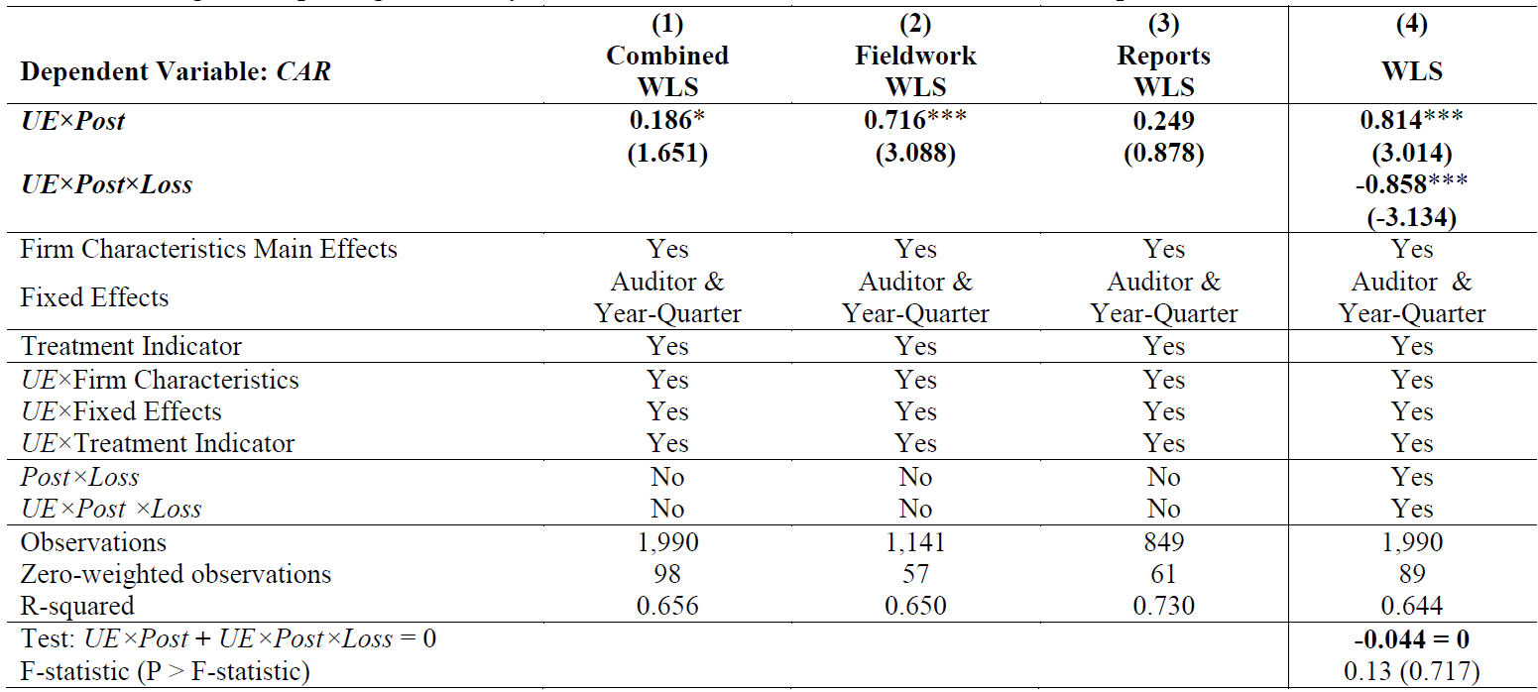
Triennial-firm inspections

Slide 37
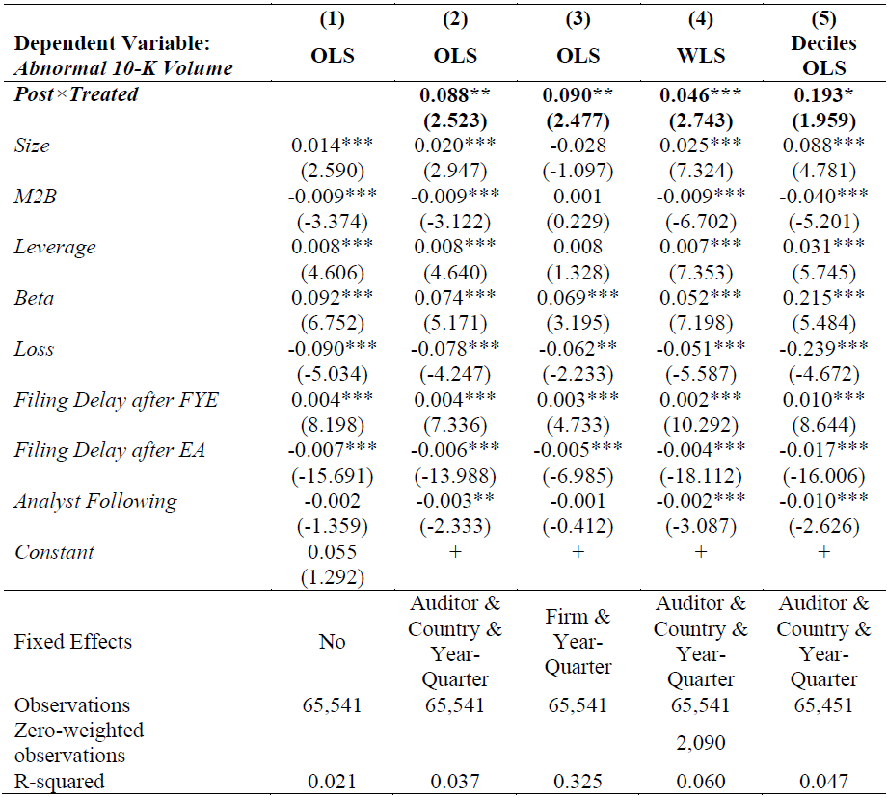
Abnormal volume analysis

Slide 38
Prior literature on auditing and reporting credibility
Holthausen and Verrecchia (1988)
Investor’s response to an earnings surprise will depend on the perceived credibility of the earnings report
Teoh and Wong (1993)
provide evidence that ERCs reflect perceived audit quality, use size as proxy for credibility
Moreland (1995)
SEC sanctions of audit firms lead to lower credibility/ERCs
Ghosh and Moon (2005)
ERCs are higher for auditors with longer tenure
Francis and Ke (2006)
ERCs/Credibility is significantly lower for firms with high levels of non-audit fees
Aobdia et al. (2015)
Use Taiwanese data, find higher ERCs for higher quality audit partners

Slide 39
Prior literature on audit oversight
Watts and Zimmerman (1983)
Auditor incentives are crucial for audit credibility
there are agency problems between managers and auditors
the credibility of an audit depends crucially on the independence of the auditor as well as the thoroughness with which the audit is conducted
Hilary and Lennox (2005)
Peer review opinions provided credible information about quality differences between audit firms
Lennox and Pittman (2009)
Audit clients do not perceive that PCAOB inspections have information value (no switching based on favorable/unfavorable reports)
Notes:
The barrier that we look at is arguably different from the barriers in the prior literature (more explicit). Ours is more like language but language does not change (so no diff-in-diff)

Slide 40
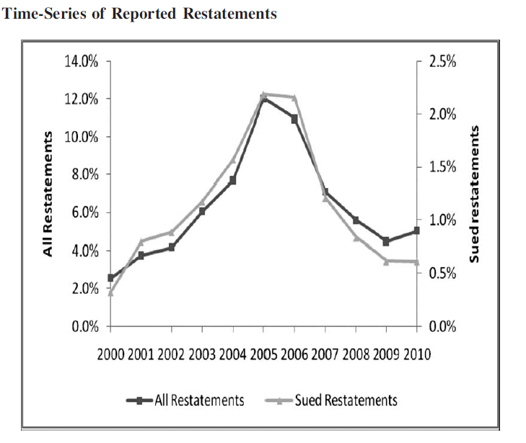
Restatements

Slide 41
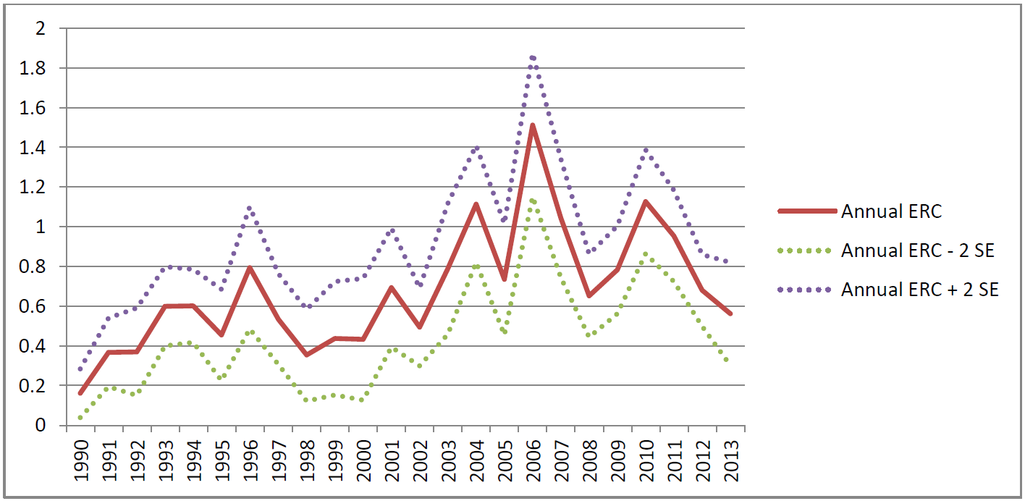
ERCs (Annual)

Slide 42
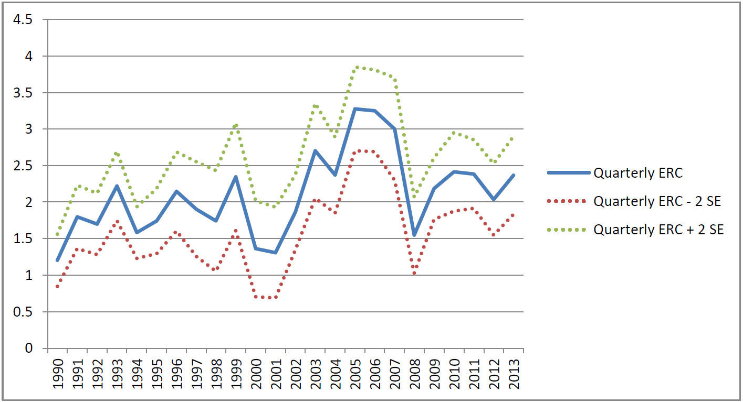
ERCs (Last Quarter)

