Slide 1

Introduction
Marco Becht
Professor of Finance, Solvay Brussels School
Executive Director and Fellow, ECGI
ECGI RESPONSIBLE CAPITALISM SUMMIT | 21 OCTOBER 2022

Slide 2
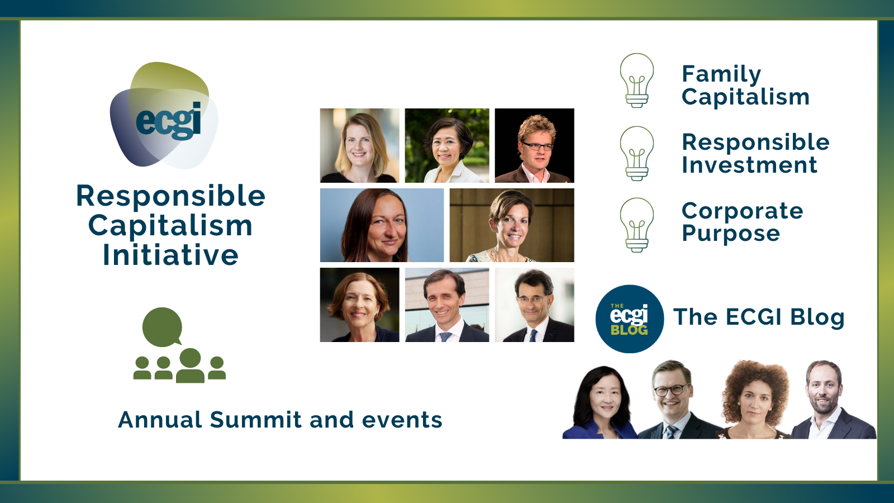

Slide 3

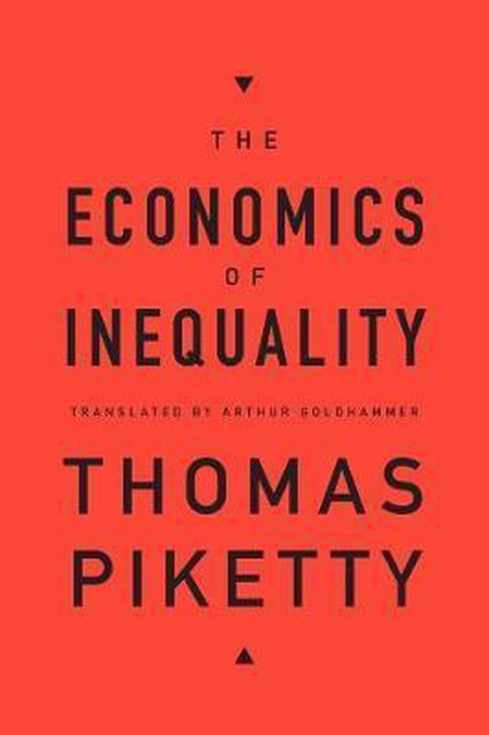
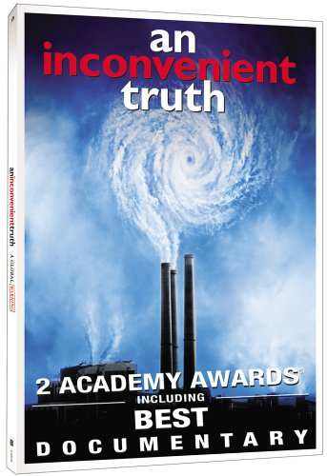
The Affluent Society
Capitalism has been very successful in moving much of the world from subsistence to affluence.
but ….
and ….
1958
2015
2006

Slide 4
Irresponsible Capitalism
What is irresponsible capitalist behaviour?
“Pursuit of self-interest with guile” (Oliver Williamson, 1975).
Irresponsible capitalism means economic actors selling goods and services that cause harm for people or the planet, in the pursuit of profit or power.

Slide 5
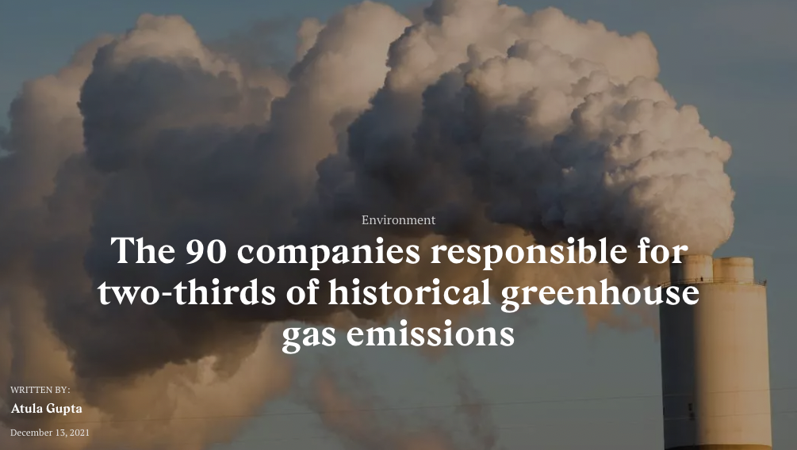
The Effluent Society
Ekwurzel, B., Boneham, J., Dalton, M.W. et al. The rise in global atmospheric CO₂, surface temperature, and sea level from emissions traced to major carbon producers. Climatic Change 144, 579–590 (2017). https://doi.org/10.1007/s10584-017-1978-0

Slide 6
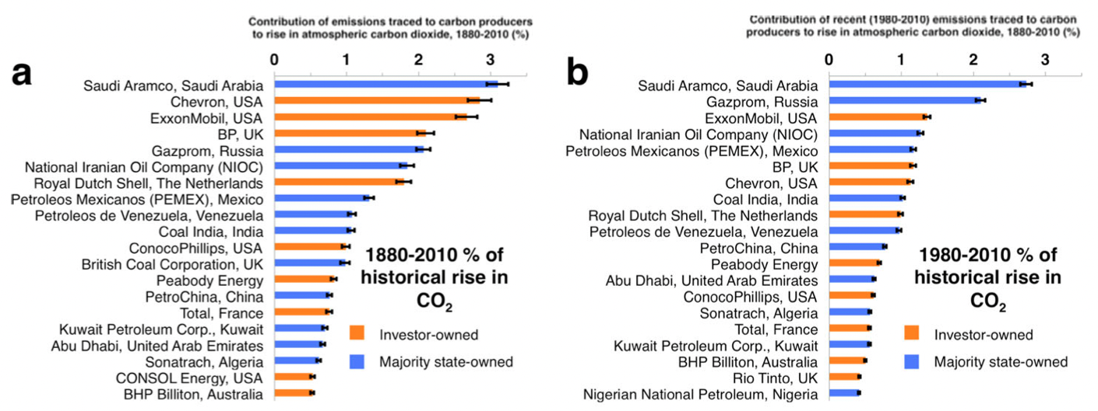
When did fossil fuel exploration and production become irresponsible?
1988 Toronto conference …. 1997 Kyoto Protocol ….

Slide 7
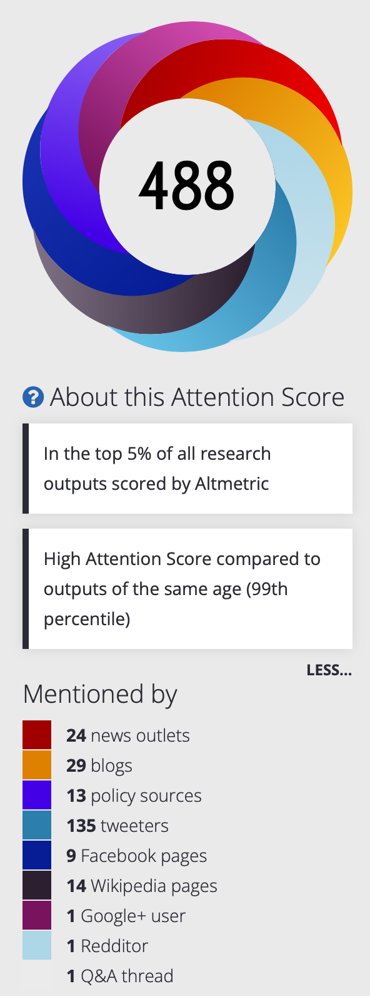
350 ppm – Watershed Scientific Article published in 2008
Abstract
Paleoclimate data show that climate sensitivity is ~3°C for doubled CO₂, including only fast feedback processes. Equilibrium sensitivity, including slower surface albedo feedbacks, is ~6°C for doubled CO₂ for the range of climate states between glacial conditions and ice-free Antarctica. Decreasing CO was the main cause of a cooling trend that began 50 million years ago, the planet being nearly ice-free until CO fell to 450 ± 100 ppm; barring prompt policy changes, that critical level will be passed, in the opposite direction, within decades. If humanity wishes to preserve a planet similar to that on which civilization developed and to which life on Earth is adapted, paleoclimate evidence and ongoing climate change suggest that CO₂ will need to be reduced from its current 385 ppm to at most 350 ppm, but likely less than that. The largest uncertainty in the target arises from possible changes of non-CO₂ forcings. An initial 350 ppm CO₂ target may be achievable by phasing out coal use except where CO₂ is captured and adopting agricultural and forestry practices that sequester carbon. If the present overshoot of this target CO₂ is not brief, there is a possibility of seeding irreversible catastrophic effects.
Hansen, J., Sato, M., Kharecha, P., Beerling, D., Berner, R., Masson-Delmotte, V., Pagani, M., Raymo, M., Royer, D.L., Zachos, J.C., 2008. Target Atmospheric CO2: Where Should Humanity Aim? The Open Atmospheric Science Journal 2, 217–231. https://doi.org/10.2174/1874282300802010217

Slide 8
Evolution of Global
CO2 Level
Direct Measurement
Data Source: NASA
https://climate.nasa.gov/vital-signs/carbon-dioxide/

Slide 9
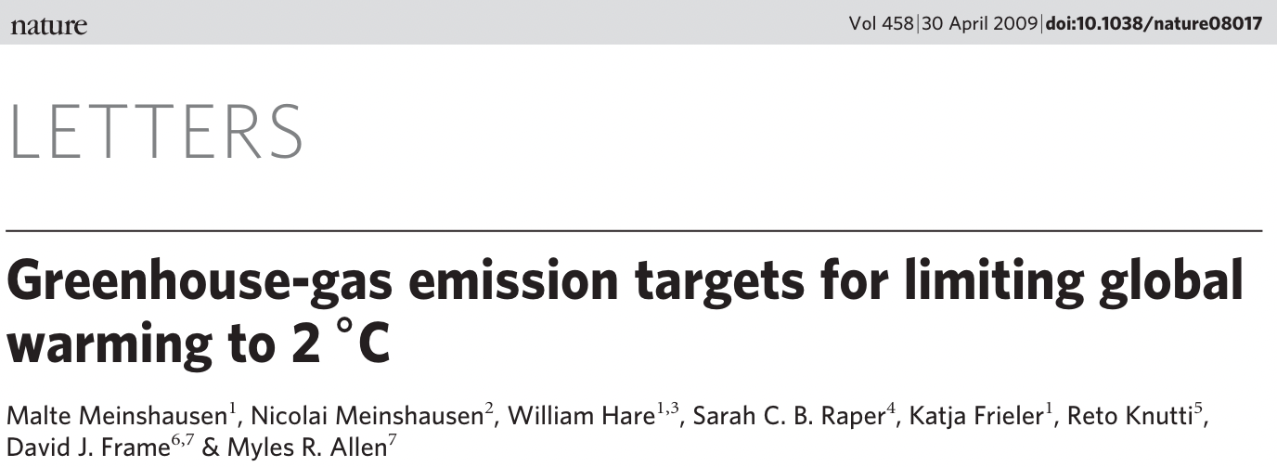
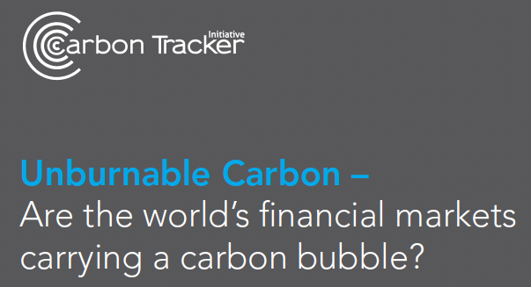
The Carbon Budget
Nature
2009: First estimate of volume of CO2 emissions to keep within 2 degree centigrade global warming;
2011: Carbon Tracker Initiative applies carbon budget concept to listed companies; what is their emissions potential?
(accessed April 2022)

Slide 10
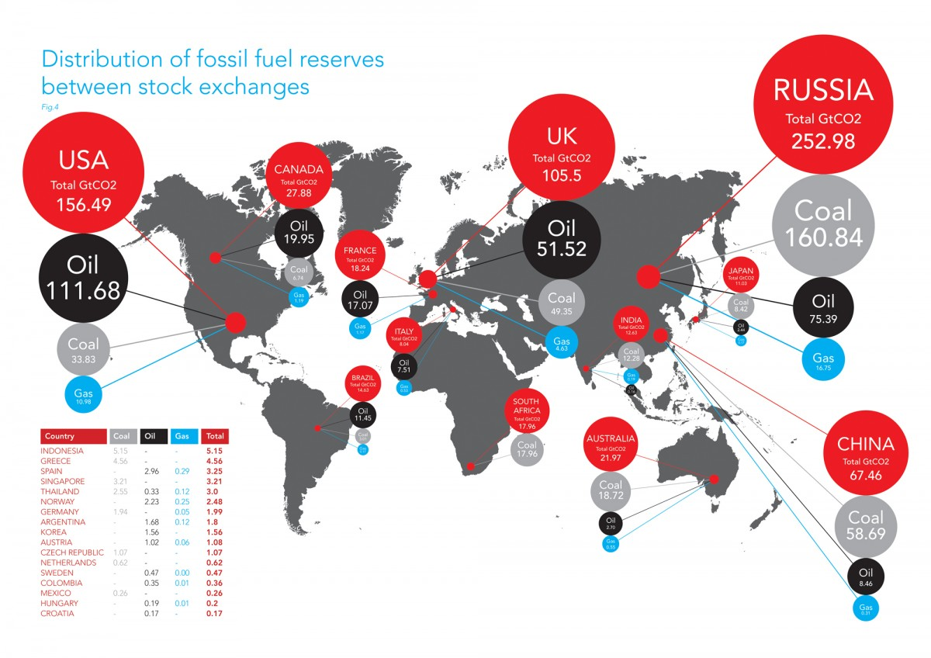
Campanale, M., Leggett, J., Leaton, J., 2011. Unburnable Carbon Are the world’s–financial markets carrying a carbon bubble? Carbon Tracker Initiative, London.
Unburnable Carbon
by Stock Market in 2011

Slide 11
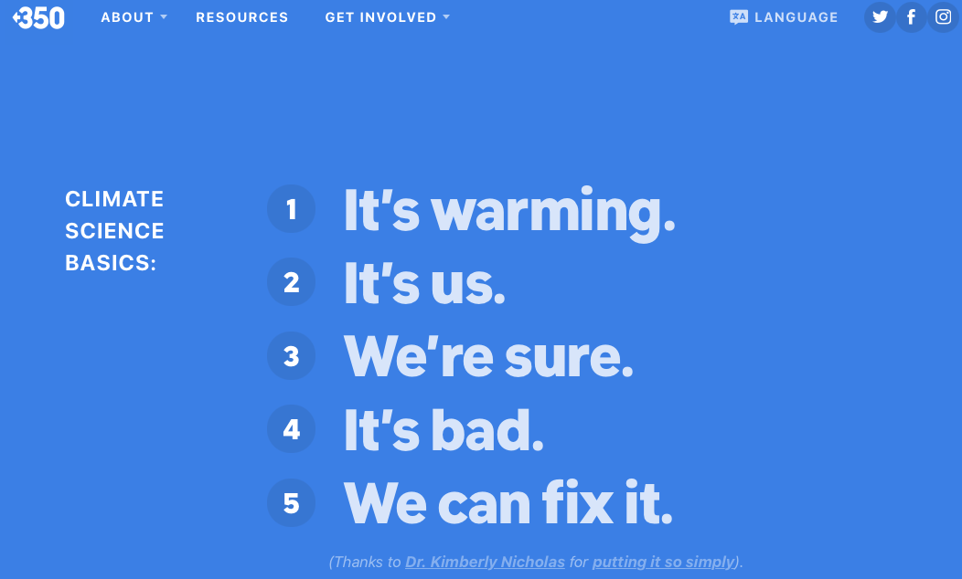
350.org
https://350.org/science/

Slide 12
Milton Friedman on the corporation
“[A] corporate executive is an employee of the owners of the business.“ It is the responsibility of the executives to “conduct the business in accordance with [the owners’] desires, which generally will be to make as much money as possible while conforming to the basic rules of the society, both those embodied in law and those embodied in ethical custom.”
Milton Friedman, The Social Responsibility of Business is to Increase its Profits, The New York Times Magazine, 13 September 1970.

Slide 13
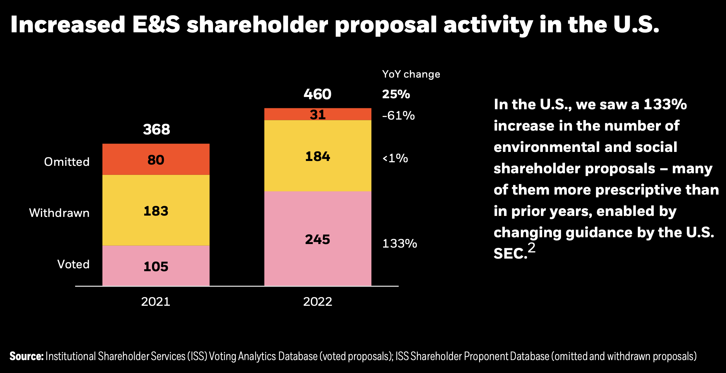
https://www.blackrock.com/corporate/literature/publication/2022-investment-stewardship-voting-spotlight-summary.pdf

Slide 14
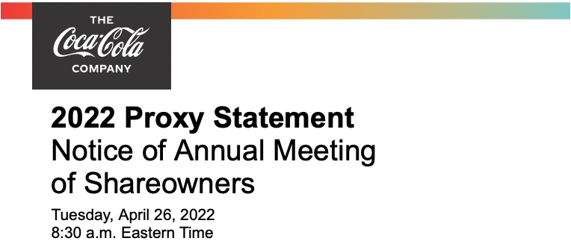
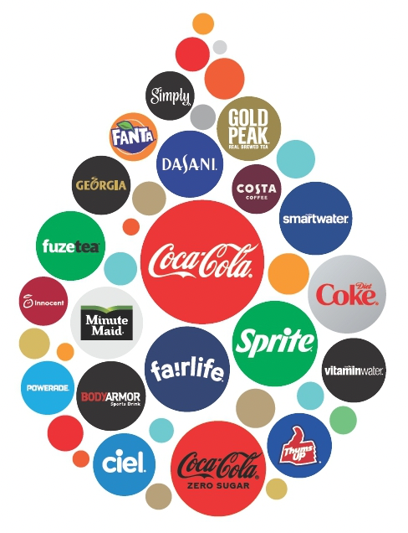


Slide 15
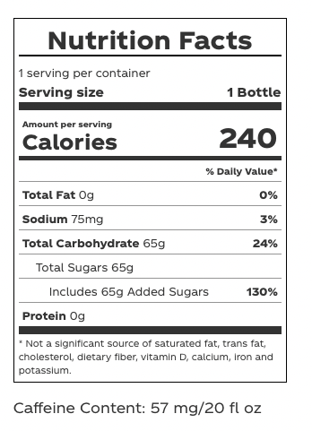
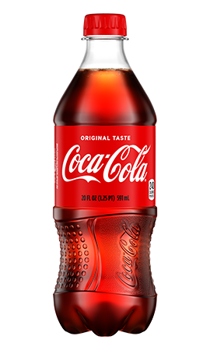

Slide 16
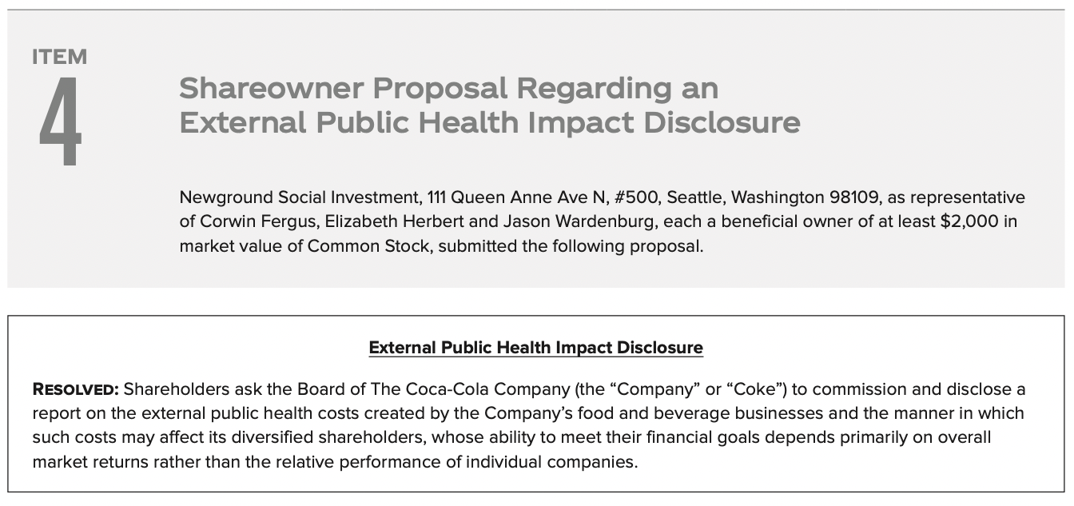
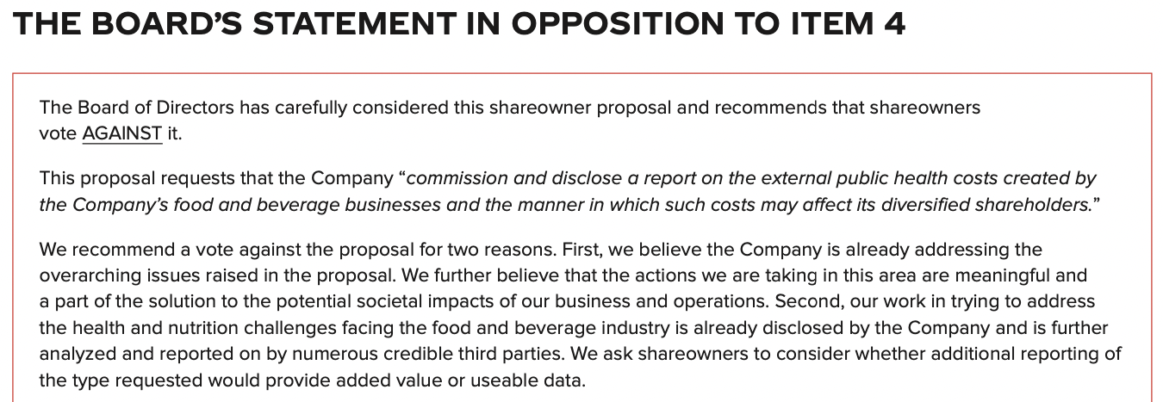
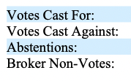


Slide 17
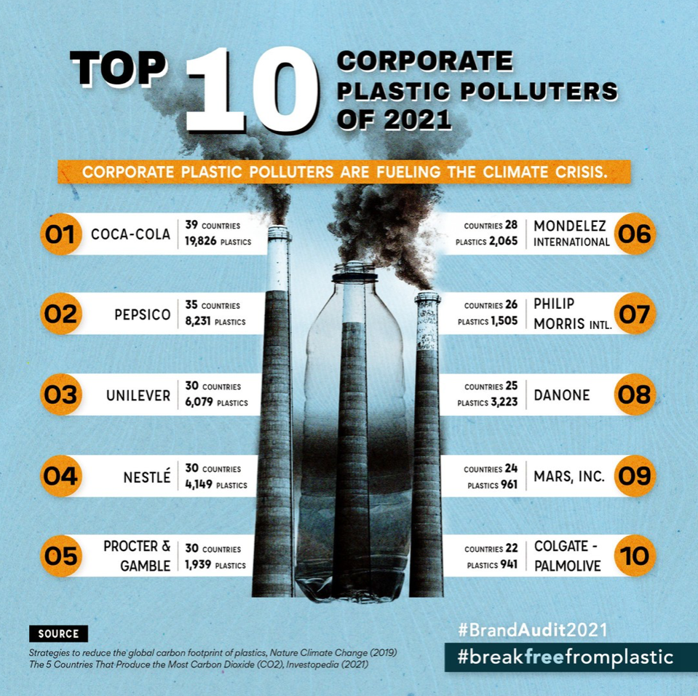

Slide 18

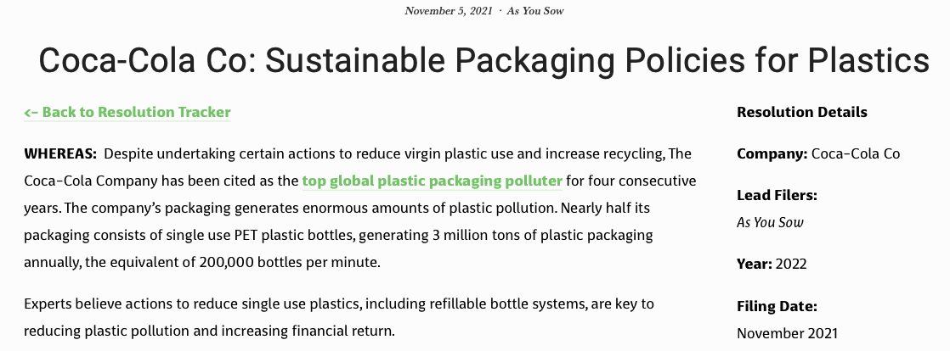

Slide 19
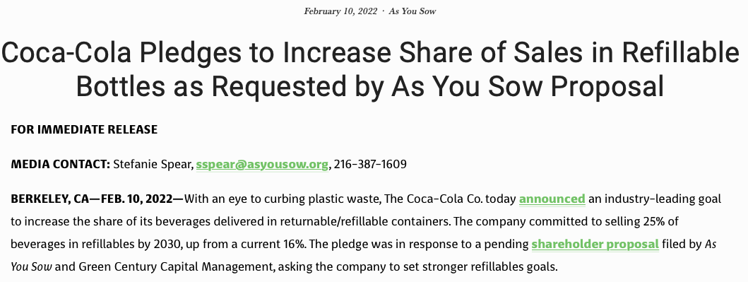
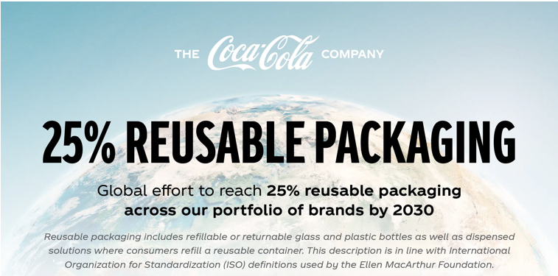

Slide 20
The Market for Corporate Control
Responsible behaviour that does not immediately translate into financial performance is subject to control challenges.

Slide 21
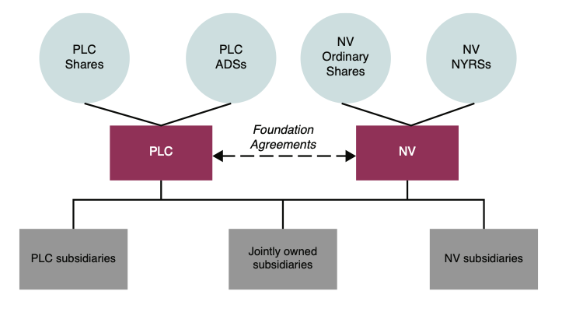
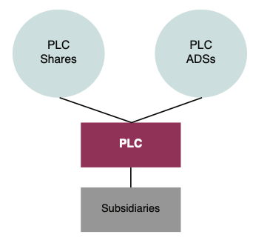
Unilever Plc / NV
Opening up for hostile bids: Unification of the Dutch and UK parts completed in November 2020
Source: Prospectus
https://www.unilever.com/Images/unilever-plc-and-unilever-nv-shareholder-circular_tcm244-553855_en.pdf

Slide 22
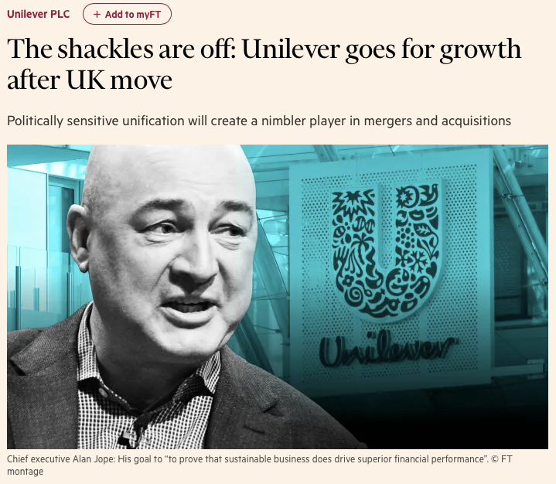
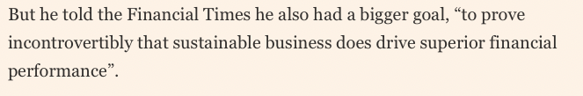

Acquirer or Target?

Slide 23

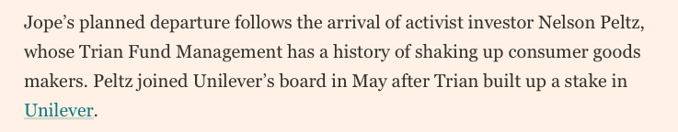

Slide 24
The Role of Families
Most companies in the world are controlled by families
Family controlled companies are less exposed to the market for corporate control
Are families behaving responsibly?

Slide 25
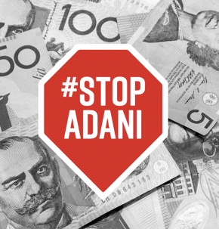
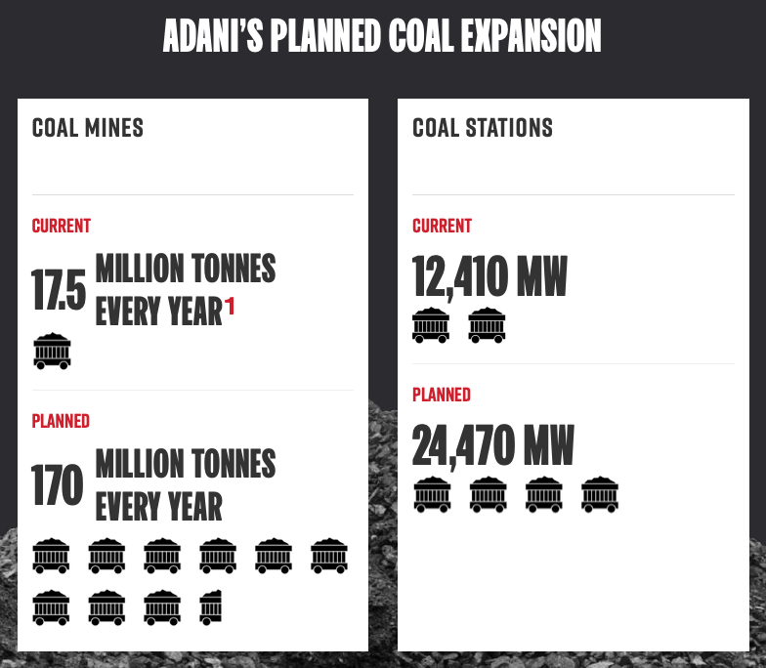
“If Adani’s mine and all the other coal mines proposed for the region reach full production by 2030, the Galilee Basin on its own could account for up to 5.45 per cent of global climate pollution in 2030.”
(Climate Analytics, 2019)
https://www.stopadani.com

Slide 26
The Role of the State
Two main issues
Regulatory capture (George Stigler)
The state as an economic actor

Slide 27
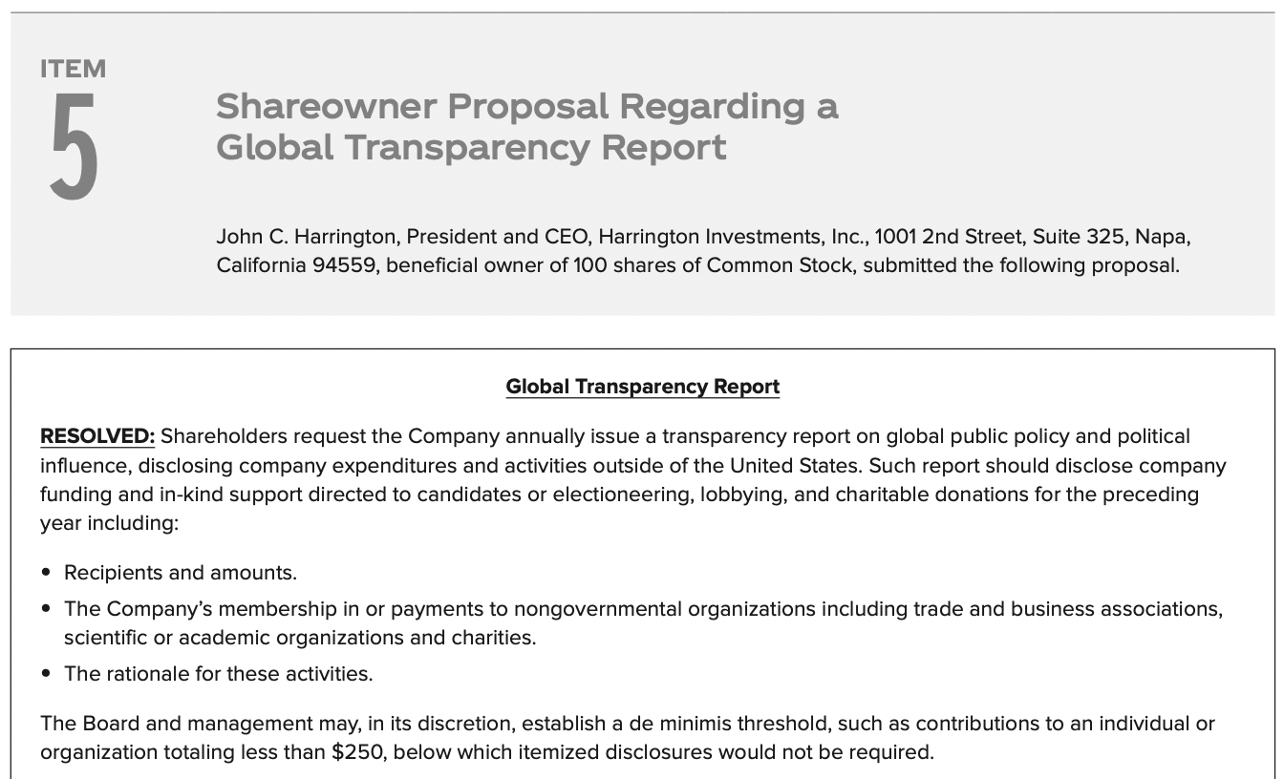
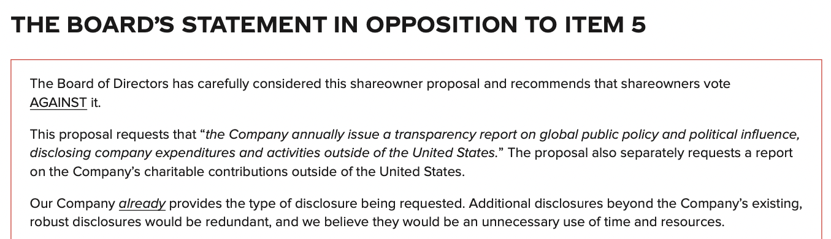
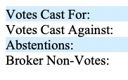
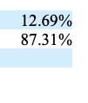

Slide 29
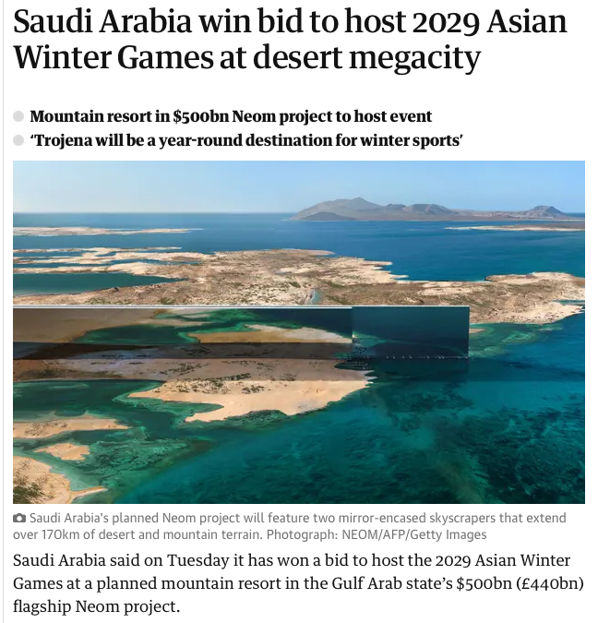

Slide 30


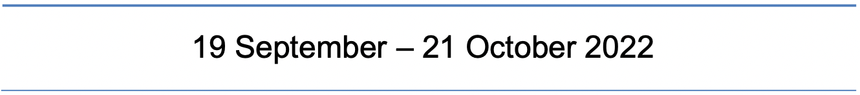
Chapter VI (New Chapter)
Sustainability and Resilience

Slide 31
