Slide 1

Institutional Investors’ Impact on the Outcome of Freeze-out Tender Offers
Beni Lauterbach
Yevgeny Mugerman
December 10th 2017

Slide 2

Do Institutional Investors Defend the Public?
Institutional investors are often perceived as passive on corporate governance issues.
Yet, regulators and lawmakers trust them to defend the public, for example, by repelling expropriation attempts by controlling shareholders.
Is this a wishful belief of naïve regulators?
Do institutional investors play a positive role in defending small investors?
Our answer: Yes, they sometimes do, as evident from our study of an extreme deal in an extreme environment.
Notes:
2

Slide 3
Freeze-out Tender Offers
Control group offers to buy all public shares.
Legitimate reasons
  Achieve synergies; save regulatory costs; keep information confidential; implement idiosyncratic vision; simplify corporate structure; or see no value in remaining a public company.
However,
  The motivation might be deficient: expropriating public shareholders – buying public shares at below their true value.
  Equity tunneling based on asymmetric (“inside”) information.
Notes:
3

Slide 4
Previous Evidence on Institutional Investors’ Skills/Role
The academic literature generally accepts that institutional investors are more informed (Sias, and Starks, 1997; Nagel 2005; McCahery, Sautner, and Starks, 2016).
Help to diminish the information asymmetry (Boone, and White, 2015).
Engage in some monitoring activities (Callen, and Fang, 2013).
Tend to suffer less, than the public at large, from behavioral biases (Barber, and Odean, 2008; Kaustia, 2010; Chang, Solomon, and Westerfield, 2016).
Notes:
4

Slide 5
Institutional Investors’ Impact on Significant Firm Deals
Studies on mergers and acquisitions, in general, present a significant impact of institutional investors.
Gaspar, Massa, and Matos (2005) find that target firms held by institutional investors extract on average a 3% higher premium.
Chen, Harford, and Li (2007) show that concentrated holdings by independent long-term institutions are positively associated with post-merger performance. The presence of these institutions also makes withdrawal of “bad” proposals more likely.
Notes:
5

Slide 6
Contribution
Previously unexplored deal (in this context). We expect that in the extreme case of freeze-out offers, institutional investors’ impact would be beneficial for small investors. This is because the transaction is big and significant for institutional investors as well, and because public and institutional investors’ interests appear to coincide.
Previously unexplored data. We collect data from an economy where regulation of freezeout offers is extremely lax, and where (consequently?) about half of the offers are rejected.
Interesting unexplored (?) hypothesis. Strategic behavior.
Notes:
6

Slide 7
Three Competing Hypotheses
Hypothesis 1 (Null): Institutional investor holdings has no impact on the outcome of freezeout tender offers.
Hypothesis 2: Institutional investor provide an unbiased rational response to each freezeout offer.
  Hypothesis 2a: On average, accepted offers' premia increase with institutional holdings;
  Hypothesis 2b: Higher institutional ownership increases the frequency of offer rejection;
  Hypothesis 2c: When institutional investors hold the firm, stock price does not retreat after the offer is rejected and its cumulative excess return exceeds on average the offer premium.
Notes:
7

Slide 8

Three Competing Hypotheses
Hypothesis 3: Institutional investor provide a strategic response to freezeout offers
  Hypothesis 3a: On average, accepted offers' premia increase with institutional holdings;
  Hypothesis 3b: Higher institutional ownership increases the frequency of offer rejection;
  Hypothesis 3c: When institutional investors hold the firm, stock price may or may not retreat after the offer is rejected and its cumulative excess return may or may not exceed on average the offer premium.
Notes:
8

Slide 9
Extreme Economic Setting
Transaction Type | Merger (US) | Tender Offer (US) | Tender Offer (Israel)
Majority | Majority of shares outstanding | Reach 90% of outstanding shares | Reach 95% of outstanding shares
Board | Approval required | Opinion required | No
Special Committee | Yes | Yes (opine/veto) | No
Fairness Opinion | Yes | Yes | No
Appraisal rights | Yes | Yes | Depends
Disclosure about company | Yes | Yes | No
Notes:
9

Slide 10
Database
Identify freeze-out tender offers (2000-2015): TASE
  274 transactions
  excluded: stocks with no trading volume in the last 20 days; non-cash deals; the offer price is below the recent stock price.
  201 cases; 170 companies.
Stock prices, accounting data, institutional holdings: TASE, Super Analyst; Praedicta.
Going private mergers (only 38).
Notes:
10

Slide 11
Sample Descriptive Statistics
Notes:
11

Slide 12
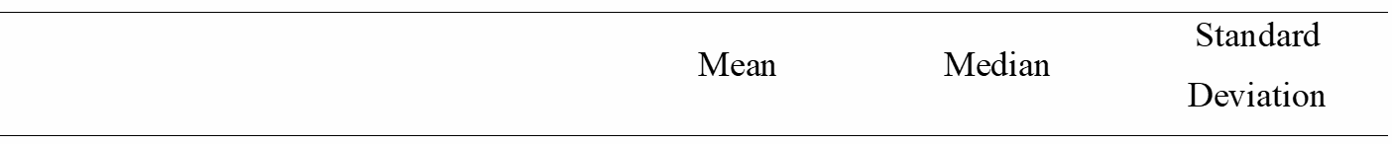
Sample Descriptive Statistics
Notes:
12

Slide 13
Sample companies
Small. Mean Market Cap = NIS 191.8m.
132 offers in firms with institutional holdings (69 without).
Non-representative of TASE:
  Merchandising (31%) – TASE 14%;
  Manufacturing (22%) – TASE 15%;
  Real Estate (21%) – TASE 21%;
  Investment and Holding (18%) – TASE 11%;
  Others include : banks, financial services.. ;
  Technology (0%) – TASE technology sec – 16%.
Notes:
13

Slide 14
Distribution of the Freezeout Offer Premiums
Notes:
The offered premiums spike around 5%-25%

Slide 15
Offer Rejection Rate
Restrepo and Subramanian (2015), US, 2001-2012
  Pre-Cox Communications Inc. ruling (June 2005) – 12.5%;
  Post-Cox Communications Inc. ruling (similar requirements for freezeout merger and tender offers) – 23%.
Øyvind and Krosvik (2013), Norway, 1999-2010
  11%.
Our data set, Israel 2000-2016
  43%, overall. 1st offer – 48%!!
Notes:
15

Slide 16
The Impact of Institutional Investors on Freezeout Offers
Offer Premium
Notes:
16

Slide 17
The Effect of Institutional Investor Holdings on Offer Premium

Slide 18
The Effect of Institutional Investor Holdings on Offer Premium

Slide 19
The Effect of Institutional Investor Holdings on Offer Premium

Slide 20
The Effect of Institutional Investors on Successful Offers’ Premium
Notes:
Here we examine institutional investor impact on accepted offers’ premium in more detail -
We regress the natural logarithm of the offer premium on several measures of institutional investors' holdings, using firm size, and the repeated offer indicator as controls. Industry and calendar year fixed effects are also employed.

Slide 21
Factors Affecting Successful Offers’ Premium
It appears that controlling shareholders of larger firms have to pay lower premia when taking their firms private.
Typically there is more market information and less information asymmetry about larger firms.
It is noteworthy that the lower percentage premium offered and paid by larger firms does not imply lower monetary premia.
The coefficients of the other control variables have the expected sign, yet are statistically insignificant.
Notes:
21

Slide 22
The Effect of Institutional Investors
on Successful Offers’ Premium
The central explanatory variables are institutional investors' presence and holdings.
It appears that accepted offers premia are 10-11% higher when there is at least one institutional investor that holds the company shares.
When we add the aggregate percentage holdings of institutional investors as an explanatory variable, its coefficient is positive and statistically insignificant.
Notes:
22

Slide 23
The Effect of Institutional Investors
on Successful Offers’ Premium
At the average institutional investor holdings of 4.3%, the fitted increase in premium due to institutional investors is 11.7%, most of which (9.2%) is due to the mere presence of institutional investors.
Higher holdings by institutional investors are associated with higher premia, yet the main factor boosting the premium appears to be the mere presence of institutional investors.
Notes:
23

Slide 24
The Impact of Institutional Investors on Freezeout Offers
Offer Acceptance Likelihood
Notes:
24

Slide 25
Factors Affecting Freeze-out Offer Acceptance

Slide 26
Factors Affecting Offer Acceptance
The larger the firm, the higher the probability of offer acceptance. (More information, less suspicion).
Second, the larger are controlling shareholders' pre-tender holdings, the higher are acceptance rates. (Shorter distance to 95%)
Third, the positive coefficient of the repeated offers indicator shows that 2nd and 3rd offers are prepared more carefully.
Fourth, offer premium has a positive yet statistically insignificant coefficient. (Figure in next slide)
Notes:
26

Slide 27
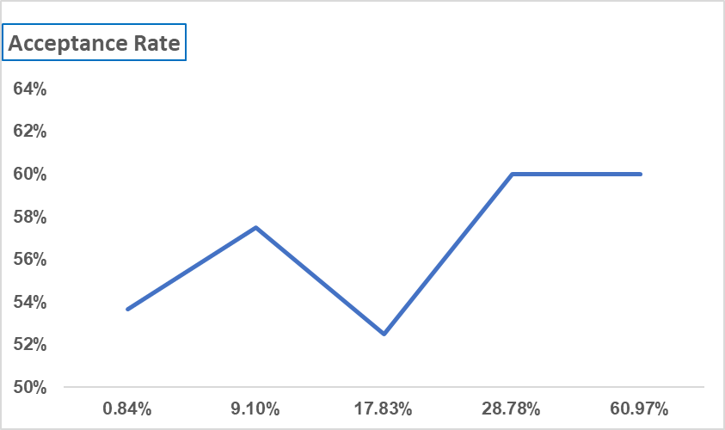
Acceptance Rate as a Function of Tender Offer Premium
Notes:
We divide the offers into five quintiles based on the premium size. The mean premium in each quintile is shown on the horizontal axis.

Slide 28
The Effect of Institutional Investors
on Offer Acceptance Rates
The presence of institutional investors in a company is associated with a lower probability of offer acceptance.
Using OLS estimates, the probability of offer rejection increases by 25% when institutional investors hold firm's stock.
Interestingly, the cumulative institutional investors' holdings do not have any additional explanatory power. As previously, the main trigger appears to be the mere presence of an institutional investor.
Notes:
28

Slide 29
The Impact of Institutional Investors on Freeze-out Offers
The Ex-Post Rationality of the
Rejection Decision
Notes:
29

Slide 30
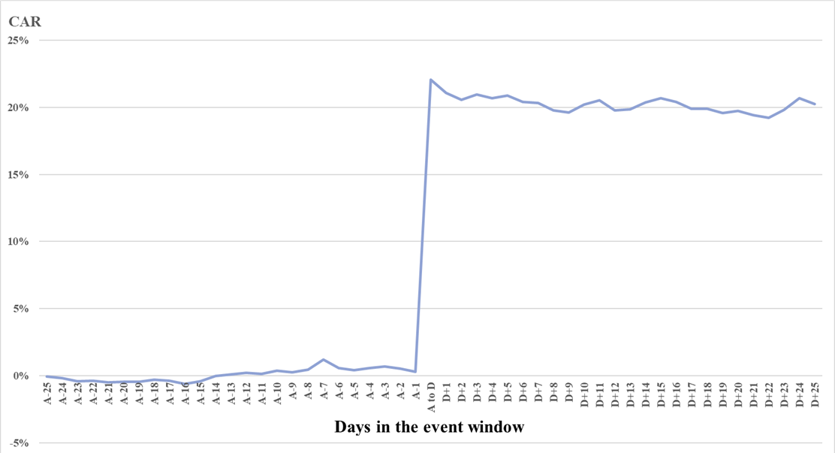
Cumulative Abnormal Returns Surrounding Failed Offers
Notes:
Explain – why net of market! The figure shows the mean cumulative abnormal return (CAR) for the target stocks in 86 failed offers around the offer announcement for each day. To calculate abnormal returns, we employ the net of market methodology. First, for each offer we identify the announcement day (day A) and decision day (day D). For each day T within the window A-25 through D+25, we compute the abnormal return of the stock i as: ${AR}_{i,T}= R_{i,T}− R_{MARKET,T}$, where $R_{i,T}$ is stock i's return on day T of the event window, and $R_{MARKET,T}$ is Israeli small stock (Yeter) index return on day T.(All of our sample stocks belong to this index.). Then, we compute the Cumulative Abnormal Return (CAR) for stock i as: ${CAR}_{i}(Tb, Te)= {\prod_{Tb}^{Te}{(1+AR}}_{i,T})−1$, where day Tb is day A-25, and day Te is the respective day T on the horizontal axis, till the day D+25.

Slide 31
Cumulative Abnormal Returns
Surrounding Failed Offers
We estimate CARs (cumulative excess returns) using the net of market methodology (where market = TASE small-stock index).
This choice is not arbitrary. When we attempt the market model methodology with parameter estimation before the freezeout announcement, we find negative intercepts for most of our sample stocks.
The typical pre-offer decline biases market model parameters.
Post-offer parameter estimation shrinks sample size by a third...
Notes:
31

Slide 32
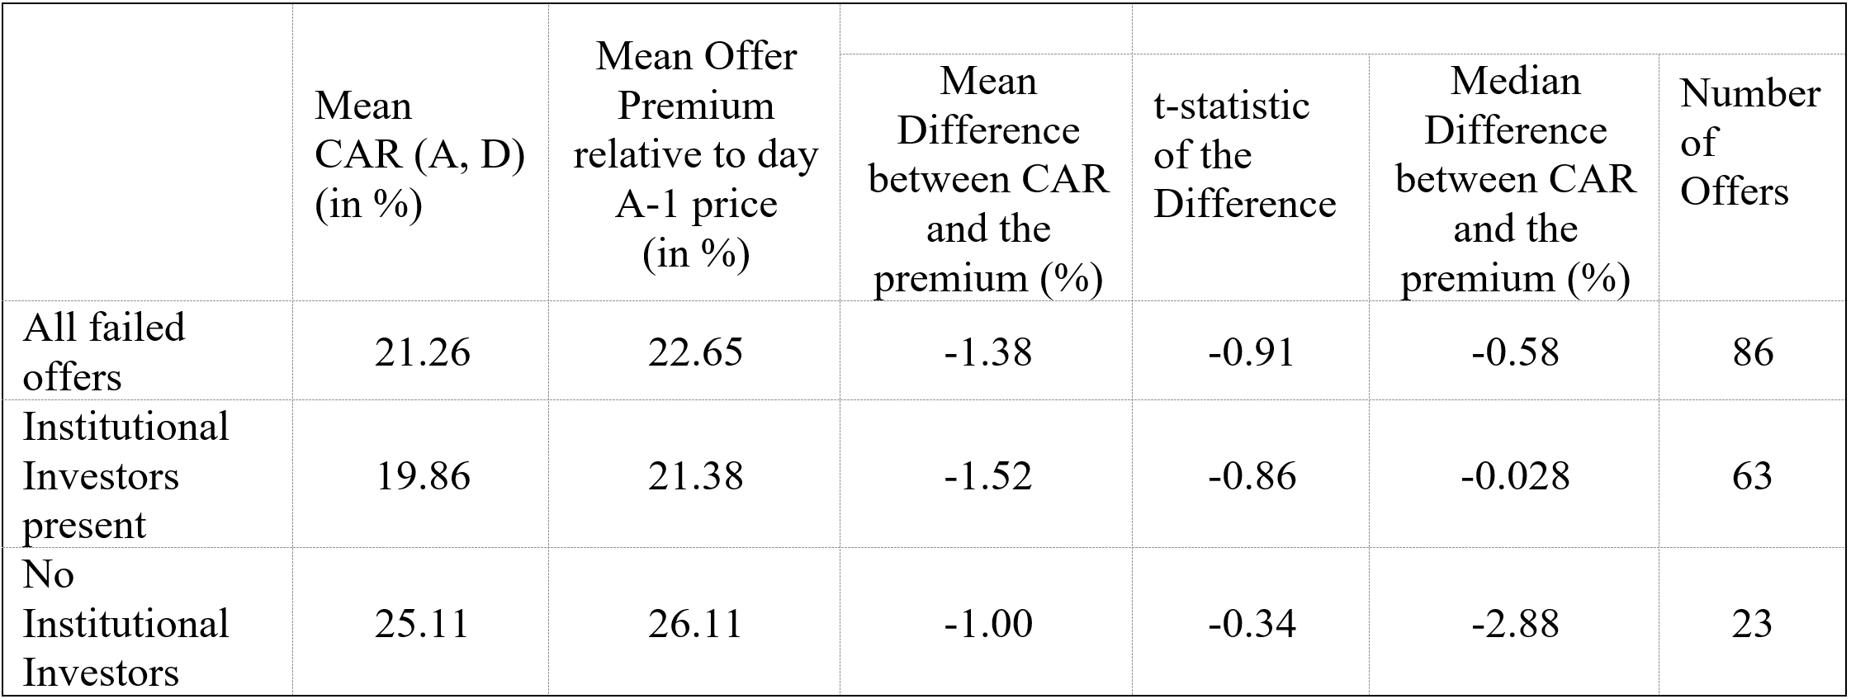
Testing the Ex-Post Rationality of the Offer Rejection Decision
Panel A: Stock response from offer announcement to offer rejection date

Slide 33
Testing the Ex-Post Rationality of the Offer Rejection Decision
Panel A: Stock response from offer announcement to offer rejection date

Slide 34
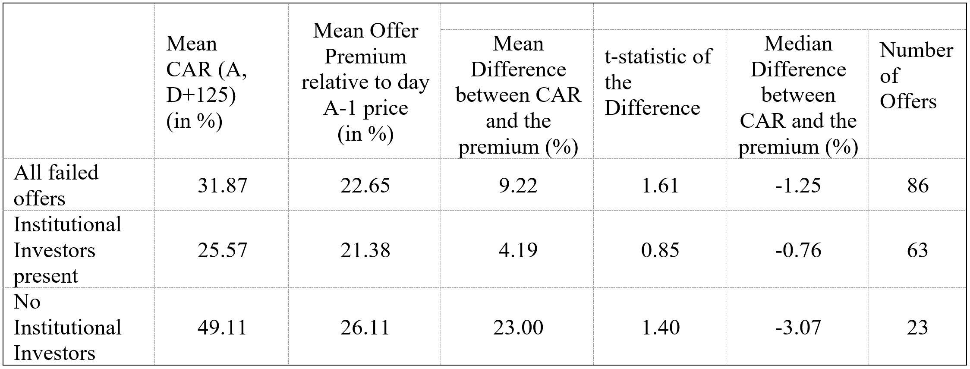
Testing the Ex-Post Rationality of the Offer Rejection Decision
Panel B: Stock response from offer announcement to half a year after the offer rejection date

Slide 35
Testing the Ex-Post Rationality of the Offer Rejection Decision
Panel B: Stock response from offer announcement to half a year after the offer rejection date

Slide 36
Interpretation
Our first two findings (higher premium and more rejections when institutional investors hold the firm) are consistent with both “competing” hypotheses.
Hypothesis 2, unbiased rational response to each offer, explains that institutional investors reject bad offers and “extract” higher premia.
Hypothesis 3, strategic decisions in a repeated game, explains that institutional investors play it tough with controlling shareholders. Hence, bad and even fair offers are rejected. Only generous offers (higher premia) are accepted.
Notes:
36

Slide 37
Interpretation
Our third finding (CAR of rejected offers close to offer premium, and no difference between firms with and without institutional investors) appears more consistent with Hypothesis 3.
Hypothesis 2 has a problem because if bad exploitive offers are rejected CAR should on average exceed offer premium.
Hypothesis 3, explains that fair or even slightly beneficial offers are rejected by institutional investors in order to gain respect from controlling shareholders. Hence, CAR_rejection might be (slightly) negative.
This does not necessarily hurt the public, as on average it might raise the accepted offers’ premia.
Notes:
37

Slide 38
Potential Criticism
The comparison of firms with and without institutional investors might be improper if firms with institutional investors differ materially from firms without institutional ownership.
For example, it can be argued that institutional investors elect better firms, and in such better firms, the premium controlling shareholders have to pay in order to take the firm private is higher.
On the other hand, if part of the premium is intended to overcome disbelief and asymmetric information problems, then in firms with a relatively large information asymmetry (firms without any institutional investor), controlling shareholders must offer higher premia.
Notes:
38

Slide 39
Potential Criticism
Differences between firms with and without institutional investors might affect our two other results as well.
In sum, we admit that there might be differences between firms with and without institutional investors’ ownership, and there might be some endogeneity issues. However, remarkably, our Hypothesis 3 does provide a solid picture that is consistent with all our results.
Notes:
39

Slide 40
Summary
We examine institutional investors' impact in a sample of about 200 freezeout offers in Israel.
Freezeout offers are "terminal" deals where a rational institutional investors' position might influence outcome (hence, defend the public).
The choice of Israeli data, where freezeout offers are rejected relatively frequently, affords higher visibility of institutional investors’ impact.
Notes:
40

Slide 41
Main Findings
Freezeout offers are rejected more frequently when institutional investors hold the firm.
In accepted offers, the offer premium is higher when institutional investors hold the firm.
Institutional investors do not appear to play a prudent role when rejecting freezeout offers. With and without institutional investors the share price increases are about equal to the offer premium.
Notes:
41

Slide 42
Conclusion
Institutional investors do benefit other investors.
Overall, the evidence provides some support to the hypothesis that institutional investors are strategic players in a repeated game or conflict with controlling shareholders.
Should institutional investors be allowed to collude on corporate governance issues? (Black, 1992! ☺).
More tests are needed to establish the strategic view.
Notes:
42

Slide 43
THANK YOU
Comments welcome!
Notes:
43

Slide 44
Differences between firms with and without institutional investors' ownership
 | Institutional Presence [132 obs.] | No Institutional Presence [69 obs.]
SIZE | 256 M | 69 M
Leverage | 69.24% | 70.81%
ALPHA (before) | -.00262% | .00657%
Controlling Shareholder Holdings | 81.13% | 83.98%
Q | 1.02 | 1.04
Institutional holdings | 6.59% | ***

