Slide 1
A Collaborative Model of the Corporation
Jill E. Fisch
Simone M. Sepe

Slide 2
Two Models of the Corporation
Management-power model
Berle & Means
Director Primacy
Shareholder-power
Both models are essentially confrontational or competitive

Slide 3
The Language of Confrontational Theories of Corporate Governance
Takeover battles
Contests for corporate control
White knights & poison pill
War
Wolf packs

Slide 4
The Alternative – Insider/Shareholder Collaboration
Descriptively collaboration is consistent with the prevailing structure of corporate law
Collaboration is also consistent with private ordering
Our paper offers a normative justification for collaboration in terms of increasing firm economic value
Several implications follow

Slide 5
A Positive View of Collaboration
Private-ordering through corporate charters and bylaws
Say on pay
Engagement between insiders and Institutional investors
Activist investors and longer term operational strategies
Anecdotal examples

Slide 6
Notes:
The SDX Protocol is a 10-point guide for public company boards and shareholders that determines when shareholder and director engagement is appropriate and how to make these engagements valuable and effective

Slide 7
Notes:
ValueAct’s Mason Morfit shook up Microsoft- 4 year investment

Slide 8
How Collaboration increases Firm Value
Economic importance of information
Partial information problem
Ability of institutional investors to bring complementary information to corporate decision-making
Interpretive value, not just information-gathering
Collaboration is the most efficient form of information-sharing between and among insiders and shareholders

Slide 9
An Example
Notes:
Goal is for product to match the market. If a match, stock is worth $200. If not, stock is worth $0

Slide 10
How to Structure Collaboration – Lessons from Game Theory
Properties of insider-shareholder coalitions
Complementarity of information
Superaddivity
Monotonocity
Incentive compatibility
Assignment of economic rights
Based on shareholdings
Assignment of decision-making rights
Shared decision-making structures
Structure and role based on marginal contribution
Structure
Formal contracts (including charter and bylaws)
Relational contracts
Notes:
satisfied: that players can do better together than alone (this is the superaddivity condition) and larger coalitions be more valuable than smaller ones (this is the monotonicity condition).

Slide 11
Collaborative Breakdown and the Risk of Opportunistic Behavior
Managerial Entrenchment
Shareholder Short-termism
These risks provide the basis for our regulatory reform proposals

Slide 12
Implications of the Collaborative Model
A preference for charter-based governance over unilaterally-adopted bylaws
Balancing board and shareholder power in takeover defenses and other areas
Reframing the scope of directors’ confidentiality obligations

Slide 13
Charters versus bylaws
Applies to rules of the game decisions
Favors joint over unilateral decisionmaking
Concerns
IPO charter provisions
Frozen charters
Possible solutions include sunsetting or shareholder initiation

Slide 14
Balancing board and shareholder power in takeover defenses
Staggered boards, poison pills, say on pay, special shareholder meetings
Preference for joint control mechanisms to encourage collaboration
Joint control also minimizes the risk of self-dealing
Concern
Shareholder use of control to exert leverage
Possible solution – time limits, power limits

Slide 15
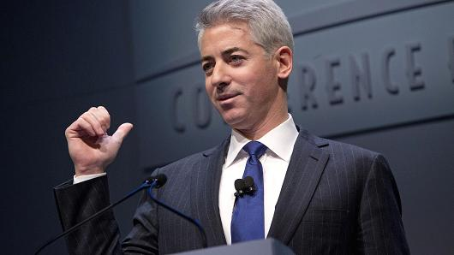
Reframing the scope of directors’ confidentiality obligations
Traditional confidentiality obligations mitigate against directors sharing information outside the firm
Value of institutional board representation depends on information sharing between the director and his/her fund
Concerns
Competition or otherwise hurting firm interests
Damaging leaks
Insider trading
Possible response may be extending fiduciary obligations to funds’ use of confidential firm information

Slide 16
Conclusion
Time to rethink the insider-shareholder relationship in collaborative terms
Today’s institutional shareholders offer the potential to increase firm value
Mechanisms to facilitate information-sharing and joint decisionmaking facilitate the collaborative process

