Slide 1
A Challenge for Corporate Governance in Korea: Tragedy of “Ownerless Firms”
Kon Sik Kim
Seoul National University

Slide 2
Introduction
What is Corporate Governance Change?
Controlling Minority S/H(CMS) Structure
Corporate Governance and Political Environment
A Problem of Corporate Governance Change? – Tragedy of “Ownerless Firms”
Conclusion

Slide 3
Corporate Governance Change
Debate as to convergence vs. path dependence in corporate governance
Q: How do you measure the change in corporate governance?
A: The most fundamental criterion seems to be the purpose for which firms are actually managed.
It is difficult to grasp from outside such purposes of firms.

Slide 4
Corporate Governance Change
Instead, it is easier to identify those who control a firm.
Depending on who controls a firm, the firm’s behavior may differ.
In identifying a controller, the share ownership structure is crucial.
Ownership structure -> controller -> firm’s behavior

Slide 5
CMS Structure
The ownership structure of large Korean firms is often characterized as controlling minority shareholder (CMS) structure.
A controlling minority shareholder effectively controls the whole group of firms with the help of inter-company shareholdings.

Slide 6
CMS Structure
CMS
51%
5%
A
minority S/H
20%
55%
51%
51%
D
C
B
20%

Slide 7
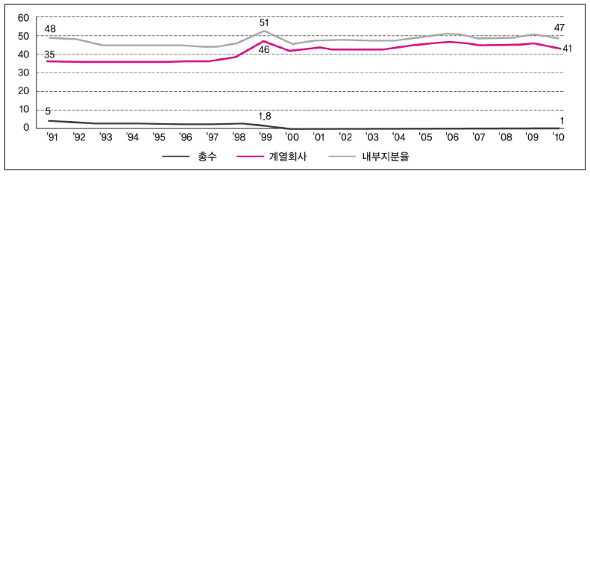
Stability of CMS Structure
CMS
member firms
—— internal ownership

Slide 8
Problems of CMS Structure
With no plan to sell his shares, CMS is interested not in share price, but in the long-term growth.
Entrenchment effect – long-term perspective vs. tunneling
It is difficult to determine the effect of the CMS structure on performance.

Slide 9
Corporate Governance &
Political Environment
Corporate governance change, especially a change affecting the ownership structure, may take place only when the political environment supports it.
Given the predominance of chaebol in most fields of society, a fundamental change in ownership structure is difficult, if not impossible, to achieve.

Slide 10
Political Environment
Allies
Managers and employees
Suppliers and distributers
Government
Media
Politicians
Academia etc.
Enemies
NGOs
Liberal intellectuals and politicians
- General investors, including foreign investors

Slide 11
Changes in Political Environment
Growing general antipathy toward chaebol owners
Causes:
- unfair business practices related to dynasty-like succession
- growing gap between the rich and the poor (chaebol firms and small and medium size firms
- Negative happenings

Slide 12
Unfair business practice - old
Issuance of equity securities to heirs of CMS at unfair prices – Samsung Group
Some of those involved in this kind of scheme got convicted.
Chairman Lee of Samsung Group narrowly avoided conviction by the 6-5 decision at the Supreme Court.

Slide 13
Unfair business practice – recent
Corporate opportunity + self dealing
1. X, a son of CMS, sets up a new firm Y
2. all the member firms exclusively deal with Y at unfair(or apparently fair) prices
3. Y goes public
4. X secures the control block in the parent company with the funds from the IPO
Ex. Hyundai Motor Co. Group (An investment of $3 million has grown to about $2 billion in 11 years.)

Slide 14
Controversial business practices
It is a wide-spread practice for heirs of CMS to engage in business activities with the expectation of the group support.
Some daughters of chaebol had to move out of the bakery business due to the public criticism that they drive independent bakery shops out of business.

Slide 15
Political Environment – election
2012 is the year of the election: general election in April and the presidential election in December
Politicians turn to this issue to seek votes
- regulating inter-company shareholding
- encouraging the National Pension Fund to play a more active role in corporate governance

Slide 16
Tragedy of “Ownerless Firms”
Even among large listed firms, only a handful of them have no individual controlling shareholder. These firms are often called “ownerless firms”
Most of ownerless firms are former government-owned firms which have gone public as a way of privatization.
Most financial holding companies with bank subsidiaries have no controlling shareholders.

Slide 17
Tragedy of Ownerless Firms
POSCO: steel manufacturer
KT: telecom firm
KT&G: tobacco and ginseng firm
KB Financial Holdings
Shinhan Financial Holdings
Hana Financial Holdings

Slide 18
Tragedy of Ownerless Firms
Ownerless firms are supposed to be run by professional managers elected by the board.
The board of directors is in turn composed primarily of outsiders.
Most of them have been enjoying an excellent reputation in terms of corporate governance.

Slide 19
Tragedy of Ownerless Firms
CEO changes in all these firms after the change of government in 2008
Most of the changes occurred in awkward situations.
CEO of KT resigned as he was indicted for taking bribes from the CEO of its subsidiary.
CEO of POSCO stepped down in the middle of his term, and a close aide to President Lee is reported to have influenced the succession process.

Slide 20
Tragedy of Ownerless Firms
Growing concern that these ownerless firms turn into spoils of the power elites.
Ownerless firms may provide job opportunities and business opportunities.
CEO change may occur whenever there is a change in political leadership.

Slide 21
Tragedy of Ownerless Firms
If such phenomenon continues, the ownerless firms will likely stagnate due to the so-called “tragedy of commons”.
As long as the tragedy of ownerless firms is not reined in, it may not be wise to turn chaebol firms into ownerless firms.

Slide 22
Conclusion
The tragedy of ownerless firms is a part of a bigger problem of ownerless institutions in Korea.
Ownerless institutions rarely succeed in Korea. An owner often exists even in non-profit institutions, such as churches, universities and hospitals.
While people are critical of chaebol owners, they generally believe that an ownerless institution will rarely succeed.

Slide 23
Conclusion
It is difficult to change the existing CMS structure into a widely dispersed ownership structure.
It seems even more difficult for ownerless firms to compete adequately with chaebol firms.
A challenge for Korea is how to secure an environment that enables an ownerless firm to operate efficiently without falling prey to the power elites.

Slide 24
Conclusion
Emergence of successful ownerless firms (and institutions) may be regarded as evidence that Korea has actually joined the ranks of advanced countries.

Slide 25
Thank you very much!

