Slide 1

Shareholder Activism in Asia
EU Asia Corporate Governance Dialogue
July 6, 2012
Tokyo
Hasung Jang

Slide 2
Corporate Governance Progress in Asia for last 10 years
Financial crisis in 1997 opened new era in corporate governance development in Asia
New rules and regulations are introduced
  Board
    Outside directors
    Audit committee
  Shareholder rights strengthened
    Derivative lawsuit
    Class action lawsuit
    Cumulative voting

Slide 3
Corporate Governance Progress in Asia for last 10 years
Improvements are mostly in rules and regulations
Practices has not improved as much as regulations did
  Disparity between regulations and practices
  Many laws and regulations exist in the law, but it is not practiced
  Weak enforcements of regulations

Slide 4
Corporate Governance Regulations in Asian Countries
 | Independent Director |  | Audit Committee |  | Derivative Lawsuit | Class Action Lawsuit | Cumulative Voting | Liabilities on “Shadow“ Directors
 | 1997 | 2011 | 1997 | 2011 | 2011 | 2011 | 2011 | 2011
China |  | v |  | v | v |  | v
Hong Kong | v | v |  | v | v |  |  | v
India |  | v |  | v | v | v | v
Indonesia |  | v |  | v | v | v
Korea |  | v |  | v | v | v | v | v
Malaysia | v | v | v | v | v | v |  | v
Philippines |  | v |  | v | v | v | v
Singapore | v | v | v | v | v |  |  | v
Taiwan |  | v |  | v | v | v | v | v
Thailand |  | v |  | v | v |  | v | v
Data source: ACGA, OECD

Slide 5
Improvements in Corporate Governance in Asian Countries
Two Surveys on Corporate Governance
CG Watch 2010 by CLSA & ACGA
  CG Rules and Practices
  Enforcement
  Political & Regulatory
  IGAAP
  CG Cultures
World Competitiveness by IMD
  Shareholders’ Rights
  Auditing & Accounting Practices

Slide 6

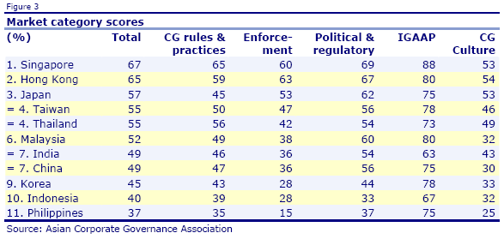
Corporate Governance Evaluation
Asian Economies

Slide 7
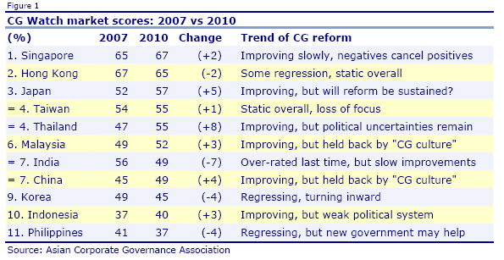
Corporate Governance Evaluation
Asian Economies

Slide 8
Shareholders' Rights
IMD WORLD COMPETITIVENESS, 2010-2012
2010-2012 Average,
1 | Finland | 8.44
2 | Norway | 8.11
3 | Denmark | 8.07
4 | Sweden | 7.71
5 | Australia | 7.60
6 | South Africa | 7.58
7 | Germany | 7.52
8 | Netherlands | 7.47
9 | Malaysia | 7.37
10 | Chile | 7.35
11 | Singapore | 7.31
12 | Canada | 7.31
13 | Switzerland | 7.13
14 | Luxembourg | 7.13
15 | Taiwan | 7.10
16 | Belgium | 7.06
17 | Austria | 6.97
18 | Qatar | 6.95
19 | Brazil | 6.95
20 | Thailand | 6.90
21 | Hong Kong | 6.88
22 | India | 6.82
23 | Ireland | 6.75
24 | USA | 6.75
25 | Lithuania | 6.72
26 | Israel | 6.71
27 | Colombia | 6.67
28 | Estonia | 6.60
29 | Peru | 6.56
30 | UK | 6.55
31 | Czech Rep | 6.52
32 | France | 6.51
33 | Spain | 6.47
34 | New Zealand | 6.47
35 | Portugal | 6.46
36 | Indonesia | 6.40
37 | Philippines | 6.26
38 | Hungary | 6.08
39 | Turkey | 6.07
40 | Jordan | 6.06
41 | Mexico | 6.06
42 | Japan | 5.98
43 | Poland | 5.95
44 | Romania | 5.94
45 | Kazakhstan | 5.88
46 | Iceland | 5.74
47 | Greece | 5.65
48 | Slovak Rep | 5.49
49 | Argentina | 5.24
50 | Korea | 5.18
51 | Italy | 5.14
52 | Croatia | 5.13
53 | China | 4.75
54 | Slovenia | 4.27
55 | Bulgaria | 4.20
56 | UAE | 3.87
57 | Russia | 3.83
58 | Venezuela | 3.69
59 | Ukraine | 3.53

Slide 9
Shareholders' Rights
IMD WORLD COMPETITIVENESS, 2000-2002
2000-2002 Average
1 | Finland | 8.78
2 | USA | 8.51
3 | Australia | 8.45
4 | Sweden | 8.39
5 | Canada | 8.35
6 | Denmark | 8.30
7 | Norway | 7.92
8 | UK | 7.85
9 | Singapore | 7.85
10 | Ireland | 7.84
11 | Netherlands | 7.79
12 | Luxembourg | 7.65
13 | Germany | 7.61
14 | Israel | 7.57
15 | Austria | 7.52
16 | Chile | 7.47
17 | Iceland | 7.42
18 | South Africa | 7.36
19 | Switzerland | 7.35
20 | Hong Kong | 7.30
21 | New Zealand | 7.16
22 | Portugal | 6.83
23 | Belgium | 6.72
24 | Hungary | 6.64
25 | Spain | 6.58
26 | Brazil | 6.57
27 | France | 6.54
28 | Taiwan | 6.53
29 | Malaysia | 6.37
30 | Greece | 6.31
31 | Mexico | 6.22
32 | Turkey | 6.17
33 | Philippines | 6.06
34 | Argentina | 5.90
35 | India | 5.89
36 | Colombia | 5.87
37 | Poland | 5.87
38 | Venezuela | 5.74
39 | Italy | 5.71
40 | Slovenia | 5.51
41 | China | 5.49
42 | Thailand | 5.43
43 | Estonia | 5.00
44 | Indonesia | 4.97
45 | Czech Rep. | 4.74
46 | Korea | 4.59
47 | Russia | 4.51
48 | Japan | 4.19
49 | Slovak Rep. | 3.78

Slide 10
Shareholders' Rights: Changes from 2000-2002 to 2010-2012
Changes |  | 2010-2012 Avg. | 2000-2002 Avg.
Changes |  | 2010-2012 Avg. | 2000-2002 Avg.
Japan | 1.79 | * | 5.98 | 4.19
Czech Rep | 1.78 | * | 6.52 | 4.74
Slovak Rep | 1.70 | * | 5.49 | 3.78
Estonia | 1.60 | * | 6.60 | 5.00
Thailand | 1.47 | * | 6.90 | 5.43
Indonesia | 1.43 | * | 6.40 | 4.97
Malaysia | 1.00 | * | 7.37 | 6.37
India | 0.93 | * | 6.82 | 5.89
Colombia | 0.79 | * | 6.67 | 5.87
Korea | 0.59 | * | 5.18 | 4.59
Taiwan | 0.58 | * | 7.10 | 6.53
Brazil | 0.38 |  | 6.95 | 6.57
Belgium | 0.34 |  | 7.06 | 6.72
South Africa | 0.22 | * | 7.58 | 7.36
Philippines | 0.20 |  | 6.26 | 6.06
Norway | 0.19 |  | 8.11 | 7.92
Poland | 0.07 |  | 5.95 | 5.87
France | -0.03 |  | 6.51 | 6.54
Germany | -0.09 |  | 7.52 | 7.61
Turkey | -0.10 |  | 6.07 | 6.17
Spain | -0.11 |  | 6.47 | 6.58
Chile | -0.12 |  | 7.35 | 7.47
Mexico | -0.16 |  | 6.06 | 6.22
Switzerland | -0.22 | * | 7.13 | 7.35
Denmark | -0.23 |  | 8.07 | 8.30
Netherlands | -0.32 | * | 7.47 | 7.79
Finland | -0.34 | * | 8.44 | 8.78
Portugal | -0.37 |  | 6.46 | 6.83
Hong Kong | -0.42 |  | 6.88 | 7.30
Luxembourg | -0.52 | * | 7.13 | 7.65
Singapore | -0.53 | * | 7.31 | 7.85
Austria | -0.55 | * | 6.97 | 7.52
Hungary | -0.57 | * | 6.08 | 6.64
Italy | -0.58 | * | 5.14 | 5.71
Greece | -0.65 | * | 5.65 | 6.31
Argentina | -0.67 | * | 5.24 | 5.90
Sweden | -0.68 | * | 7.71 | 8.39
Russia | -0.68 | * | 3.83 | 4.51
New Zealand | -0.70 | * | 6.47 | 7.16
China | -0.74 | * | 4.75 | 5.49
Australia | -0.85 | * | 7.60 | 8.45
Israel | -0.86 | * | 6.71 | 7.57
Canada | -1.04 | * | 7.31 | 8.35
Ireland | -1.09 | * | 6.75 | 7.84
Slovenia | -1.24 | * | 4.27 | 5.51
UK | -1.30 | * | 6.55 | 7.85
Iceland | -1.68 | * | 5.74 | 7.42
USA | -1.76 | * | 6.75 | 8.51
Venezuela | -2.05 | * | 3.69 | 5.74

Slide 11
Auditing and Accounting Practices
IMD WORLD COMPETITIVENESS, 2010-2012 Avg.
1 | Finland | 8.50
2 | Norway | 8.44
3 | Denmark | 8.39
4 | Singapore | 8.22
5 | Sweden | 8.08
6 | Canada | 8.04
7 | Switzerland | 7.97
8 | South Africa | 7.93
9 | Australia | 7.89
10 | Luxembourg | 7.87
11 | Austria | 7.84
12 | Germany | 7.71
13 | Hong Kong | 7.69
14 | New Zealand | 7.67
15 | Malaysia | 7.62
16 | Estonia | 7.59
17 | Netherlands | 7.55
18 | Qatar | 7.53
19 | Taiwan | 7.49
20 | Hungary | 7.44
21 | Kazakhstan | 7.37
22 | Belgium | 7.36
23 | Israel | 7.36
24 | Chile | 7.23
25 | UK | 7.09
26 | USA | 7.08
27 | India | 7.05
28 | Colombia | 7.04
29 | Czech Rep | 7.04
30 | Japan | 7.00
31 | Brazil | 6.99
32 | Thailand | 6.99
33 | Lithuania | 6.94
34 | France | 6.93
35 | Spain | 6.90
36 | Slovak Rep | 6.87
37 | Venezuela | 6.79
38 | Romania | 6.79
39 | Philippines | 6.78
40 | Poland | 6.66
41 | Jordan | 6.60
42 | Mexico | 6.53
43 | Argentina | 6.46
44 | Iceland | 6.46
45 | Ireland | 6.44
46 | Indonesia | 6.43
47 | Korea | 6.39
48 | Turkey | 6.29
49 | Portugal | 6.20
50 | Peru | 6.19
51 | Greece | 6.12
52 | Ukraine | 6.08
53 | Russia | 6.03
54 | Italy | 5.70
55 | China | 5.70
56 | Croatia | 5.54
57 | Bulgaria | 5.11
58 | Slovenia | 5.10
59 | UAE | 4.61

Slide 12
CG in Asian Economies
IMD WORLD COMPETITIVENESS, 2010-2012 Avg.
Auditing and accounting practices |  |  |  | Shareholders' rights
Rank | 2010-2012 Avg. |  |  | Rank | 2010-2012 Avg.
4 | Singapore | 8.22 |  | 9 | Malaysia | 7.37
13 | Hong Kong | 7.69 |  | 11 | Singapore | 7.31
15 | Malaysia | 7.62 |  | 15 | Taiwan | 7.10
19 | Taiwan | 7.49 |  | 20 | Thailand | 6.90
27 | India | 7.05 |  | 21 | Hong Kong | 6.88
30 | Japan | 7.00 |  | 22 | India | 6.82
32 | Thailand | 6.99 |  | 36 | Indonesia | 6.40
39 | Philippines | 6.78 |  | 37 | Philippines | 6.26
46 | Indonesia | 6.43 |  | 42 | Japan | 5.98
47 | Korea | 6.39 |  | 50 | Korea | 5.18
55 | China | 5.70 |  | 53 | China | 4.75

Slide 13
Why disparity between regulations and practices?
Entrenched ownership structure
  Concentrated ownership
    Cross ownership
    Circuitous ownership
Moral hazard of controlling shareholder
  Family values control right more than share value
  Expropriation of minority shareholders
Unfair related party transactions
  Tunneling asset through related party transactions
  Stripping business opportunities to private company owned by the controlling shareholder

Slide 14
Why disparity between practices and regulation?
Bank-financing is stronger than capital market financing
  Banks have its own poor governance problem
  Bank’s capacity of CG risk management is weak
Enforcements of rules and regulations are weak
  Supervisory agency’s capacity is limited
  Prosecutors are not independent from business influence & political consideration
  Judges are not properly trained, and are not independent from interest conflicts & outside influence

Slide 15
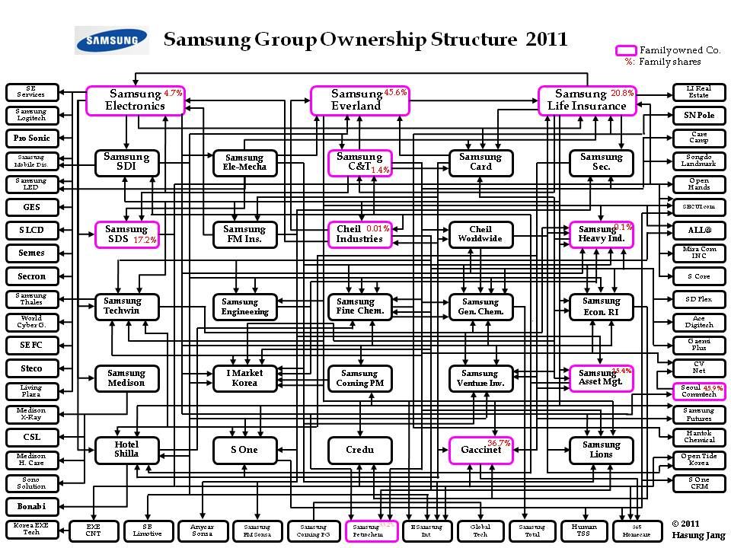

Slide 16
Why Shareholders are inactive?
High barriers in exercising rights
  Difficulties in fact discovery
  High legal cost
  Independent lawyers are scarce
Establishments have strong influences on
  Politics
  Media
  Prosecutors and judges

Slide 17
Why Shareholders are inactive?
Individual shareholders
  Speculative short term trading
  Investment horizon is too short
Institutions shareholders
  Local institutions: Interest conflicts
  Foreign institutions: Lack of long-term commitment
  Pension funds: Political inflences

Slide 18
Shareholder Activism
Empower Shareholders
  Lower barriers in exercising rights
    Procedures
    Cost
  Provide mechanisms to be active
    Electronic voting
    Cumulative voting
    Class action lawsuit
Create activist institutional investors
Public pension fund should be active investor

Slide 19
Shareholder activism in Asia
Shareholder activism in Asia is weak
  Activist investors
    Hong Kong: David Webb
    Korea: Lazard Korea CG Fund
  Quasi-Government Agency
    Taiwan: Securities and Futures Investors Protection Center
  NGO
    Korea: Solidarity for Economic Reform
    Malaysia: Shareholder Watchdog Group
    Japan: Ombudsman(Osaka)

Slide 20
Actions Shareholder Can Take
Attending shareholder meetings
Proposing agenda at the shareholders meetings
Public campaign through media
Electing directors
  Proposing outside director candidate
  Proxy fights
Taking legal actions
  Filing civil lawsuit
    Derivative actions
    Class-Actions
  Filing criminal investigation

Slide 21
Activist Investment: Case 1
Sovereign Asset Mgt. vs SK Corp
Sovereign Asset Management
  Activist foreign investor
SK corporation scandal in March 2003
  Accounting fraud
  Embezzlements by controlling family
Sovereign’s investments in SK shares
  Investments of $150 million in March 2003
  Capital gains of $800 million in July 2005
Sovereign’s strategy
  Proxy fight for management control
  Proposed improvements in corporate governance

Slide 22
Activist Investment: Case 1
Sovereign Asset Mgt. vs SK
SK Scandal

Slide 23
SK Share Price
2003 - 2006
Sovereign
left
SK Scandal

Slide 24
Increase in SK market capitalization
  from $1 billion to $6.3 billion
Capital Gains
  shares capital gains
  Sovereign: 15% $800 million
  Rest of shareholders: 85% $4.5 billion
 | Stock price |  | ROR
 | KOSPI | SK | KOSPI | SK
March 2003 | 556.33 | 8,600W
July 2005 | 1019.01 | 55,100W | 83.2% | 540.7%

Slide 25
SK Share Price
2003 – 2007
Holding Co.
established
Sovereign
Left
SK Scandal

Slide 26
SK introduced major reforms
in corporate governance in 2007
If Sovereign stayed until June 2007,
they could have made capital gains of
$2.4 billion out of $150 million investment
 | Stock price |  | ROR
 | KOSPI | SK | KOSPI | SK
March 2003 | 556.33 | 8,600W
July 2005 | 1019.01 | 55,100W | 83.2% | 540.7%
June 2007 | 1733.10 | 134,500W | 211.5% | 1463.9%

Slide 27
Alternative Approaches in Korea
Shareholder Activism
  NGO shareholder activists since 1997
  Group of two dozens volunteer professionals
  Landmark lawsuit cases brought changes
Korea Corporate Governance Fund
  Established in April of 2006
  Enhancing share value by improving CG
  Long-term commitments in value investment

Slide 28
Activist Investment: Case 2
Korea Corporate Governance Fund
Disclosure of 5% shareholding of Daehan Synthetic Fiber Co.
on August 23, 2006
Index = 100 as of August 22, 2006

Slide 29
Activist Investment: Case 2
Korea Corporate Governance Fund
Disclosure of Ownership: September 19, 2006
Index = 100 as of August 22, 2006

Slide 30
Shareholder activism will create wealth with Justice & Cause for minority investors
Thank you!

