Slide 1

Corporate Purpose, Measurement, and Performance
Gaizka Ormazabal, IESE Business School, CEPR, ECGI
Modern Capitalism and Corporate Purpose
ECGI & Copenhagen Business School, September 2023

Slide 2
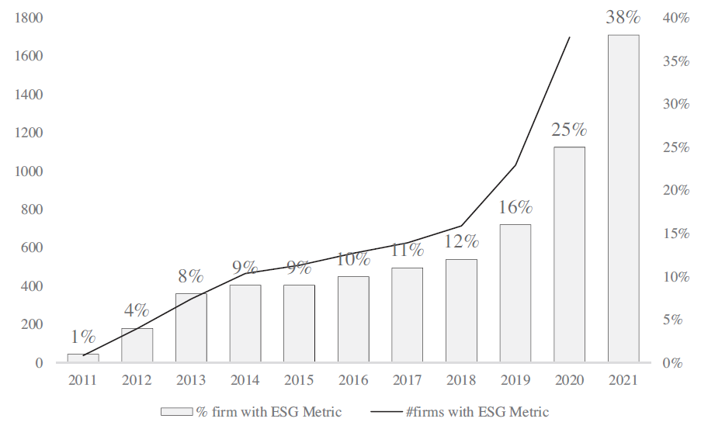
Linking Compensation to ESG
    Source: Cohen, Ormazabal, Kadach, Reichelstein, JAR 2023

Slide 3
Linking Compensation to ESG
Shor-term (annual) | Long-term (multi-annual)
40% Group organic sales growth 30% Adjusted EBITDA (organic) improvement 10% Group cash conversion rate 20% Schneider Sustainability Impact | 40% improvement EPS 35% TSR (2 benchmarks) 25% Four (external) ESG Ratings
    Source: Public filings of Schneider Electric

Slide 4
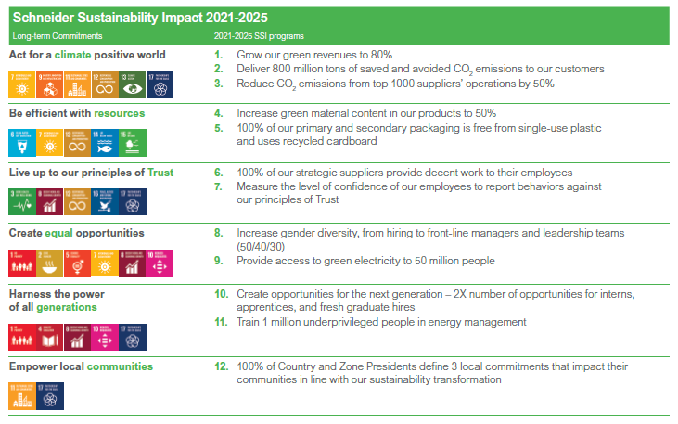
Linking Compensation to ESG
    Source: Public filings of Schneider Electric

Slide 5
Linking Compensation to ESG
NO | YES
1. Skepticism about ESG | 1. Performance measurement
“I’m skeptical about climate risk” | Financial metrics have limitations
“I don´t know what ESG means” | ESG metrics can give additional information
“It’s the Government’s job” | 2. Aligningment with ESG preferences
“I can’t afford it” | Some shareholders are ready to earn
2. “I believe in ESG but not in ESG Pay” | lower returns to improve ESG
“ESG is a must” | Give in to pressure from stakeholders
“We don’t need a bonus to incent ESG” | Necessary to go the “extra mile”
“ESG metrics are too noisy” | 3. “Signaling”
“The financial metrics do the job” | Gives credibility to public commitments

Slide 6
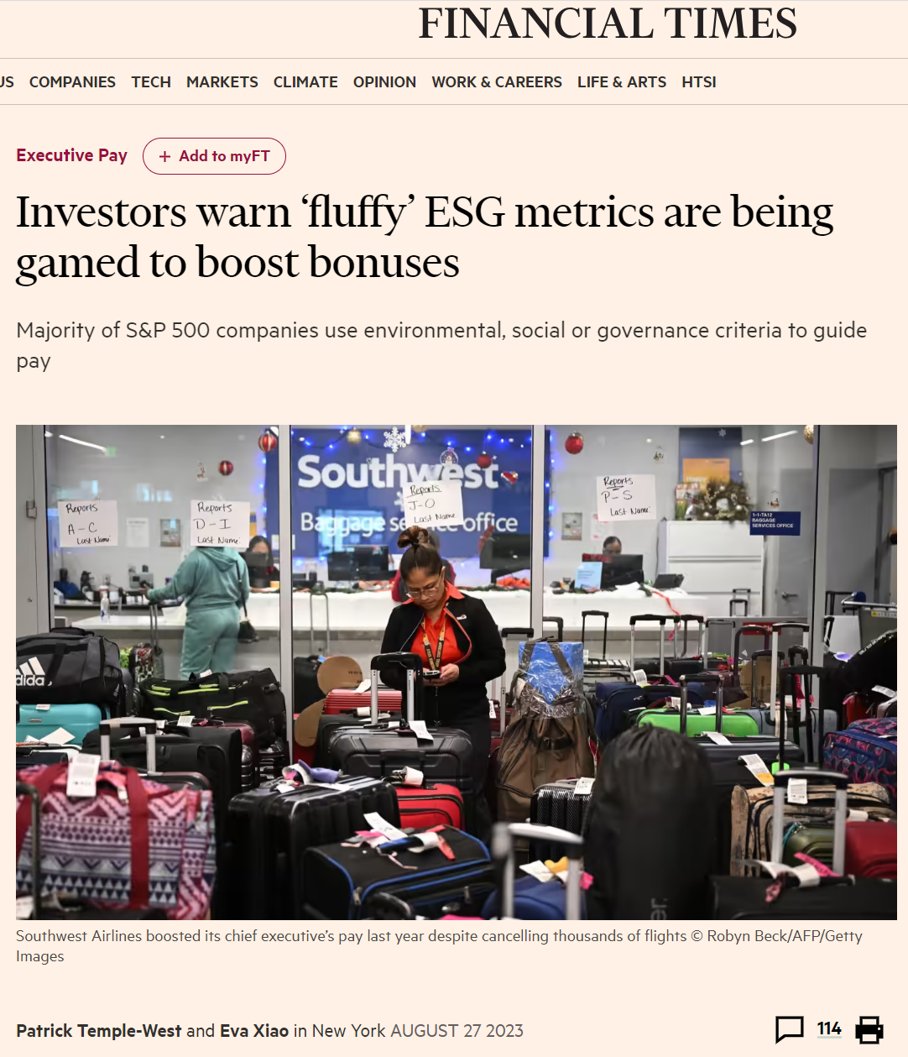
Linking Compensation to ESG

Slide 7
Linking Compensation to ESG
Findings in Cohen, Kadach, Ormazabal, Reichelstein (JAR, 2023):
At least to a certain extent, ESG Pay follows an economic rationale
ESG is followed by better ESG performance
ESG is not followed by better financial performance

Slide 8
Integration of ESG into Financial Reporting
GAAP Topic | Example
Inventory (IAS 2, Topic 330) | A regulatory change that renders inventories obsolete
Intangibles and Goodwill (IAS 38, Topic 350, 20) | An entity may develop a more energy-efficient product to substitute a legacy product, resulting in a change in the estimated useful life of the client relationship intangible asset associated with the legacy product.
PP&E (IAS 16, Topic 360) | A change in regulation that adversely affects an entity could indicate that a manufacturing plant may be impaired
Loss contingencies, environmental obligations, asset retirement obligations, gain contingencies… | Legal obligation to remove a toxic waste storage facility
Income taxes (IAS 12, Topic 740) | Estimates of future taxable income may be affected by projected increases in costs to comply with enacted environmental regulations
Fair value measurements (IFRS 13, Topic 820) | Potential legislation, or an asset’s highest and best use, may affect fair value measurements.
IFRS Foundation Educational Paper, November 2020
FASB Staff Educational Paper, March 2021

Slide 9
Integration of ESG into Financial Reporting
“ESMA highlights that issuers and auditors must consider climate risks when preparing and auditing IFRS financial statements to the extent that the effects of those risks are material to those financial statements, even if IFRS Standards do not explicitly refer to climate-related matters.”
ESMA (the European Securities and Markets Authority), October 2021

Slide 10
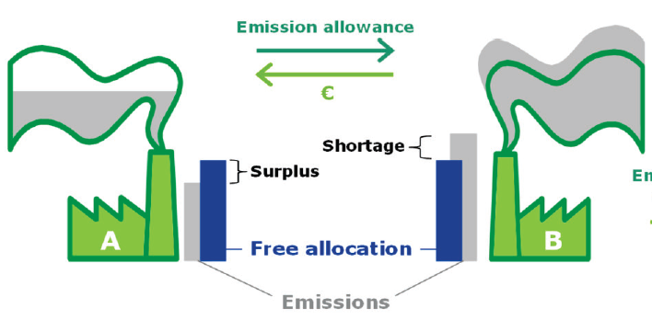
Emission Trading Systems
Other Investors
Auction
Carbon Pricing Mechanism: Cap-and-trade

Slide 11
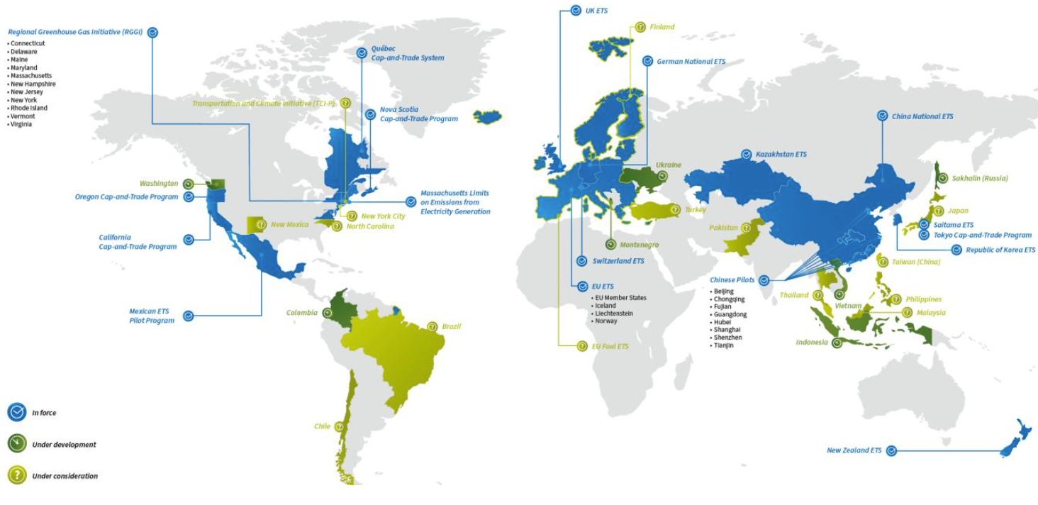
ETS Across the Globe

Slide 12
Accounting for Carbon Allowances
What type of asset is an emissions allowance?
Financial asset? Intangible asset? Inventory?
What is the nature of any liability created for a participant in a cap-and-trade ETS?
Some allowances are government grants (day 1 gain or deferred income?)
The obligation arises only as emissions are made
Which measurement approach best reflects the economic effects of emission allowances?
Fair value or book value?
Any “real effects” of the accounting treatment?
Spillovers from financial markets into carbon markets?

Slide 13
Connectivity between Financial and Sustainability Reporting
What are the friction(s) preventing climate risks from being incorporated into FS?
Agency (i.e., reporting incentives, lack of effort),
Regulation (the current rules are not clear, or make it difficult)
Production costs (some firms do not have enough resources to model/quantify certain things)
Knowledge (we are learning how to do it)

