Slide 1
Discussion of Eckbo, Nygaard, & Thorburn, Do Board Gender Quotas Affect Firm Value
By Belén Villalonga
ECGI Global Corporate Governance Colloquia
Stanford, June 6, 2015

Slide 2
The Paper in a Nutshell
Estimates the effect of the mandatory board gender quota introduced in Norway in 2005 on:
Firms’ market value
Abnormal returns to different quota-related news events
Tobin’s q
Conversions in legal form of organization
From quota-bound ASA (OSE-listed or unlisted) to quota-free AS (unlisted)
Director—and directress—characteristics
Turnover
Experience as CEOs
Board experience (multiple board affiliations)
Notes:
ARs – more specifically, comparing the returns on a portfolio of “treated firms” (ASAs in OSE) to portfolio of different control groups
Q –firm-level IV regressions of ind-adj tobin’s q on the predicted value of a measure of big a change the mandatory quota represented for each firm, which is in turn estimated in a first stage regression of the shortfall of female directors as of 2001 (prior to all quota-related events) on interactions of the same variable year dummies

Slide 3
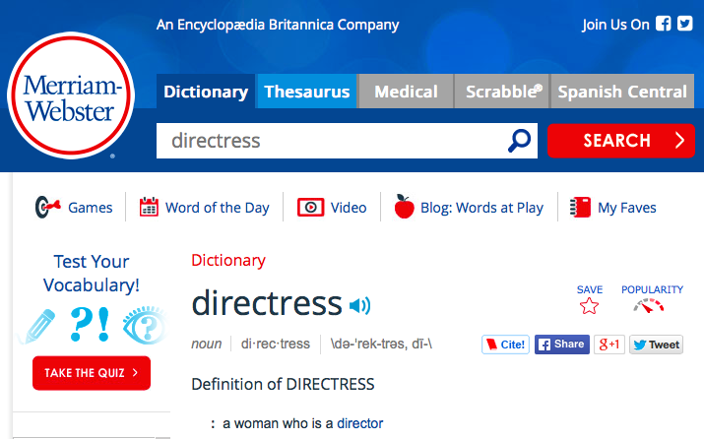

Slide 4
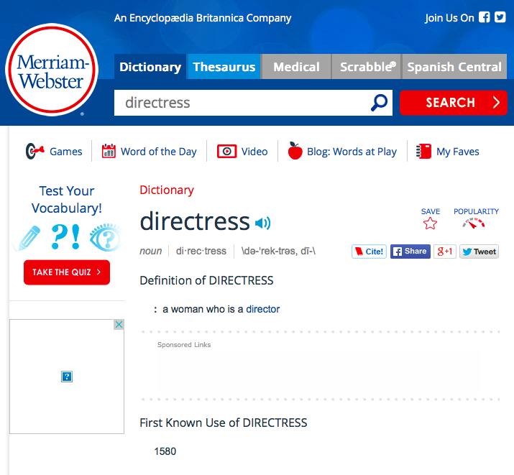

Slide 5
The Paper in a Nutshell
Estimates the effect of the mandatory board gender quota introduced in Norway in 2005 on:
Firms’ market value
Abnormal returns to different quota-related news events
Tobin’s q
Conversions in legal form of organization
From quota-bound ASA (OSE-listed or unlisted) to quota-free AS (unlisted)
Director—and directress—characteristics
Turnover
Experience as CEOs
Board experience (multiple board affiliations)
Notes:
ARs – more specifically, comparing the returns on a portfolio of “treated firms” (ASAs in OSE) to portfolio of different control groups
Q –firm-level IV regressions of ind-adj tobin’s q on the predicted value of a measure of big a change the mandatory quota represented for each firm, which is in turn estimated in a first stage regression of the shortfall of female directors as of 2001 (prior to all quota-related events) on interactions of the same variable year dummies
P[Conversion] regressed on shortfall too

Slide 6
Prior Literature
Estimates the effect of the mandatory board gender quota introduced in Norway in 2005 on:
Firms’ market value – Nygaard, Ahern & Dittmar
Abnormal returns to different quota-related news events
Tobin’s q
Conversions in legal form of organization – Nygaard, Bohren & Staubo
Board characteristics – e.g. Bertrand et al
Turnover
Directors’ CEO experience
Directors’ multiple board affiliations
And many others

Slide 7
So… What’s New Here?
(1) Better methods than prior studies:
Of the impact on market value, esp. Ahern & Dittmar
Event study: 10 events v. 1
Not obvious which event(s) are most critical
Some methods issues in A&D (e.g. event window, subsample)
Tobin’s q analysis: Better measure of how big a change the quota imposed on each firm: shortfall v. % of female directors
Better b/c the mandated quota varies across firms according not just to board size but also based on how many directors are shareholder-elected, which in turn depends on firm size, and on industry
Of the impact on legal form of organization conversions, esp. Bohren & Staubo whose analysis is basically flawed
For each firm that converts they backfill with ones every year prior to its conversion

Slide 8
So… What’s New Here?
(2) Different and more credible results
Abnormal returns to a portfolio of “treated” firms (ASAs in OSE)
Significant in very few cases
Sign varies depending on the event
Non-significant relative to a control portfolio of foreign OSE-listed firms
Specifically debunk A&D finding of negative abnormal returns to the 2/22/2002 announcement
Tobin’s q not significantly related to measure of how big a change the quota imposed on firms
No evidence that conversions from ASA to AS were driven by quota

Slide 9
What’s So Exciting about a Non-Result?
Notes:
Or three, rather?

Slide 10
Hint, Hint…

Slide 11
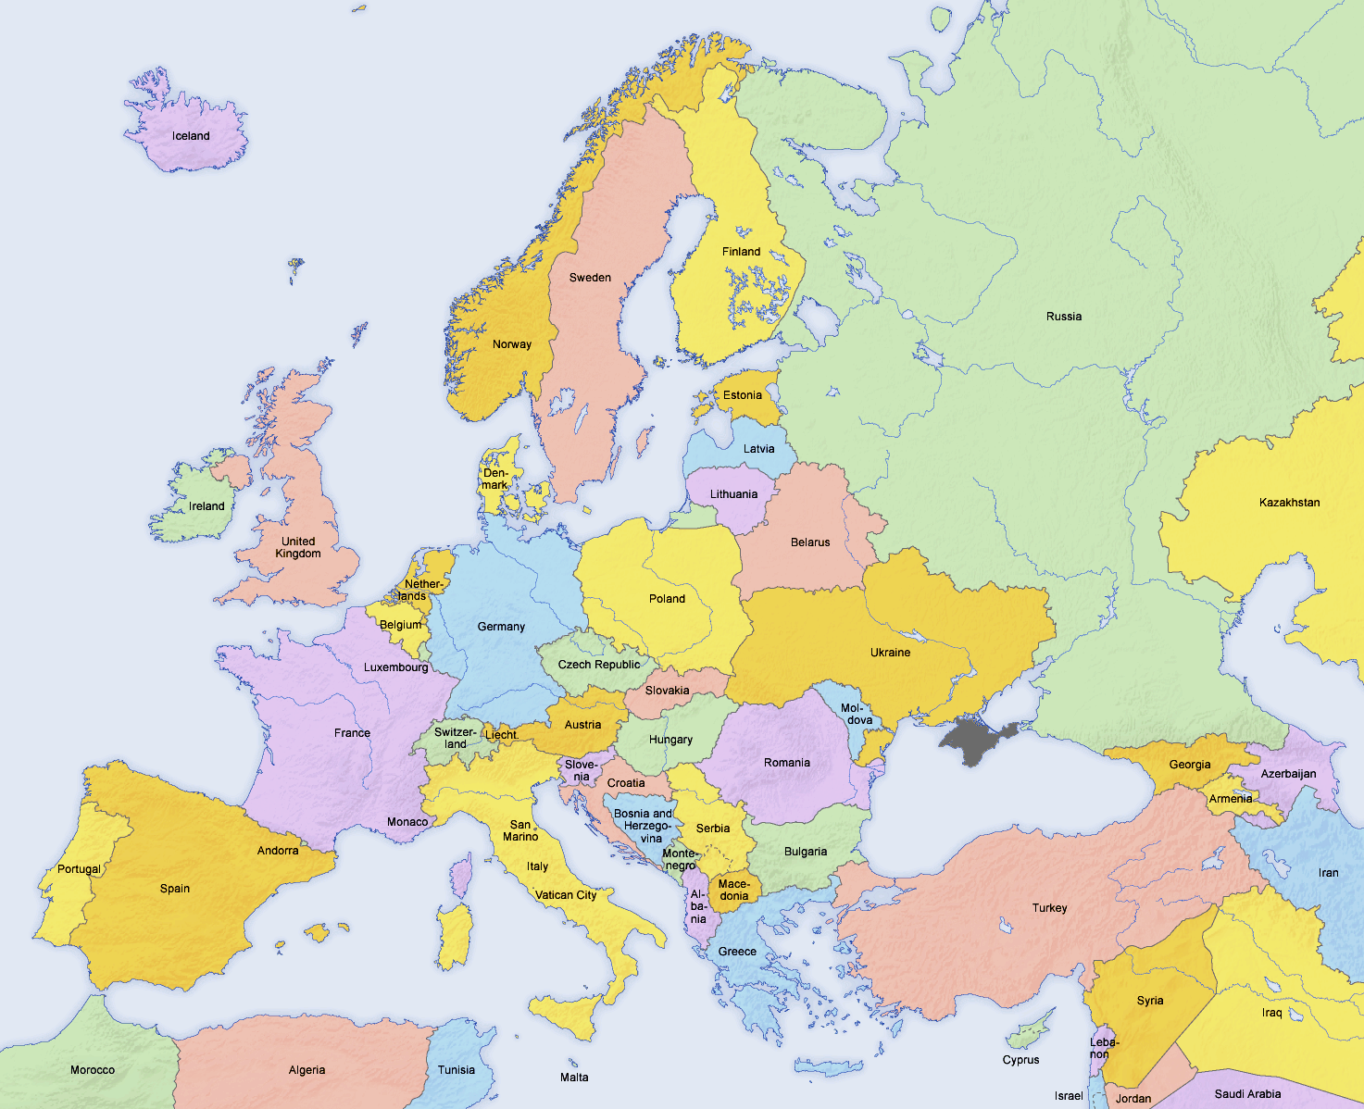
Beyond Norway…

Slide 12
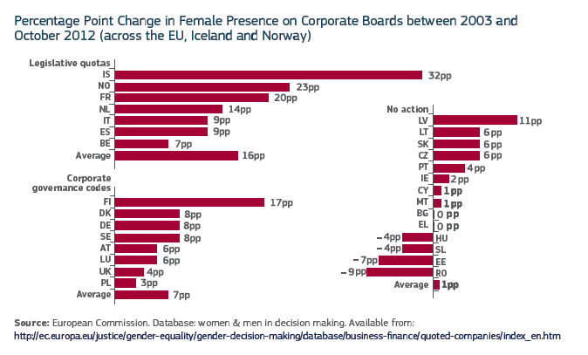
Beyond Norway…

Slide 13
… Lies Spain

Slide 14
… Lies Spain
2007 Law of Gender Equality established “mandatory” board quota of 40% by June 2015

Slide 15
Full Disclosure

Slide 16
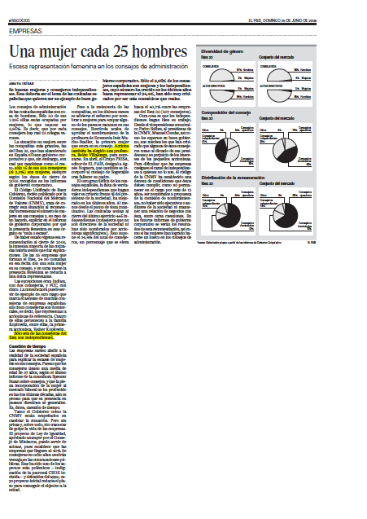
Directresses in the IBEX35
2006: 16 or 3% of 508 board members were women
Only 6 of those were independent (1.1%)
2015: 73 women (80 seats, or 17.3% of all)
56 of those women are independent (13.6%)

Slide 17
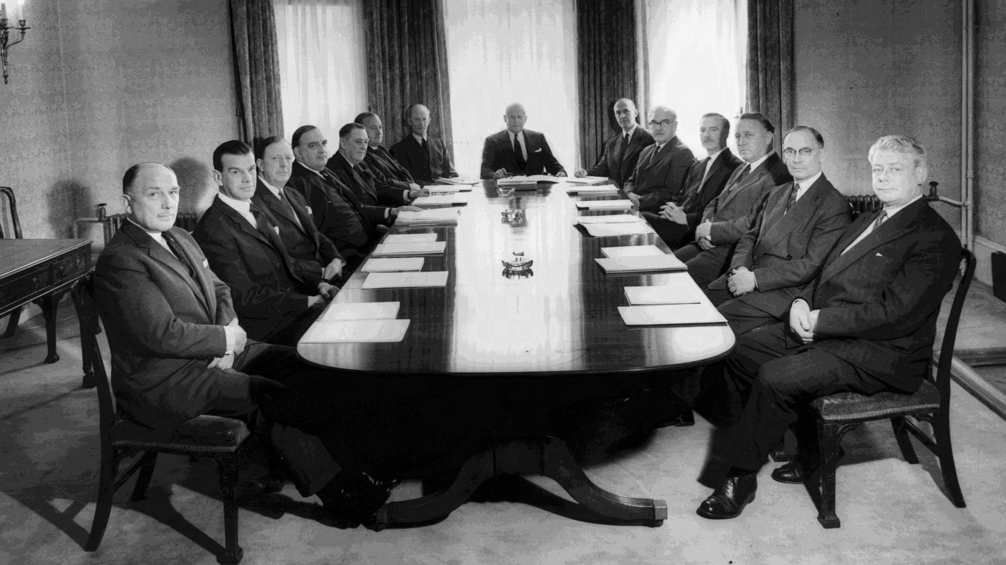
What’s Wrong with this Picture?

Slide 18
What’s Wrong with this Picture?
Less than ideal from point of view of
Society at large (women and men)
Stakeholders of corporations
Perhaps even shareholders – leaving talent and money on the table

Slide 19
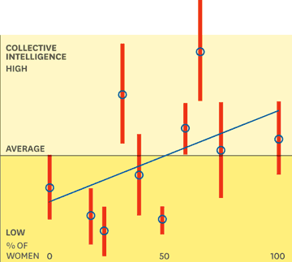
Collective Intelligence in Groups
Woolley, Malone, et al. show that a group’s collective intelligence
Bears little correlation with the IQs of its individual members.
Increases with the number of women in it

Slide 20
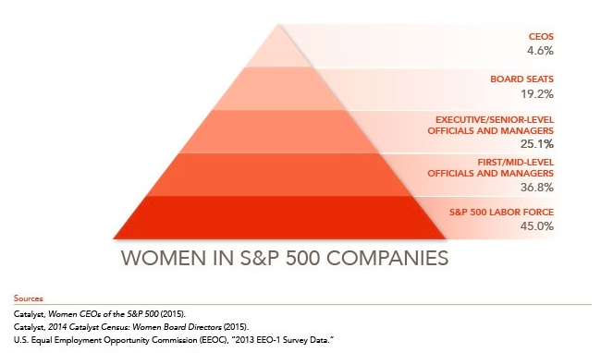
Women in S&P500 (Catalyst)

Slide 21
What’s Wrong with this Picture?
Less than ideal from point of view of
Society at large (women and men)
Stakeholders of corporations
Perhaps even shareholders – leaving talent and money on the table
There is evidence that diversity in boards trickles down the corporate pyramid
Boards can have a multiplicative effect on the potential gains from diversity in an organization
On the other hand, there is evidence about the unintended consequences of diversity policies

Slide 22
Back to Eckbo, Nygaard, & Thorburn
Paper’s main contribution is timely and important but
Main contribution lies in debunking the work of others
Built on three non-results
Minor issues:
Your shortfall variable is technically not an instrument
Despite the lack of significance of the conversion results, I would like to see a Heckman selection model where the performance effects (which are estimated on the subsample of firms that did not delist as part of their conversion) are corrected for that possible bias
Not even clear if the market is reacting (one way or another) to the women issue per se or to the government’s interference in business
Could compare to the reaction to other corporate governance changes mandated by law (e.g. SOX) or the exchanges

Slide 23
Underlying Theory
Theoretical motivation is shallow and not well mapped into the empirical analysis
The finding that the quota effect is negatively related to ownership concentration is not convincing evidence for the Board Entrenchment hypothesis
Neither is the CEO experience result (directresses’ lower & decreasing, directors’ increasing), although it is consistent with the neutral effect
Directresses’ voluntary turnover does not necessarily indicate poor quality – so your failure to find such is not convincing evidence against the Board Efficiency hypothesis
Network analysis is creative but not too interesting since 80% of directors serve on just one board (+ board interlocks are in decline)
Codetermination hypothesis is not very interesting
➔ Need to go deeper, and/or use better proxies

Slide 24
Suggestions
Could you do more on the board characteristics front?
E.g. event study of elections of directresses and regress on the characteristics of both incoming directresses and the outgoing directors that they are replacing
Better data to illustrate the network connection issue (not just board interlocks but also social / educational /other professional ties)?
Perhaps look at the differential impact of some shock (post-quota) on ASA firms v. control groups with lower /no female representation on boards?
Highlight the implications for another countries and the generalizability or the results (or lack thereof)

