Slide 1
Privatized bankruptcy
A study of shipping financial distress
Julian Franks, Oren Sussman and Vikrant Vig
A study of shipping financial distress
Privatized bankruptcy?
Discussant
Dan W. Puchniak
Notes:
MAIN PARTS OF PRESENTATION
The key question I had about the paper
Suggest an answer to the key question
Highlight some additional points of interest and questions

Slide 2
Thank You
Notes:
Thanks for making my view interesting

Slide 3
Two Convincing Arguments
For Shipping
Financial distress is effectively resolved by way of contract and other private institutional arrangements in shipping
The economic cost of financial distress is low in shipping
Notes:
Financial distress
Courts have mostly played a limited role other than in the enforcement of contracts
Contractual innovations emerged a long time ago and have been stable—and appear to work well—an example of (near) “spontaneous ordering”
Economic cost
Low proportion of arrests, with the financially distressed debtors frequently resorting to “voluntary” private sales of ships
Proportion of total industry capacity under arrest is very small
Fire sale discount almost disappears with good quality ships

Slide 4
Key Question
“The question remains…
to what extent might these results extend to other industries?”
Notes:
The paper hints at the answer: “authors cautious in suggesting that…results extend to other industries” (last page—should be moved to first page)
The implications of the answer to this question are crucial
If “no”, then this does not present a challenge to the US model of Chapter 11 or the more general authority of courts to stay the liquidation rights of secured creditors
Even if “no”, however, still important as it suggests that in shipping courts should limit themselves to enforcing the terms freely contracted between the creditor and debtor

Slide 5
Perhaps Not Many…
Notes:
We do not live in a water world

Slide 6
Shipping May Be An Outlier

Slide 7
One Ship (Asset) Companies
Avoid Much of the Complexity of Bankruptcy
Notes:
Incorporating a separate company for every asset would not be feasible for most businesses
No issue with piece meal liquidation that would cause assets to be valued at below best use
No real issue with run on the assets when there is only one asset
This reduces the common pool problem
No private benefits to third parties through liquidation like in the classic distressed 19th century railroad
Tends to be only one secured creditor (and the story presented really just talks about secured creditors)

Slide 8
Contractual Innovations Are Innovations For Shipping—Not Common Corporate Bankruptcy
The Maritime Lien makes labour senior to capital for commercial considerations in shipping
“To the best of our knowledge, shipping is the only industry where labour is senior to capital for commercial considerations. It is an interesting twist on theories of control, which predict that the party in control should be junior and hold a residual claim”
(2) The Double Mortgage reduces transaction costs when the debtor defaults in shipping
Notes:
Labour seniority
Crews have physical control of the sole asset of the company on the high sea
If a distressed owner refuses to pay--collaboration with the crew for the creditor becomes paramount
The bank can contact crew and direct them towards specialized port for arrest and promise to pay them wages immediately
Commitment problem
Solved by “maritime lien”—a security interest that the crew has on the vessel—which makes the crew’s wages senior to a secured mortgage
Double mortgage in shipping
A double mortgage is where the creditor takes a security interest on all of the shares of the one ship company and a mortgage on the physical vessel
On default shares can be transferred to quickly effect transfer of owners through a share sale rather than physical sale of the asset—which would involve arrest
Works well in one ship company not feasible in large company with multiple assets and secured creditors

Slide 9
No Need For Court Intervention
to Mitigate the Risk of a Fire Sale Discount in Shipping
“Shipping has advantages in so far as there is a large market for second hand ships and the brokers who sell the ships are able to market the vessels to a global market”
Notes:
No asset liquidity problem in shipping—global deep market—normally can liquidate at best use value

Slide 10
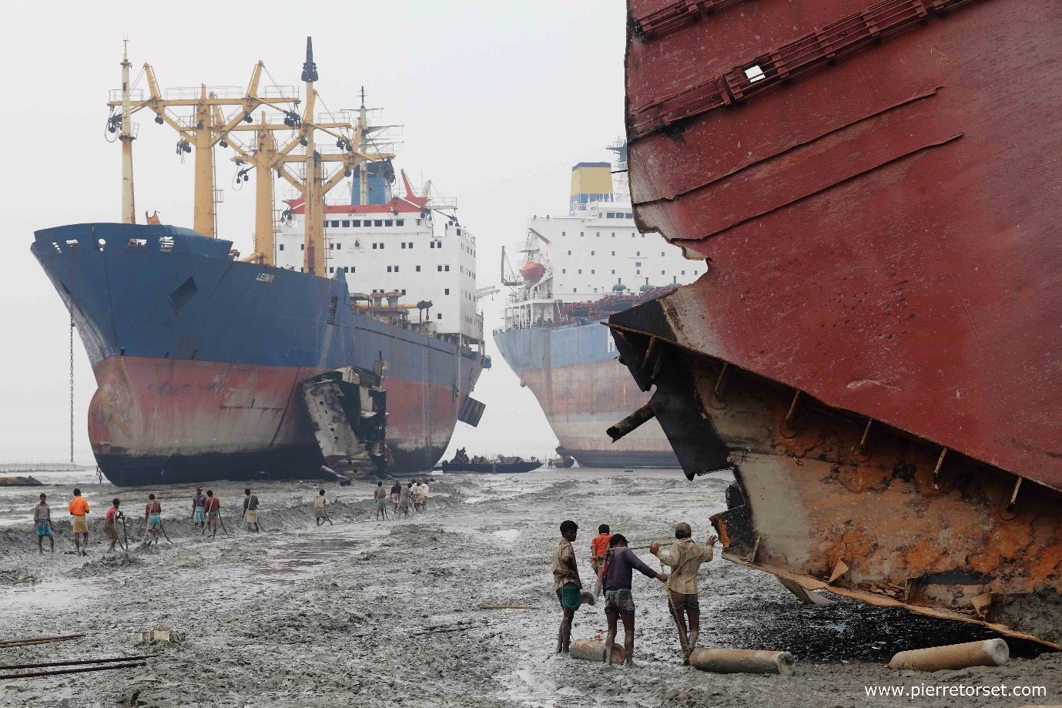
In shipping the Main Economic Cost of Financial Distress Originates with Dysfunctional Debtors Rather than Poorly Coordinated Creditors
Notes:
“Hence, the result is consistent with the hypothesis that the resolution of financial distress is not economically costly because of coordination failures among creditors but rather when company owners have given up trying to save the company”
Maybe owners give up more quickly in shipping because the primary asset (the ship) often turns into a major liability--and veil piercing may be a real possibilityy

Slide 11
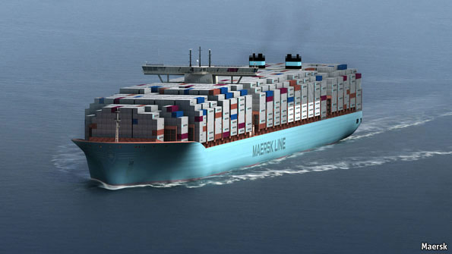
Perhaps There is a Small Community of Repeat Players
in Large Vessel Shipping
Notes:
Large ships
Smaller ships with non-repeat players many cut a special deal with the crew to take the ship to a corrupt port—maybe much more chaotic and costly

Slide 12
Alternative Story
Regulatory Competition
“The shipping industry with its multitude of jurisdictions might be expected to provide for disorderly defaults”
“Ports, like flags, compete on quality of service,”
regulation, institutions and courts

Slide 13
Delaware of the Sea?
Clear and effective regimes for dealing with the liquidation process
Arrest specialized ports | Other High Volume Port Jurisdictions
Gibraltar | China
Singapore | USA
Hong Kong | Japan
Netherlands | Germany
South Africa | South Korea
UK | Australia

Slide 14
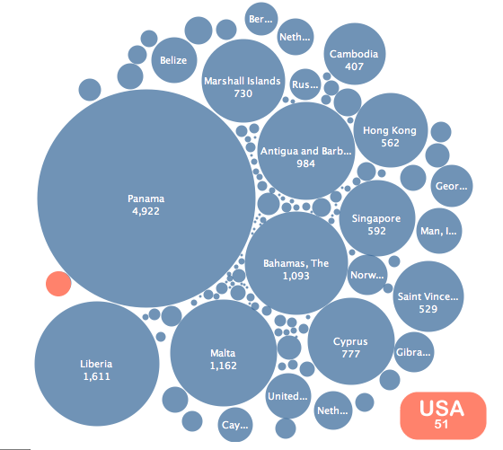
Delaware of the Sea?
Clear and effective regime for dealing with registering property rights

Slide 15
The Importance of the Shadow of the Courts

Slide 16
The Importance of the Shadow of the Courts
“Creditors of shipping companies rely on maritime courts to arrest ships, in the event of default, and auction them in a timely and cost effective manner. Thus, there is an important role of enforcement for the courts”, which serves as the linchpin for the entire maritime bankruptcy system

Slide 17
Questions
How are unsecured creditors protected?
Was there a greater fire sale discount during periods of recession?
What impact does the role of the Admiralty Court in the UK (and other jurisdictions) have in determining the sale price of arrested ships (i.e., does the court interfere in the private bargain struck between creditors and third party buyers in determining a “fair” price)?
Notes:
How are unsecured creditors protected?
They trigger almost as many arrests as the bank (secured creditors)
Would seem small unsecured creditors not directing ships to ports
If this is the case, is the regime really only dealing with one secured creditor?
Did you examine whether there was as a greater fire sale discount in times of a recession?
Huge variation in secondary market
Industry heavily impacted by GFC
What impact does the Admiralty Court’s role in determining that a sale price is “fair” have on this analysis?
This goes beyond merely enforcing the contractual terms between the parties
The UK is one of the “expert arrest specialist ports” but the court is involved in the price setting process
How might this impact fire sale discount prices?

Slide 18
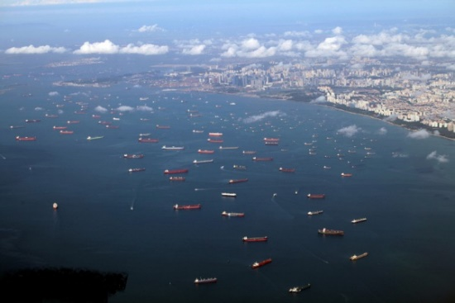
Thank You

