Slide 1
Global Corporate Governance Colloquia
2015 Conference
Discussion on
Public Audit Oversight and Reporting Credibility
Evidence from the PCAOB Inspection Regime
June 5, 2015
Woochan Kim (Korea University Business School)

Slide 2
Comment #1 (Alternative Control Groups)
Why Not Use Non-Big 4 or Auditors of <100 Clients?
This paper uses ‘cross-listed non-US issuers’ as a control group
In a study investigating the effect of SOX 404, Illiev (2010) uses firms with a public float less than $75 million (non-accelerated filers) as a control group (Illiev (2010) missing in reference)
Similarly, the authors can use the following control groups
Treatment (firms audited by Big 4) ↔ Control (firms not audited by Big 4)
Treatment (firms audited by >100) ↔ Control (firms not audited by <100)
Can be a good robustness check
A DiD result is more convincing when a treatment group is compared against different control groups

Slide 3
Comment #2 (RDD)
Why Not Use Regression Discontinuity Design (RDD)?
If the paper uses the alternative control groups, it can also benefit from a regression discontinuity design (RDD)
That is, conduct DiD using firms close to the cutoff
Treatment (firms audited by the 3rd and the 4th largest accounting firms ↔ Control (firms audited by the 5th and the 6th largest accounting firms)
Treatment (firms audited by an accounting firm with 100-150 clients ↔ Control (firms audited by an accounting firm with 50-99 clients)
RDD ensures that the treatment group firms and the control group firms are well balanced … that is, in the absence treatment, outcome variable (ERC) would be similar (‘local continuity’)

Slide 4
Comment #3 (Covariate Balancing)
Are Treatment and Control Groups Balanced?
DiD result would be even more convincing if covariates in the two groups are well balanced … closer to random assignment … but, do not see any table on this
The paper instead includes various types of fixed effects and post-treatment covariates … they certainly help
But, why not control for ‘firm’ fixed effects (FFE)?
The paper includes auditor, country, and year-quarter fixed effects, but never firm fixed effects in CAR regressions
Includes FFE in abnormal 10-K volume regressions, but not elsewhere … inconsistent
Trying out FFE could be a useful robustness check

Slide 5
Comment #4 (Treatment Reversal)
Why Not Investigate Treatment Reversals?
PCAOB discloses auditors that failed to address quality control (QC) criticisms satisfactorily
This is equivalent to treatment reversal … public audit oversight increases reporting credibility … conversely, the disclosure of criticism lowers reporting credibility
Earning figures disclosed by firms audited by the failed accounting firms would suddenly be LESS credible (at least for one year)
If one finds an opposite effect (ERC falling), the paper’s key argument (public audit oversight increases reporting credibility) can be more convincing

Slide 6
Comment #5 (Exogenous Treatment)
Is the Treatment Truly Exogenous?
The decision to limit audit oversight to Big 4 initially, and then to auditors with more than 100 clients is exogenous
But, firms do not have to retain the Big 4 or those with more than 100 clients as their auditors
Auditors cannot self-select, but the firms can
What if firms with high reporting credibility retain Big 4, but those with low reporting credibility switch to smaller auditors?
Then, firms audited by Big 4 will show higher ERC even if public audit oversight had no real effect
The ERC estimates reported in the paper can be biased upward

Slide 7
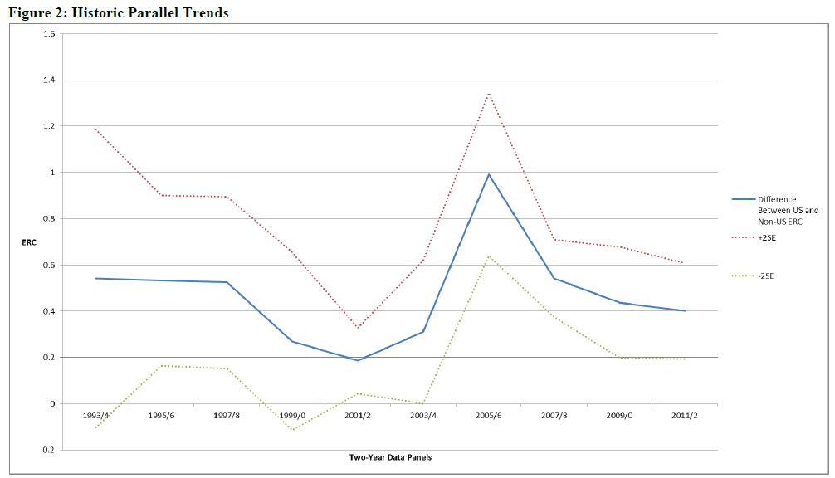
Comment #6 (Effect Persistence)
The DiD (2nd regime) sample period: 2002.6 – 2006.5

Slide 8
Comment #6 (Effect Persistence)
Non-Zero Difference
But, this is OK
The DiD (2nd regime) sample period: 2002.6 – 2006.5

Slide 9
Comment #6 (Effect Persistence)
The Effect
Does Not Persist
The results can be highly sensitive if include later years

Slide 10
Comment #6 (Effect Persistence)
Why Not Show Both Groups’ ERC
Is the difference in ERC dropping because other countries are adopting similar reform measures in later periods? (authors’ explanation)
Need to show ERC of US firms rising first and then a subsequent rise of non-US firms’ ERC … but, may not observe this given the coefficients in Table 3
The coefficients on ‘UE x Post’ are negative … this indicates that ERC of non-US firms are actually lower during the treatment period
The coefficient sum of ‘UE x Post’ and ‘UE x Post x Treated’ is positive, but quite small … this indicates that ERC of US firms are higher only slightly during the treatment period
Positive DiD coefficient is largely coming from the drop of non-US firms’ ERC

Slide 11
Comment #7 (Control Group)
Is the Control Group Truly Controlled?
(Accounting Reform Measures in Korea)
 | First News Appearance | Revision Bill Approved | Effective Date of Implementation
Require CEO/CFO certification of financial statements | Nov. 2002 | Dec. 2003 | Apr. 2004
Preserve audit materials for at least 8 years | Nov. 2002 | Nov. 2003 | Apr. 2004
Limit consulting activities by external auditors | Nov. 2002 | Nov. 2003 | Dec. 2003
Require at least one accounting or financial expert in audit committee | Nov. 2002 | Dec. 2003 | Apr. 2004
Ban external auditors from serving more than six consecutive years | Apr. 2003 | Nov. 2003 | Jan. 2006
DiD estimate peaks in 2005 (Figure 2)
But control group is not controlled during the treatment period
Did any other country go through a similar reform during this period?

Slide 12
Comment #8 (Alternative Explanation)
Any Other SOX Provisions Exempting Foreign Issuers?
Audit Committee
Permit a ‘board of auditors’ created under local law to act in lieu of an audit committee
Exempts from the audit committee ‘independence requirement’ (as long as, separate from BoD, not elected by management, does not include an executive officer, subject to standards established by home-country legal or listing requirements)
Effective date: April 25, 2003 (clearly, within the treatment window) … can this be an alternative explanation?
Conduct DiD comparing firms with fully independent audit committees (control group) and those without (treatment group) before and after 2003
If ERC does not increase in the treatment group, the results are robust

Slide 13
Comment #9 (Minor Points)
Within sample DiD?
The research design used to investigate PCAOB triennial inspection should not be named as DiD
It is simply a ‘time-series difference’ without a control group
Arthur Andersen clients vs. non-Arthur Andersen clients
The paper states “… we fail to reject the hypothesis that the ERC increase for former Arthur Andersen clients is larger than the increase for non-Arthur Andersen clients (p-value = 0.817)”
‘Fail to reject’ … does that mean you accept?
“we fail to reject to null that the ERC increase for former Arthur Andersen clients is equal to the increase for non-Arthur Andersen clients (p-value = 0.817)”

